Slide 1
Terminology Server
Semantics for Medical
Documentation and Interoperability

Slide 2
Semantics for primary systems
System use Vocabularies i.a. for ...
Diagnosis documentation
Measures documentation, for example surgery-documentation, laboratory value documentation, radiographic findings...
Symptoms documentation
Nursing documentation
Medical documentation
Emergency data
Med. basic information
and many others
Office Dr. Meier
Office Dr. Müller
Hospital
zum Heil
Common and/or statutory use of ICD and OPS, various billing catalogs
Variety of „small“ vocabularies for
different aspects of documentation, for example
  Line types in ambulance information systems
  Intern catalogs for medical measures
  Classification for facility types
  Document naming or classes
  Diagnostic confidence, -localization, severity...
  Specialist Groups, roles
  ..... approx. few 100 to 1000
  vocabularies for medical documentation
  in local systems
“In my review … I have pointed out that accurate representation of medical concepts or medical information is crucial to many functions of health information systems.” (Möhr 1998)

Slide 3
Local semantics - motivation
Office Dr. Meier
Formalization of information for ...
Uniformity and comprehensibility of
documatition
Statistics
Billing
Legal documentation requirements
Quality management
Knowledge based functionalities
Decision support functionalities
Collaboration with other institutions
→ also interoperbility of information systems
Research
Office Dr. Müller
Hospital
zum Heil

Slide 4
Background – document exchange
Examples:
Hospital discharge letter
Radiographic findings and images
Specialist Report
Laboratory values
Operation report
Diagnosis list
Transfer/admission to hospital
Medication plan
....
Office Dr. Meier
Office Dr. Müller
Hospital
zum Heil

Slide 5
Semantic interoperability
... is according to IEEE (1990) the „ Ability of two or more systems or components to exchange information and to adequately use of the
exchanged information.“
= „correct“ interpretation and further processing in terms of algorithmic processing, for example:
Assign
Store / correct „sorting“
Classify correctly
„Understand“ of content, possible knowledge based interpretation of receiving data
Set relations correctly
Further processing / converting
React / answer
Triggering alarms/messages
Possible „self-learning“
System 1
System 1
Office Dr. Müller
Hospital
zum Heil
Indikation
Prof
nis-
ibut
Patient
en-
hme
Maßn
Shared availability of this semantic
in all participating systems necessary!
Terminology Server
„Adequately use“ can only be achieved by the use of shared semantic for designated attributes, for example in the form of controlled vocabularies or terminologies.

Slide 6
Shared „global“ vocabularies e.g.
Classes of drugs
Drug side effects
Document classes/-taxonomy
Measures
Diagnosis
Symptoms
Variety of observation and documentation attributes
e.g. diverse vocabularies within the Gematik- & KBV specifications -> e-prescription, emergency data, medication plan ...
Office Dr. Meier
German medication plan (AKdÄ/BMG)
System 1
Country code
Language code
Administration form
Dosing units
Guidelines
Treatment
System 1
System 1
Office Dr. Müller
Hospital
zum Heil
Emergency data (gematik)
Diagnosis (HL7)
Diagnosis localization
Diagnostic confidence
Diagnosis codesystem
Medicines code
Medicines codesystem
Release
Administration form
Administration route
Dosing units
Drug code
Dosing text
Diagnosis type
Diagnostic confidence
Side localization
Localization
Fabric structure
Biological behavior
Phenomenon type
Immun phen type
TNM-Qualifier
Certainty Faktor
...
  ..... today even over 100
  vocabularies in IOP agreements

Slide 7
Global cross-system semantic
Office Dr. Meier
Top-Down Synchronisation
System 1
Terminology & Ontology Server
System 1
System 1
Global catalogs/vocabularies
Office Dr. Müller
Hospital
zum Heil
Global deployment of vocabularies
  Retrieval
  Verification of codes
  Synchronization of local vocabularies
  Additional information of concepts
Deployment of cross-mappings
  Retrieval of cross-mappings for concepts
→ Generally: CTS2 services
Local catalogs/vocabularies

Slide 8
Terminology Server of FH Dortmund - overview
Primary systems
Management of semantic catalogs of any type and structure
Helps to use semantic in clinical documentation
  with the help of information systems via web services
  by users via web application
Collaborative development and maintenance of semantics catalogs
Import and export of vocabularies
Administrators
Administrational
functions
Webservices
Import/Export-
module
CSV
ClaML
LOINC
…
Graphical user interface
CTS2 & ClaML-based
data model
End user
Project assistants and terminology workers

Slide 9
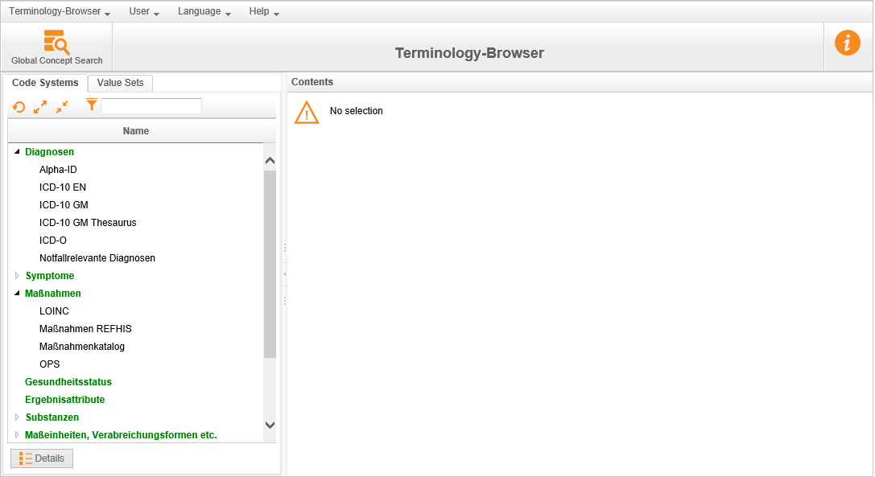
Terminology Browser – Taxonomy of vocabularies
Taxonomy

Slide 10
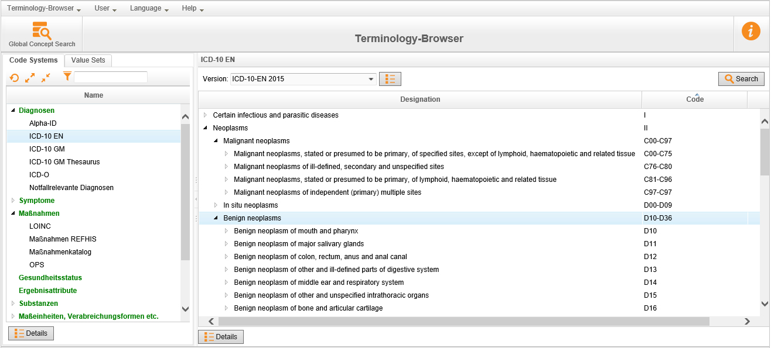
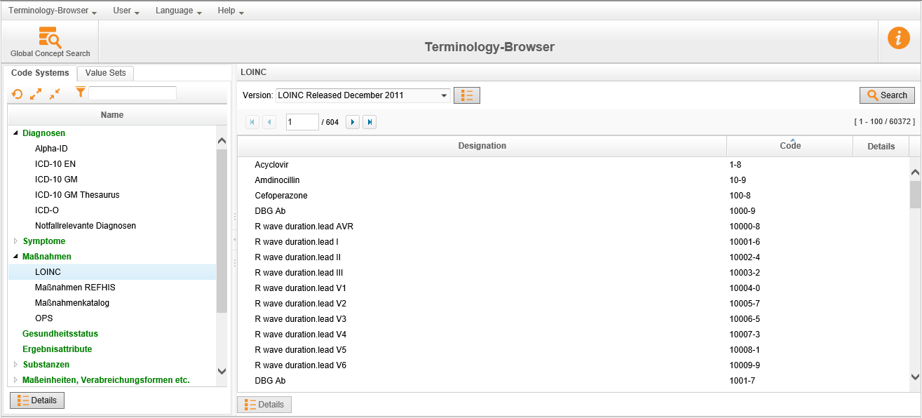
Terminology Browser – vocabulary view
Taxonomy

Slide 11
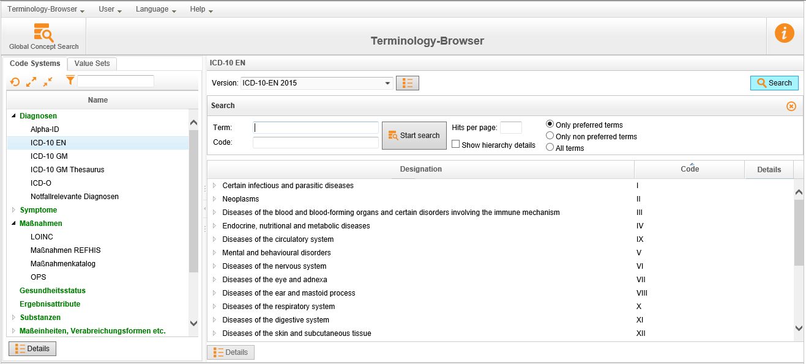
Terminology Browser – search within vocabulary
Taxonomy
Vocabulary content / concepts

Slide 12
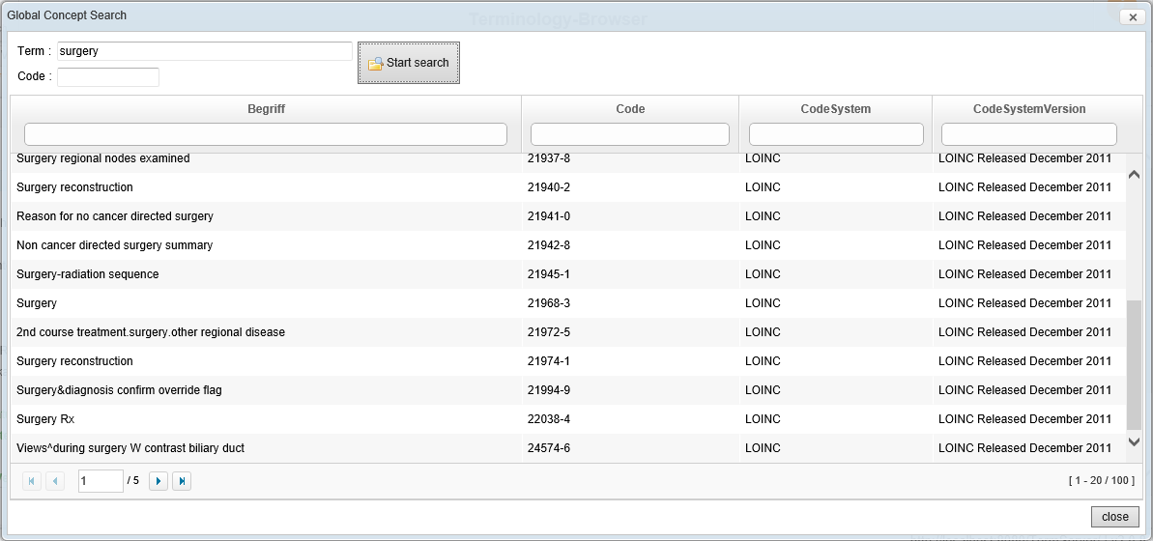
Terminology Browser – global search

Slide 13
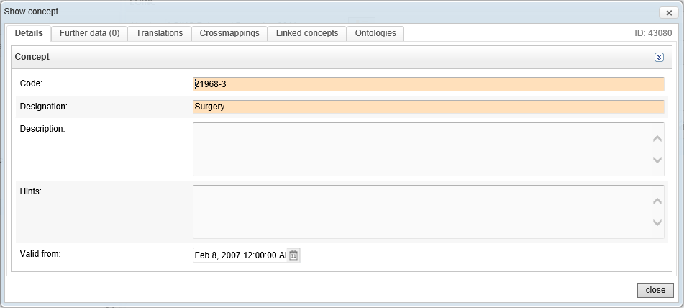
Terminology Browser – concept details

Slide 14
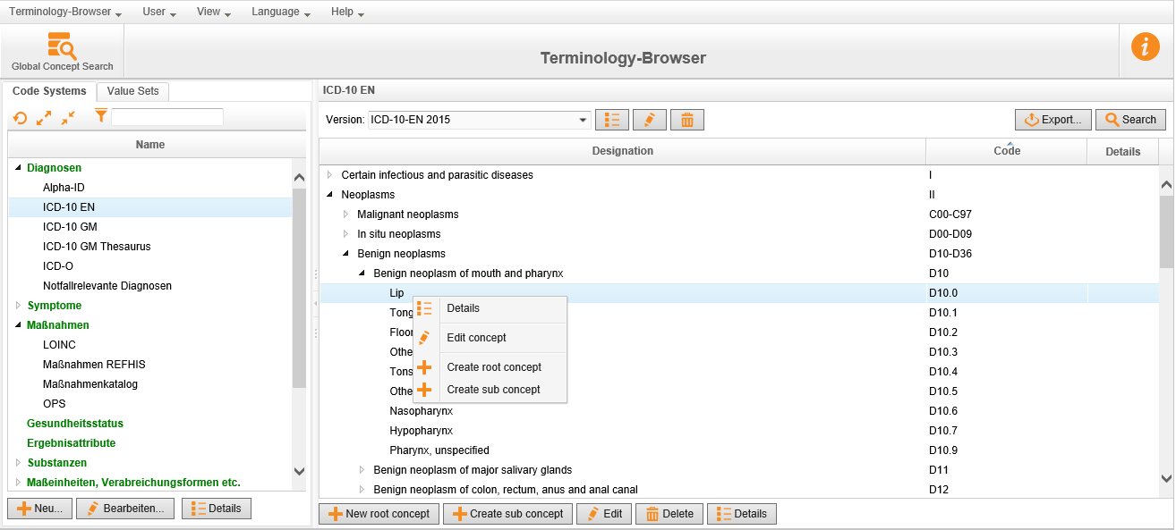
Example: maintenance of a code system

Slide 15
Summary
Vocabulary/terminology based documentation is needed in medical information systems
Multiagency IT-based collaboration requires industry-wide standards for selected semantic aspects
Industry-wide knowledge generation, knowledge management and knowledge application require industry-wide semantics
IT-based collaborative terminology work necessary
Semantic distribution in shared systems indispensable
→ Terminology Server
Terminology Server as an essential infrastructure component for telematics applications

