Slide 1
e-SENS WP5.2 eID Pilot
INTRODUCTION

Slide 2
CardInfo eID configuration
CardInfo artifacts specify and configure specific eID carrier for use with e-SENS eID building blocks
support auto-detection of plugged eID carrier
constrain the attribute realm to be available (SMP?)
  PT – basic profile, extended profile
  IT – basic profile, extended profile
  LX – basic profile, limited functionality (cert.-based)
  GR – basic profile, limited functionality (cert.-based)
  AT – extended profile
  ES – missing ☹
  DE – extended profile, no piloting planned

Slide 3
e-SENS LARMS
Local Attribute Mapping and Retrieval:
  extract, transform, and process attributes from an eID
  processing local to the PoC in country-B
  independent of locally available middleware/country-A NI
  also referred to as passive AuthN
  provides two baseline profiles:
    BASIC – identity traits can be freely extracted (Identification)
    EXTENDED – identity traits can be extracted after controlled AuthN
  access to further information depending on eID carrier
  Status: INTEGRATED & DEPLOYED
  IF INTERESTED: Double Demo with DE & PT (5’+10’ Discussion)

Slide 4
advanced/distributed e-SENS eID SAT
distributed attribute retrieval and cross eID mapping:
  usefulness limited but interesting for STORK enrichment
pre-authorization by PIN-controlled attribute release:
  required for advanced functions, prerequisite for many MW
providence of authenticated attributes from eID:
  very useful for mobile eID and STORK-based integrations
digital signature for cross-border documents:
  patient consent as manifest of patient authorization
  no other document/AuthZ currently envisioned
  PAC out of scope due to missing x-border properties

Slide 5
E-SENS LAM
Fully local card-based AuthN and implicit AuthZ
  based on locally available smart card service functions
  mandates a full patient authentication cycle by card
  unlocks higher level card functions:
    based on Authentication and Signature plan configuration and national constraints
    issues patient-signed epSOS assertions with NCP-B and NCP-A enforcement options
    may link to external signature creation and validation schemes
  requires country-A anchor in SecMan NCP-A
  reopens ancient issue on introduction of Security Context
  Status: INTEGRATED & NCP-INTEGRATED & DEPLOYED

Slide 6

DCA
STORK 2.0 Junction
selecting most appropriate eID means available:
  STORK 2.0 (discussion: STORKv1 DSI component?)
  advanced e-SENS eID profile (AuthN/AuthZ), FutureID
  e-SENS LARMS,
  „typing“ (epSOS), local extraction, proprietary
tool chain required is available and dry tested
early demonstrator components available
need access to STORK 2.0 infrastructure for real tests
priority component for regulatory robustness
  Status: EARLY DEMONSTRATOR w/ GR & IT

Slide 7
eID Integration
integration development artifacts and progress:
  e-SENS LARMS: jnlp.fokus.fraunhofer.de
  e-SENS ready OpenNCP demonstrator
  e-SENS eID Attribute Mapping Policy documents:
    not included in current work assignments / budget consideration
  e-SENS Digital Signature code base re-integrated (harmonizing LARMS and DSig code for joint use)
  prototype integration into OpenNCP (not RC2 yet)
auto-detection of plugged/available eID token carrier
auto-filling of search masks with extracted attributes

Slide 8
eID physical Integration
all integration is unofficial based on OpenNCP
staged, complimentary deployment
missing architectural cornerstones:
  security context handler (XACML-style on NCP level)
  NCP-level services but facades for pan-European selective providence to unburden local HIT (AIS, STORK)
  metadata / middleware locator and retrieval services
  re-issuing, compilation, enrichment of attributes from different sources, final LoA/AAL assignments
local HIT integration by PAM/JS LARMS component

Slide 9
e-SENS WP5.2 eID Pilot
REAL-WORLD INTEGRATION
AND DEPLOYMENT (e-SENS SCOPE)

Slide 10
eID Integration // OpenNCP
LARMS is decoupled, „passive“ data provisioning
LAM is an active component:
  needs to be fed with NCP-internal data
  needs to be granted processing time
  blocking scheduling, use case MUST be suspended @LAM
  needs to return data to internal NCP components
DCA is an active, externalized component:
  substitutes/enriches an NCP-internal artefact
  is coordinated from the PoC, not NCP or NI
  needs to be granted blocking processing time @DCA

Slide 11
eID Integration // OpenNCP II
NCP workflow coordination / orchestration:
  specified Workflow Manager not implemented
  XACML Security Context Handler not commonly available
Liferay Message Bus absorbs orchestration needs:
  session is the common umbrella for meta data
  assertions, endpoints, etc. are held in session context
  Liferay orchestrates time sequence of service invocation
  Liferay invocation of external NCP services and data flow
  Liferay implements and triggers epSOS workflows
Problem: LAM/DCA have no portal interactions
  not every PN uses Liferay → no message bus

Slide 12
eID Integration // OpenNCP III
Problem session-centricity:
  HP epSOS IdA should not relate with a portal session:
    def epSOS IdA
  no portal session = no IdA → no epSOS use case runs
  matching IdA (+ TRC) are persisted in the session context
  unknown what IdA relates to which TRC and vice versa
Problem Certificates & Management:
  certificates still rather incompliant to spec’s.
  huge problem in combination with x-signatures of eID
  massive changes in cert validation services on country-A

Slide 13
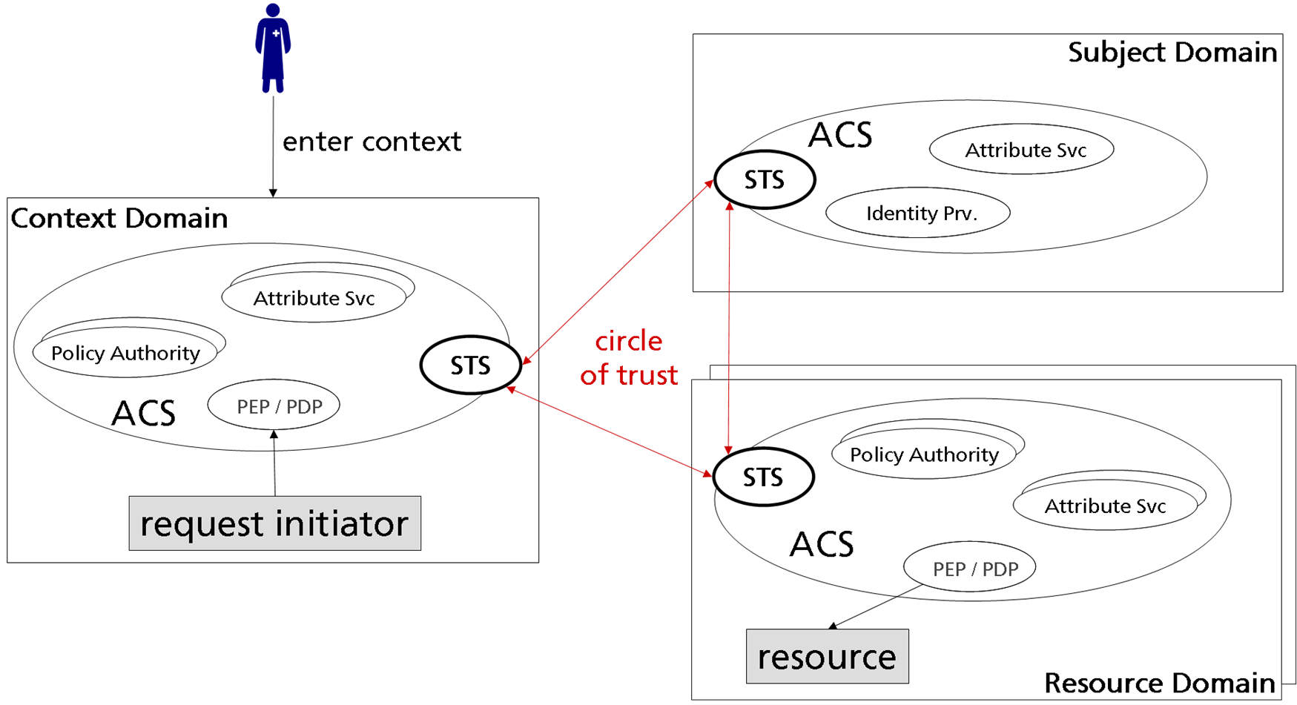
eID Integration // OpenNCP III
Problem merging of security zones:
  portal merges all security zones into classic MitM vector:
    holds all endpoints, IdA, TRC, and signature material
  epSOS after security relaxations:
Portal B
Portal B
Acts on CLAIMS
from Portal-B

Slide 14

eID Integration // OpenNCP IV
epSOS as specified (Animation):
NI-B + NCA-B +
legal domain B
PoC-B
NI-A + NCA-A +
legal domain A

Slide 15
eID Integration // OpenNCP III
Problem merging of security zones (con’t.):
  portal merges all security zones into classic MitM vector:
    holds all endpoints, IdA, TRC, and signature material
  no portal session = no IdA → no epSOS use case runs
  matching IdA (+ TRC) are persisted in the session context
  unknown what IdA relates to which TRC and vice versa
Problem NCP w/f Sequencing/Orchestration:
  as specified, portal is not a component of the NCP
  orchestration/sequence hard-coded or portal controlled
  STS’s and Facades cannot re-flow/divert information
  (con’t. on next slides)

Slide 16
Security Architecture: injection of new sequencings
LAM time & succession = orchestrating
  time: LAM/DCA cannot determine *when* to trigger DSig
  succession: LAM/DCA do not know *if* to engage
  completion: NCP/STS/LAM cannot control chronology
Options:
  TRC-STS triggers LAM w/ piggybacked TRC-A prototype
    STS needs to localise LAM, LAM blindly trusts TRC, IdA opaque
  LAM substitutes TRC-STS and is triggered with IdA
    NCP needs to localize LAM, LAM trusts NCP, IdA inaccessible
  portal mediates exchange between TRC-STS and LAM
    portal merges domains, may withhold tokens, no „local“ display
  NCP may disengage all advanced functions in all options

Slide 17
Security Architecture II: injection of new sequencings
OpenNCP v3 Proposal (compatibility & innovation):
  Option #1 – TRC-STS triggers LAM
  provides adequate security degree & AAL/LoI:
    separation/decoupling of concerns
    clear responsibilities of SOP’s (card, terminal, environment, etc.)
    much easier integration regarding workflow, IdA available @NCP
    harder localization of local LAM module by TRC-STS
    LAM as a local deployment needs to listen for requests
  preserves NCP-level orchestration & fat-client support
  acknowledges patient control regarding eID token
  encapsulates patient-centric DSig strictly to trusted zone
  enables trusted viewer for exercising patient control

Slide 18
Security Architecture II: injection of new sequencings
OpenNCP v3 Proposal (compatibility & innovation):
  Option #2 – LAM requests unsigned TRC-A from TRC-STS
  provides adequate security degree & AAL/LoI:
    clear responsibilities of SOP’s (card, terminal, environment, etc.)
    harder workflow synchronization: w/f NCP and PoC decoupled
    correct IdA must be made available to TRC-STS prior to request
    easier local handling and no external connectivity (but portal)
  preserves NCP-level orchestration & fat-client support
  acknowledges patient control regarding eID token
  encapsulates patient-centric DSig strictly to trusted zone
  enables trusted viewer for exercising patient control
DECISION required to avoid Blocker

Slide 19
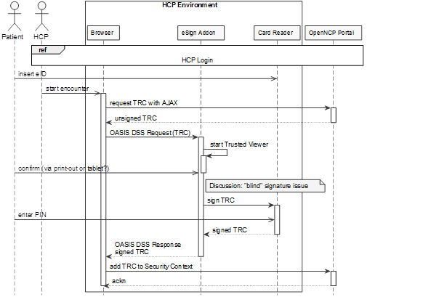
Security Architecture III: injection of new sequencings

Slide 20
e-SENS WP5.2 eID Pilot
Housekeeping INTEGRATION

Slide 21
Housekeeping // Integration
Current To-Do‘s:
  SP certificate exchange IT, PT, AT, GR for STORK 2.0 Test
  provision of test-PS/eP bound to the test cards
  PT to provide context for eID Architecture Document
  PT to clarify documentation need for x-project work
  AT to formalize joining the pilot, provisioning of S/W

