Slide 1
e-SENS CC5.2 eID sub-task f2f
Berlin, 25 August, 2015
NCP Deployment and Direct Brokered Trust
Massimiliano Masi

Slide 2
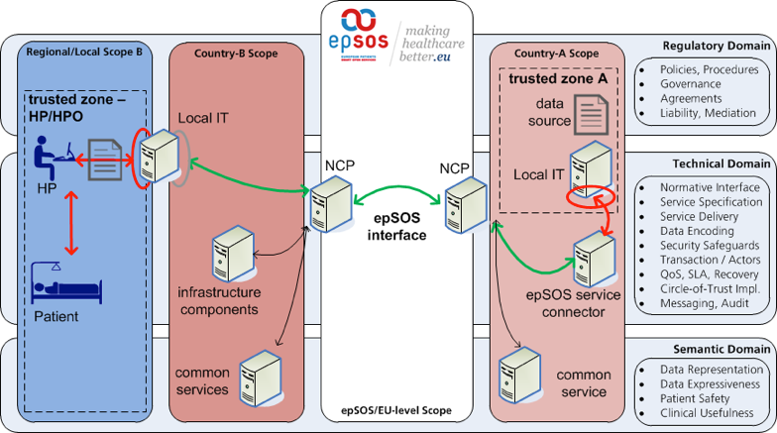
EpSOS Scoping and Sectors
D3.A.3 epSOS EED Design

Slide 3
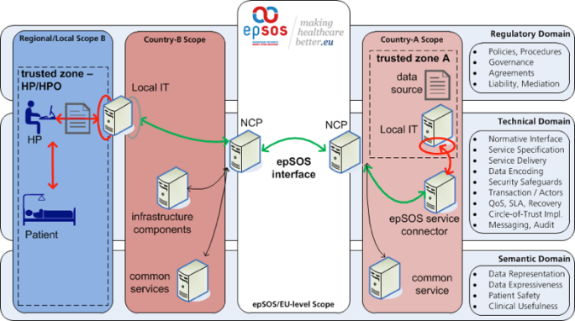
EpSOS Scoping and Sectors
The epSOS specifications do not instruct how to build a gateway product
They define the messaging infrastructure and its related security measures
Country-specific applications (“fat clients”) are considered out-of-scope of the OpenNCP
Missing architectural approach?
Implementing the white box only
WP6.A calls it “Backend Integration”

Slide 4
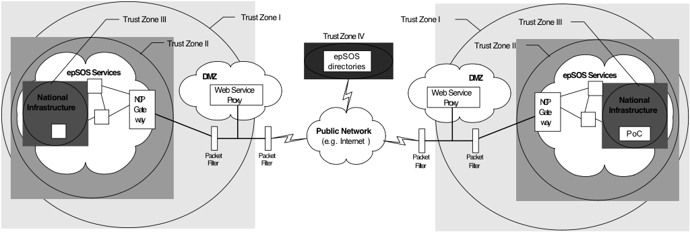
EpSOS Scoping and Sectors
The epSOS Trust Zones: ISO27000 protection rings
Set the security of each zone and how to use gateways (or similar techniques) to escalate to the next zone
Cannot use claims in two different zones (threat for the zone’s authentication)
EpSOS NCP is the only entry point in Trust Zone II

Slide 5
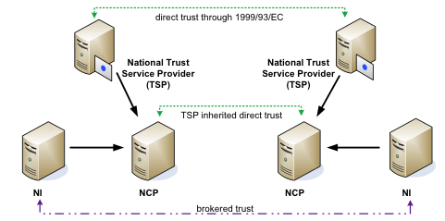
EpSOS Scoping and Sectors
The epSOS Trust Relationships are based on
1999/93/EC between
Brokered Trust (mandated by ISO27k)
Thus, the epSOS Trust Model is Direct Brokered Trust
The IdA is the broker token
IdA should not be used for authN

Slide 6
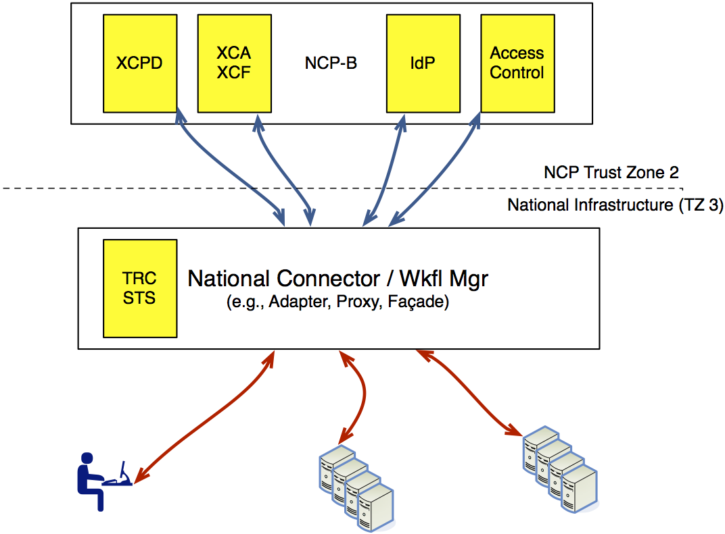
EpSOS Original Deployment
National Connector:
Should WP6 further profile it?
No market interest in the NCP, but vendor’s interest in the NC
NC provides a uniform access to the NCP services

Slide 7
TRC-STS
The TRC-STS should be national concern
Treatment confirmations under national umbrella
Separated service from the NCP (NI security zone)
Per-request TRC. Orchestrated by the NC session handler
The Netsmart TRC-STS signs TRCs using the NCP Signature certificate
This was a security relaxation
Assertion returedToken = null;
try {
returedToken = issuer.issueTrcToken(identityAssertion, patientID, purpose_of_use,attList );
l.addInfo("Got token");

Slide 8
TRC-STS
Patient signs the TRC
IdA must be available, patient must be identified
Purpose of Use must be clear, Key pair must be available
Problems
NCP-STS and TRC-STS are in two different security zones
Assertions shall not cross security domains
Patient Keys are in the National Infrastructure for a limited amount of time
Assure one TRC per transaction: how to hold and persist the backend session?
No NCP-STS available, IdA is used by the portal for authentication
If the portal is decoupled, how the IdA can be retrieved?

Slide 9
TRC signature

Slide 10
TRC Signature
The following interfaces may help the creation
TRCAssertionIssuer(
NameIDType doctorId,
DateTime notBefore,
DateTime notOnOrAfter,
DateTime authnIstant,
DataTime sessionNotOnOrAfter,
PrivateKey key, X509Certificate cert,
String patientId, String PoU, ID IdA).
TRCAudit()
TRCWsTrustConversation()

Slide 11
Hints for the NC
National Connector is the «glue» that orchestrates the epSOS profiles (implemented in OpenNCP)
Several Design, Enterprise, and Security patterns can be applied
Secure Session Facade, Message Inspector, Message Bus, Adapter, Proxy
It must follows requirements of [D3.7.2-II, Sec. 5.1]
It should handle epSOS sessions with Fat Clients

Slide 12
A sample from the competitor
Source: https://connectopensource.atlassian.net/wiki/display/CONNECT4/System+Overview

Slide 13
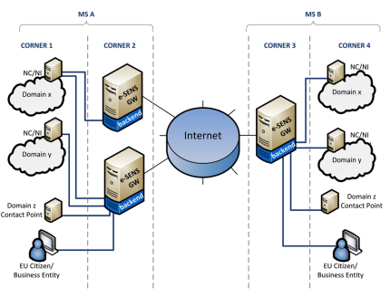
e-SENS can help
WP6 introduced the «Backend Integration ABB»
C2 and C3 == NCP-B and NCP-A, respectively
C1 and C4 are the national infrastructures.
BI ABB settles the requirements how to integrate NI with NCPs
WP5.2 sees an opportunity to further profile Backend Integration as Specification for the epSOS National Connector
OpenNCP team is strongly encouraged to participate in the development
http://wiki.ds.unipi.gr/display/ESENS/ABB+-+Backend+Integration+-+1.6.0

Slide 14
WP6
Does TRC STS signature should follow requirements set by ABB – eSignature Creation – 1.1.2 (and SP – eSignature Standards for Creation and Validation?
This may have an impact on the TRC-STS
Signature Creation Service: provides a signature that is compliant with ETSI Rationalised Framework for ESS and EU Mandate and Directives
Currently the TRC-STS signature is defined as plan XML-DSG [D3.4.2, Sec 5.3.2]

Slide 15
Testing Strategies
E-SENS testing strategy (ex-CC 6.4) shares the same model as IHE: OASIS TA
Step-by-Step model
Specifications ABB
Creation of TA
Full Test in Minder
Connectathon

Slide 16
Testing
Start with specifications
MUST, SHOULD, MAY, SHALL keywords are extracted to create the TA (rigorous operation)
Feedback to the specification developers is possible
Development team implements specifications
Software Under Test is tested by Gazelle (at the Connectathon) and by Minder (e-SENS)
Tests are created automatically by Tas, feeding Gazelle and Minder

Slide 17
Test Strategy for eID
Testing Strategy for eID has a similar approach
Once the eID LAM is specified and included into WP6 EIRA, TAs are created
WP6 and development team will review
TA will be formalized into TAML and imported in Gazelle and Minder
The goal should be the December Expandathon?
To coordinate with WP6 and EXPAND
If TRC-STS will be in scope, if the signature will follow e-Sens eSignature BB, ETSI Plug Tests should be considered

Slide 18
Discussion?

