Slide 1
e-SENS CC5.2 F2F
Porto, May 12/13, 2015
SMP & SML
Massimiliano Masi

Slide 2
New e-SENS Architecture
A new e-SENS architecture has been proposed
Solution Architectural Template (SAT)
  a model of assembly of building blocks that solution architects and designer can follow to built their own solution
Architectural Building Block (ABB)
  an artifact that represent a capability (e.g., Evidence Emitter)
  ABB Specs: the technical specifications of the ABB (e.g., the implementation details of the Evidence Emitter)
Solution Building Block (SBB)
  The bytecode, the reference implementation.

Slide 3
The problem
Static configuration
  OpenNCP relies on a set of static configuration entries mapping the remote capabilities; FET NCP used the Central Configuration Services
  Due to the epSOS modular architecture, the capability of the remote NCP are not known in advance
  This is the second BB that tries to fill the gaps left open by epSOS
Sample questions
  Does the remote NCP support XCA? Or XCF?
  Which Identity Traits?
  Which certificate the remote is used to secure the specific epSOS endpoint?
  Is the patient identifier exchanged using Stork / FutureID or XCPD?
  Is the remote ready for FHIR?

Slide 4
The e-SENS solution
Capability Lookup ABB
  provide metadata about the communication partner’s interoperability capabilities on all levels defined in the European Interoperability Framework (Legal, Organizational, Process, Semantic and Technical interoperability levels). The metadata can be used to dynamically set interoperability parameters and ambitions between the sender and receiver (Service Metadata Publishing, BDX-SMP)
Service Location ABB
  To use to a metadata service, the sender needs to know the location of that service. The e-SENS Service Location ABB defines a standard location for metadata service providers. The located metadata service can be used to obtain service metadata to properly configure the transport connection to the endpoint for that entity (or service provider) and to send documents or data to an end entity (or its service provider, BDX-Location).

Slide 5
Service Metadata Publishing
OASIS standard from the BDXR TC
Based on the PEPPOL Experience
  Having in PEPPOL its most important stakeholder
Editor is Sven Rasmussen (former e-SENS lead architect)
Extensible data model + REST Interface
Service location is based on DNS (BDXL)
Two mode of operation:
  Centralized
  Distributed

Slide 6
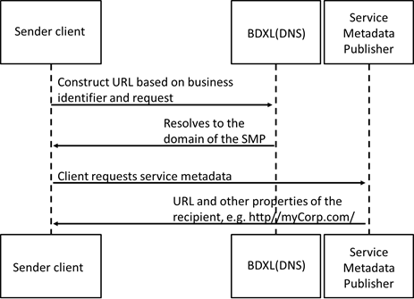
Centralized SMP

Slide 7
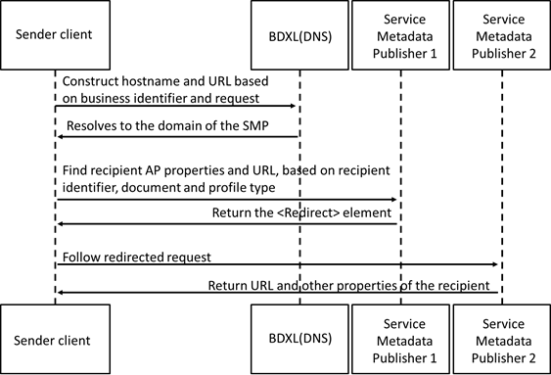
Distributed SMP

Slide 8
Data Model
ServiceGroup
  represents a set of services associated with a specific Participant Identifier that is handled by a specific SMP
ServiceInformation
  contains information about a specific service
    its identifier
    type of document exchanged

Slide 9
A first mapping
A first naïve mapping is to group an NCP to a Service Group
<!-- This is the Service Group file for the German NCP, according with 4.5.8.1 epSOS EventIDs -->
<ServiceGroup>
<ParticipantIdentifier scheme="urn:epsos:2015:smp:scheme:participant_id">urn:germany:ncpb</ParticipantIdentifier>
<ServiceMetadataReferenceCollection>
<!-- For the 1,2 transaction: should we group them, or we allow to have different endpoints for the same service? -->
<!-- epsosIdentityService::FindIdentityByTraits epsos-docid-qns::urn:epsos:services##epsos-11 -->
<ServiceMetadataReference href="http://smp.location.de/urn%3Aepsos%3A2015%3Asmp%3Ascheme%3Aparticipant_id%3A%3Aurn%3Agermany%3Ancpb/services/epsos-docid-qns%3A%3Aurn%3Aepsos%3Aservices%23%23epsos-11"/>
<!-- epsosPatientService::List -->
<ServiceMetadataReference href="http://smp.location.de/urn%3Aepsos%3A2015%3Asmp%3Ascheme%3Aparticipant_id%3A%3Aurn%3Agermany%3Ancpb/services/epsos-docid-qns%3A%3Aurn%3Aepsos%3Aservices%23%23epsos-21"/>

Slide 10
Service Information
<ServiceInformation>
<!-- Same as the service group -->
<ParticipantIdentifier scheme="urn:epsos:2015:smp:scheme:participant_id">urn:germany:ncpb</ParticipantIdentifier>
<DocumentIdentifier scheme="epsos-docid-qns">epsos-docid-qns::urn:epsos:services##epsos-31</DocumentIdentifier>
<ProcessList>
<Process>
<ProcessIdentifier scheme="urn:epsos:2015:smp:scheme:proc_id">urn:germany:ncpb:epsosOrderService::List</ProcessIdentifier>
<ServiceEndpointList>
<Endpoint transportProfile="urn:ihe:iti:2013:xca">
<EndpointURI>http://germany/ncp/patient/list</EndpointURI>
<RequireBusinessLevelSignature>false</RequireBusinessLevelSignature>
<MinimumAuthenticationLevel>urn:epSOS:loa:1</MinimumAuthenticationLevel>
<ServiceActivationDate>2015-04-29T12:55:39Z</ServiceActivationDate>
<ServiceExpirationDate>2015-04-29T12:55:39Z</ServiceExpirationDate>
<Certificate>SGksIEkgYW0gYSBuaWNlIFg1MDkgQ2VydGlmaWNhdGU=</Certificate>
<ServiceDescription>This is the epSOS Order Service for the German NCP</ServiceDescription>
<TechnicalContactUrl>http://germany/contact</TechnicalContactUrl>
<TechnicalInformationUrl>http://germany/contact</TechnicalInformationUrl>
</Endpoint>
</ServiceEndpointList>
</Process>
</ProcessList>
</ServiceInformation>

Slide 11
Suggestions
Use SMP as a Record Locator Service
Automatic configuration of client / servers
Terminology services capabilities (RDF, OWL, FHIR)
Security assertion broker (e.g., SAML to JWT)

Slide 12
Service Location
Based on DNS (rfc4848)
  Using the NAPTR DNS entry
  http://<hash over recipientID>.<schemeID>.<SMLdomain>/<recipientID>/services/<documentType>
  IN NAPTR 100 10 "U" "Meta:SMP" "!^.*$!https://serviceprovider.peppol.eu/e49b223851f6e97cbfce4f72c3402aac/!" .

Slide 13
Implementation
Two available implementations can be used
  EU Commission (register and SMP)
  University of Piraeus (SMP, register?)
Both client libraries and services
Technical Resources may be allocated by the commission

Slide 14
Discussion?

