Slide 1
WP 5.4 eHealth pilot -
epSOS OpenNCP Tcon,
July, 7th 2014
Robert Scharinger & Gottfried Heider (Ministry of Health, AT)
Stork 2.0 is an EU co-funded project INFSO-ICT-PSP-297263

Slide 2
General
STORK = Secure idenTity acrOss boRders linKed
STORK 2.0 will contribute to the realization of a single European electronic identification and authentication area.
It does so by building on the results of STORK, establishing interoperability of different approaches at national and EU level, eID for persons, eID for legal entities and the facility to mandate.
It will be a step forward towards the creation of a fully operational framework and infrastructure for electronic identities and authentication in the EU.
2

Slide 3
General
Strong liaisons with other LSPs (epSOS, eSENS, Peppol, Spocs and e-Codex), the thematic network SSEDIC, as well as ISA’s STORK Sustainability action, closely following and relating to other international efforts in eID.
STORK 2.0 Participating Countries
3

Slide 4
Political framework
The Digital Agenda & its eGovernment Action Plan 2011-2015, ISA Work Programme (2009/922/EC), the European Directive on Electronic Services
address the importance of pan–European interoperability & of eIDs as key enablers for eGovernment Services and for strengthening the Digital Single Market
stress the development and use of a pan-European infrastructure for eID for citizens and businesses.

Slide 5

The Vision
STORK 2.0 will contribute to the realization of a single European electronic identification and authentication area by:
  building on the results of STORK
  establishing interoperability of different approaches at national and EU level, eID for persons, eID for legal entities and the facility to mandate
Notes:
NOTES:
STORK 2.0 moves to a completely new dimension (thus the “2.0” in its name):
STORK 2.0 takes a significant and pioneer leap from identifying and authenticating citizens, to the ability to authenticate legal entities and citizens and link the citizen to their role in the business world. STORK 2.0 will be linking the citizen and legal entities to attributes, delegations and mandates. By enabling cross border and sector interoperability for legal entity eIDs a wealth of new pan European applications and services can be facilitated.

Slide 6


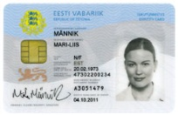


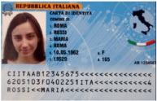

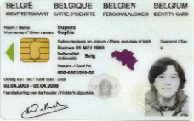
Government eID projects …
Early birds started late 1990’s early 2000
  Finish eID card: December 1999
  Estonian eID card: from January 2002
  Austrian citizen card: from 2003, mass-rollouts 2005
  Italian CIE / CNS: test phase 2003 (CIE)
  Belgian eID card: from 2nd half 2003
Evolved as
national islands

Slide 7




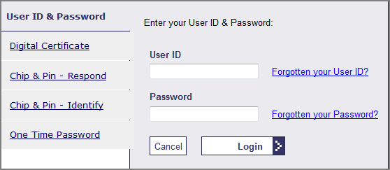

National eIDs landscape
Heterogeneous in various dimensions
  Technology
    Smartcards: AT, BE,EE, ES, FI, GE, IT, PT, SE, …..
    Mobile eID: AT, EE, FI, LU, NL, NO, UK, …
    Soft certif.: ES, SE, SI, …
    usern./pass.: NL, UK, …
  Operational
    Issued by public sector, private sector, combined
    Issued at federal, local, regional level
    Use of identifiers
  Legal
    (limited) use of identifiers; flat, sectoral, combined
Claim: None is the “better”
system, they’re just different

Slide 8
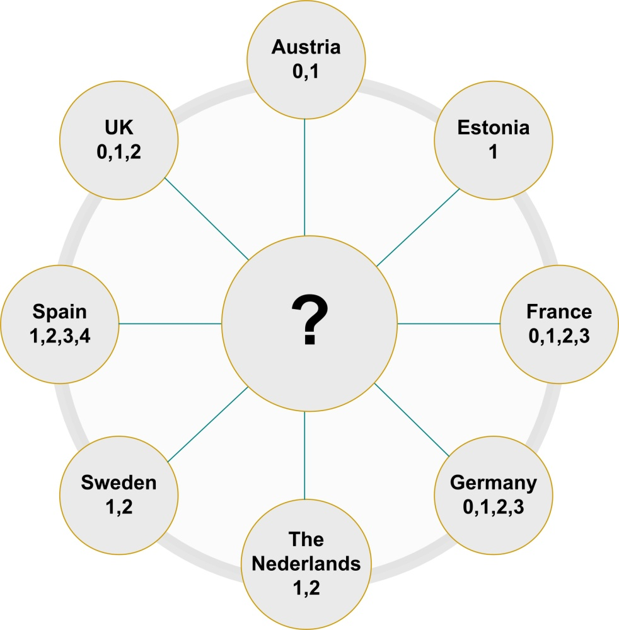
One problem tackled: Trust levels
Different technologies
and security levels:
Smart cards
Software certificates
Mobile Phones
Username-password

Slide 9
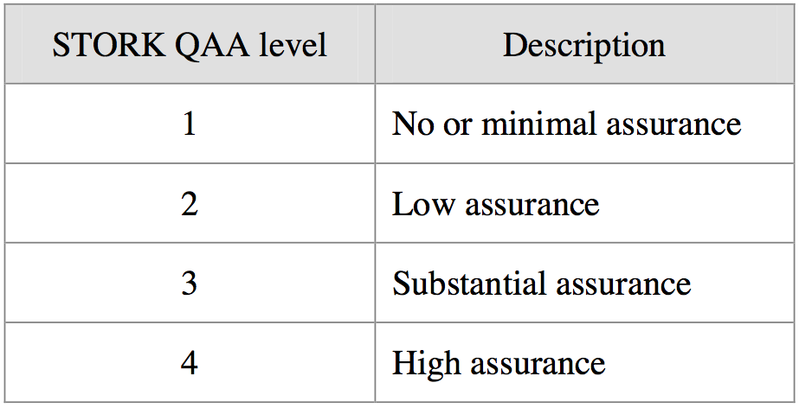
STORK QAA levels
(Source: STORK D2.3 – Quality authenticator scheme)

Slide 10
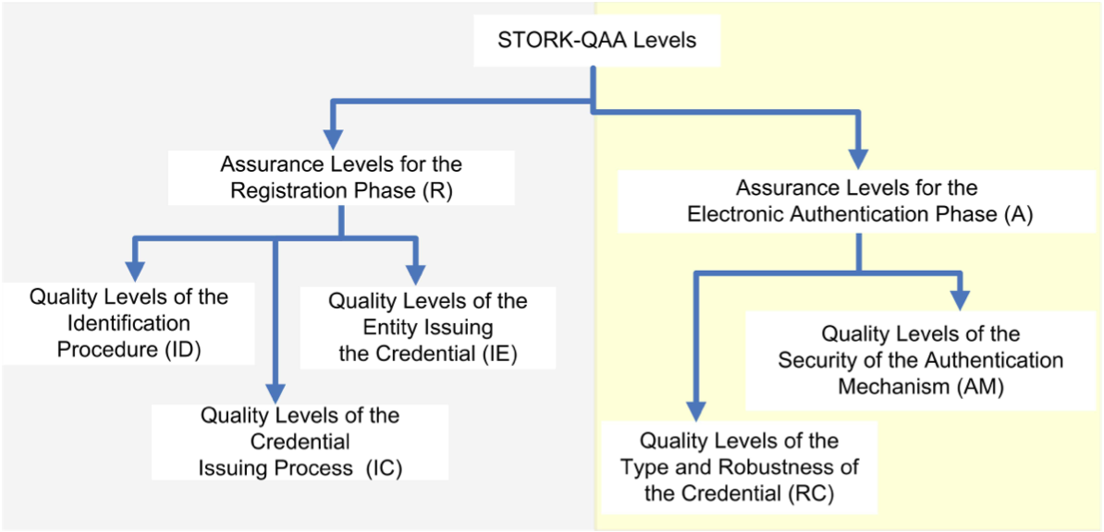
Organisational factors influencing STORK QAA levels
(Source: STORK D2.3 – Quality authenticator scheme)

Slide 11
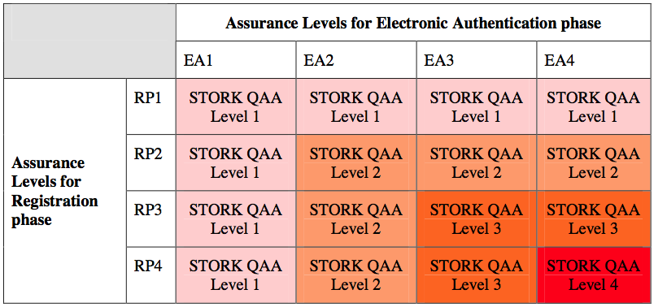
Technical & organisational assessment of STORK QAA levels
(Source: STORK D2.3 – Quality authenticator scheme)

Slide 12
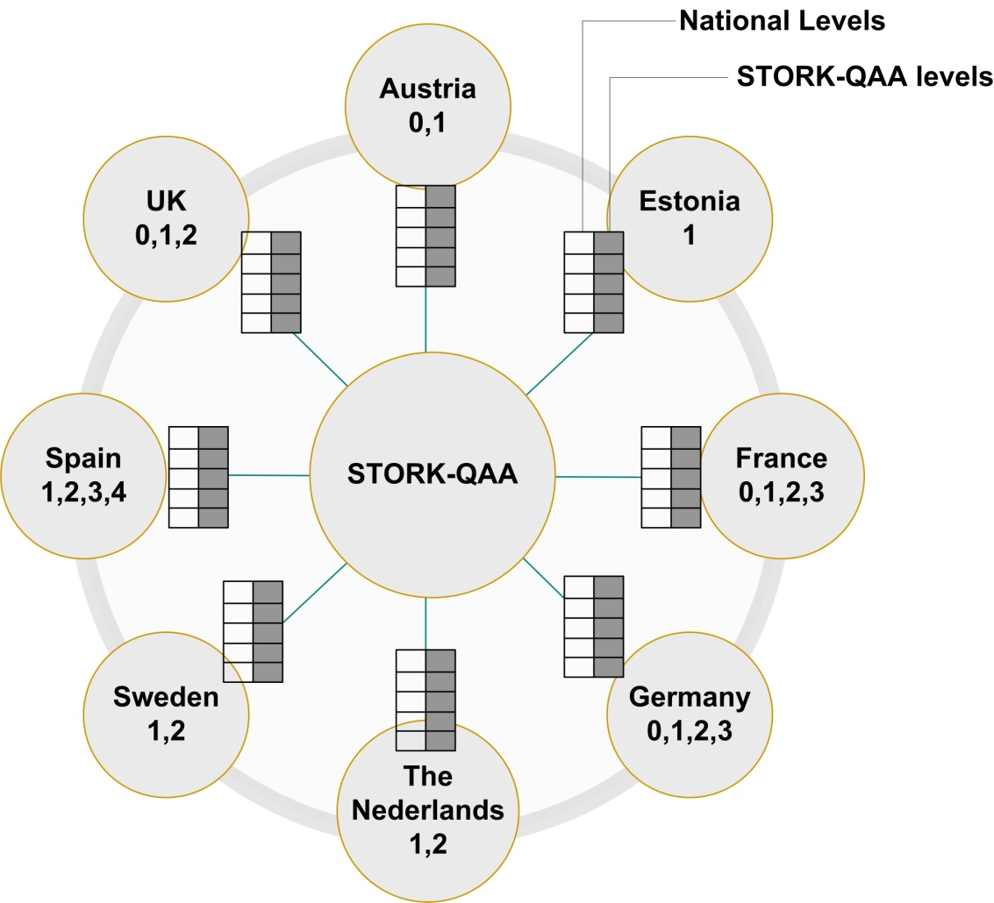
Approach: Mapping to QAA levels

Slide 13















STORK – PEPS Model
TRUST – STORK’s QAA
Pan European Proxy Services (PEPS)

Slide 14
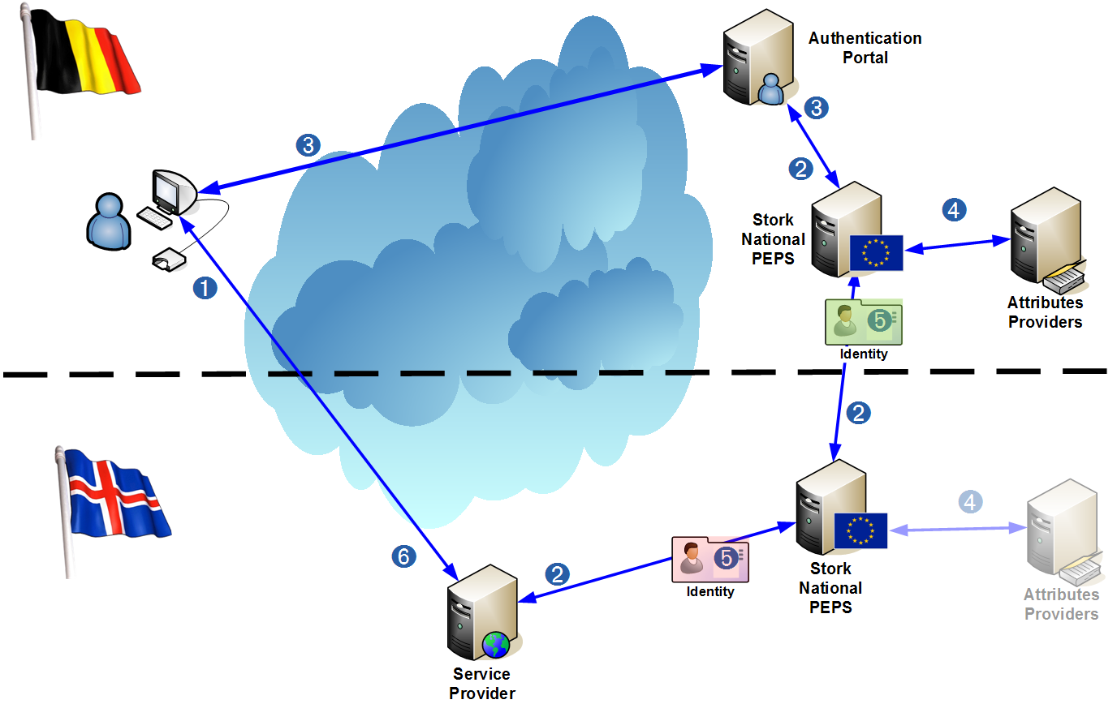
STORK PEPS data flow (logical)

Slide 15
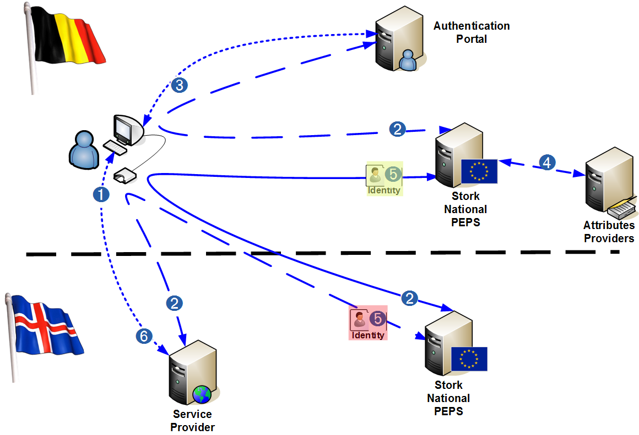
Protocol: Federated Identity (SAML 2.0)

Slide 16

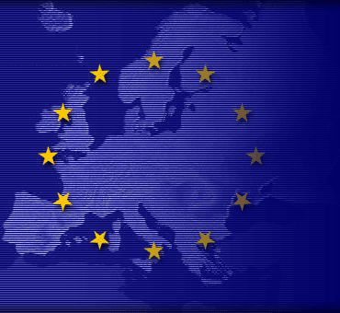

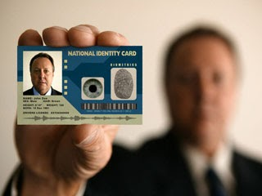
Objectives STORK 2.0
Accelerate the deployment of eID for public services
Maximize the take-up of its scalable solutions throughout the EU
Seek & showcase uses of eID for the authentication of both legal and natural persons throughout the EU
Test in real life environments secure and easy-to-use eID and attribute solutions in 4 relevant cross- border pilots
Notes:
NOTES:
The objectives of STORK 2.0 are to:
Accelerate the deployment of eID for public services, while ensuring co-ordination between national and EC initiatives in the field, and support a federated eID management architecture across Europe, by building on existing eID.
Maximize the take-up of its scalable solutions throughout the EU, with a strong commitment to open specifications and longer-term sustainability around a strong vision of eID as a Service Offering (backed by participating European countries and industry) which contributes to Europe‟s role of leadership of the eID market.
Seek and showcase the convergence of private and public sectors in a fully operational framework and infrastructure which encompasses eID for secure and coherent electronic authentication of both legal and natural persons (including facility to mandate in different forms) widely useable across the EU, based on high level of data protection and secure ways to transfer attributes, all under user control.
Test, in real life environments, secure and easy-to-use eID and attribute solutions in four relevant cross- border and cross sector pilots.

Slide 17

STORK2.0 Pilots
17

Slide 18
STORK 2.0 Pilot
WP 5.4 eHealth
eHealth - Objectives
The pilot is fully in line with Key Action 13 “Undertake pilot actions to equip Europeans with secure online access to their medical health data by 2015” of the Digital Agenda as well as with the patients’ right of getting access to their personal medical data in crossborder healthcare as a topic in the EU Directive 2011/24/EU.
The pilot leverages the existing STORK infrastructure to processing medical data, i.e. an area with the highest data protection requirements due to special categories of data that receive particular protection under the Data Protection Directive 95/46/EC.

Slide 19
eHealth pilot
Main Goal:
Use STORK to access epSOS eHealth Infrastructure (epSOS provides eHealth services)
Enable access to health data of patients in a foreign country using their local eID mechanism
8 MS involved AT, (BE), (CH), IT, SE, (SI, TR & UK), additional Switzerland Region Geneva (with epSOS OpenNCP)

Slide 20
Pilot Use Cases
Use Case 1: Patient access to eHealth records
eIdentification plus eAuthentication with Mobile Tan, Cards within national eHealth Infrastructure
Patient Access within national eHealth Infrastructure
  Eg: Consent, Medical Information, Patient Summary, Audit Logs
Use Case 2: Representative access to eHealth records
Use Case 1
Additional: Patient Access on behalf (delegate, mandate)
Use Case 3: HCP identification
Providing HCP Attributes (Identification, Role) for further Consideration
20

Slide 21
Overall Pilot Scope & Technical /Business Goals
Main Goal:
Using STORK eID Infrastructure to access eHealth Infrastructure
Enabling patients to access their health data in a foreign country using their local eID mechanism
Support of mandates
Using STORK as a source for authorization attributes from local eHealth Infrastructures
The pilot intends to enhance the arbitrary (including paper based) means of patient identification of epSOS by electronic processes using STORK 2.0 functionalities

Slide 22
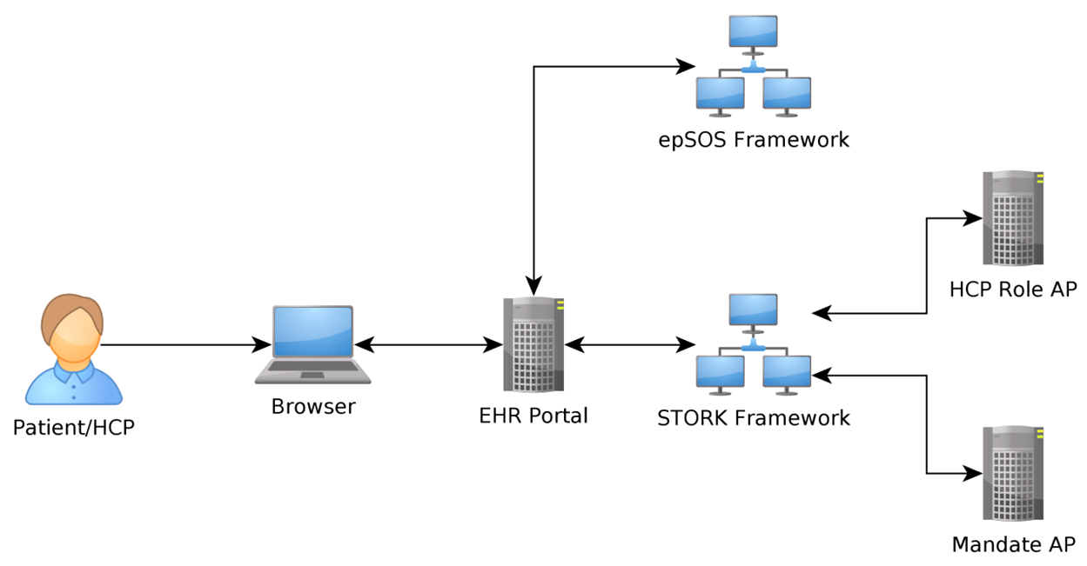
Opportunities enabled by eHealth Pilot
2 LSPs in eHealth working together (STORK, epSOS) –> input for eSENS / sustainabilitiy!
eID from STORK Infrastructure for Patient Identification
Fulfillment of Patient Right Directive
"Information can save life"

Slide 23
Status – Vision
STORK 2.0 eHealth <-> epSOS OpenNCP
Status:
UC1: Patient Access with STORK eID Infrastructure for exchange of Medical Information (only Patient Access) on Test Environment
Vision:
UC1, UC2 and UC3 on Production Environment in September 2014
UC1: Additional Patient Consent
UC2: Login with delegated person – otherwise like UC1
UC3: Login of HCP with STORK 2.0 Infrastructure and additional the foreign county receives the attributes that the citizen is indeed a doctor. Afterwards workflow like UC1. (Demo was shown at the Review meeting)

Slide 24
eIDAS Regulation
”Directive 2011/24/EU of the European Parliament and of the Council sets up a network of national authorities responsible for eHealth.
To enhance safety and the continuity of cross-border healthcare, the network is required to produce guidelines on cross-border access to electronic health data and services, including by supporting 'common identification and authentication measures to facilitate transferability of data in cross-border healthcare'. Mutual recognition of electronic identification and authentication is key to make cross border healthcare for European citizens a reality. When people travel for treatment, their medical data needs to be accessible in the country of treatment. This requires a solid, safe and trusted electronic identification framework."

Slide 25
Visit STORK 2.0 website www.eid-stork2.eu !
Subscribe to STORK 2.0 Newsletter!
Participate & “like” Stork eID Facebook page!
“Follow” us on Twitter @StorkEid !
Connect to Stork 2.0 EID LinkedIn page!
Register in STORK 2.0 online groups!
Contact us at info@eid-stork2.eu !
HOW TO GET INVOLVED…

Slide 26
Discussion

Slide 27
Thank you for your attention! www.eid-stork2.eu robert.scharinger@bmg.gv.at gottfried.heider@ehealthcon.at
27

