Slide 1
A proposal for a Non Repudiation Protocol for epSOS
Massimiliano Masi

Slide 2
Motivation
EpSOS D3.7.2 defined the “Non Repudiation Security Service” (section 5.2)
ISO13888 tokens, Non Repudiation of Origin, of Receipt, of Delivery, and of Submission
Technologies indicated where
IPSec, TLS, Message Payload Signatures, TTPs, and Audit Trails
To reduce the costs of the initial pilot (2009), “the required acknowledge of every message could be relaxed” (section 7.8.1)

Slide 3
Motivation
The e-SENS project aims at the definition of Solution Building Blocks (SBB)
SBB Interoperable Cross Border and Cross Domain (not only eHealth)
SBB Guaranteed to be sustainable through CEF
Existing LSP (such as epSOS) can use the e-SENS BB to enhance existing infrastructure

Slide 4
Motivation
The e-SENS Non Repudiation Task Force defined a per-hop non repudiation protocol using notary services (Trusted Third Parties)
Solution is eIDAS compliant
Each actor (e.g., NCPs) stores evidence in the database, located in the same security zone of the TRC Issuer
Solution: to fulfill the 3.7 requirements by using ATNA (as per 3.4.2) and ETSI REM

Slide 5
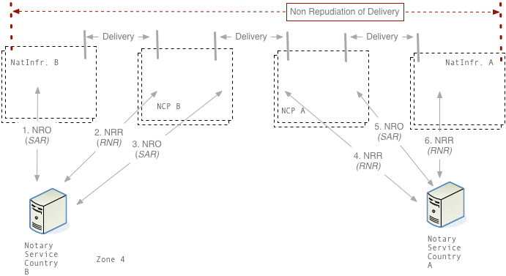
High Level Overview

Slide 6
Country B
Message is in transit from B to A (e.g., XCA CrossGatewayRetrieve)
National Infrastructure MAY issue the NRO token (SubmissionAcceptanceRejection, SAR)
The message is received by NCPB, which MUST issue a NRR token (ReceiptNonReceipt, RNR)
NCPB performs internal operations
NCPB MUST issue a NRO token when the message is sent
All the tokens are stored in the Notary Service

Slide 7
Country A
NCPA receives the message, and it MUST issue a NRR token
NCPA performs internal operations
NCPA MUST issue a NRO token before sending the new message to the national infrastructure
National Infrastructure MAY issue a NRR token

Slide 8
Discussion
Non Repudiation of message exchange
Translation, Transcoding, Security, are not considered
If National Infrastructures issues their tokens, there is an additional NRD evidence to be sent to the end-user
No storage of documents in NCP
No change in the epSOS message flow and message semantics
Solution legally stable (eIDAS compliant)
Tokens based on ETSI REM and ISO 13888 (under analysis)
Highly flexible system through the usage of epSOS Extended Security Safeguard (ESS) XACML-based approach

Slide 9
Implementation
Implementation is provided by e-SENS
OpenNCP just *INTEGRATES*
It is based on the Evidence Emitter ABB
Test performed by e-SENS (GITB testing)
Gazelle’s test assertions, schema, are already integrated
Schematrons are on their way

