Slide 1
OpenNPC Challenges
@ EXPAND WP5 Technical Meetings
2014-11-05

Slide 2
OpenNCP - Solution Usage
pilots
Malta

Slide 3
OpenNCP - Solution Usage
Patient Summary
PN | PS A | PS B
Austria | FET (OpenNCP) | FET (OpenNCP)
Estonia | OpenNCP | OpenNCP
France | FET | FET
Hungary | N/A | OpenNCP
Italy | OpenNCP | OpenNCP
Luxembourg | N/A | OpenNCP
Malta | OpenNCP | OpenNCP
Portugal | OpenNCP | OpenNCP
Slovenia | OpenNCP | OpenNCP
Spain | OpenNCP | OpenNCP
Switzerlan | OpenNCP | OpenNCP
ePrescription
PN | eP A | eP B
Croatia | OpenNCP | OpenNCP
Denmark | FET (OpenNCP) | FET (OpenNCP)
Finland | OpenNCP | OpenNCP
Greece | N/A | OpenNCP
Hungary | FET (OpenNCP) | FET (OpenNCP)
Italy | OpenNCP | OpenNCP
Spain | OpenNCP | OpenNCP
Sweden | OpenNCP | OpenNCP
(OpenNCP) Require confirmation on
migration progress status

Slide 4
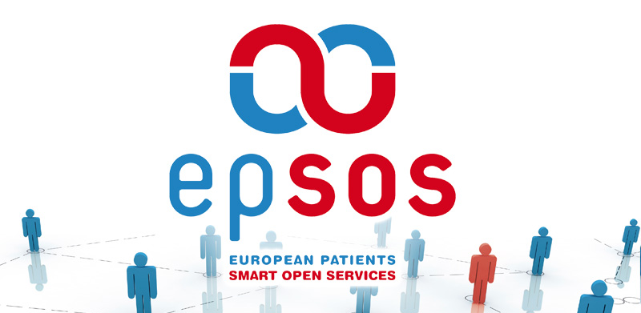
OpenNCP Community
Beyond epSOS…
New vision
New governance
New goals
but ALWAYS
Acknowledging the remarkable epSOS Team

Slide 5
Community – raison d’être
along epSOS
Open group of people orchestrated by an agile software development methodology conducting effort on designing, coding, testing and delivering OpenNCP software
beyond epSOS
Open group of people orchestrated by common principles, conducting effort on designing, coding, testing and delivering eHealth Interoperability technology

Slide 6
Community
people
values
skills
tools
joint by a
common
vision

Slide 7
Community – vision
along epSOS
Design and develop a set of Open Source Components (OpenNCP) that can be adopted by Participating Nation, to build their local implementation of the epSOS NCP.
beyond epSOS
Design, develop and sustain a set of open source components (OpenNCP) that can be adopted by anyone, to build an eHealth Information Exchange Point.

Slide 8
Community Governance Model

Slide 9
Community
Challenges ahead!
Using
Contributing
Interested
Pushing
Malta

Slide 10
Technology Evolution – Why?
Using
Contributing
Interested
Pushing
14 countries already use the technology
3 new countries are looking for the opportunity to start using
4 EC projects rely on this Technology and Community to achieve their goals

Slide 11
The driving motivation
USING Countries
eHealth projects
“desire to improve”
EC

Slide 12
Technology Evolution - Drivers
Evolve
Reduce dependency from Central Services;
Fix and Extend Master Value Catalogue;
Sustain
Components Fix and Improve
Disseminate and educate usage
Incorporate non-sectorial building blocks from e-SENS, while keeping eHealth specificities
Extend Patient Summary to support Chronic Diseases, Rare Diseases (SHnet);
Morph OpenNCP to be used at national level;
Support PATIENT REGISTRIES interoperability;
Consolidate knowledge repositories
Consolidate Patient Access related services;
Support new adopters

Slide 13
Technology Evolution - Roadmap

Slide 14
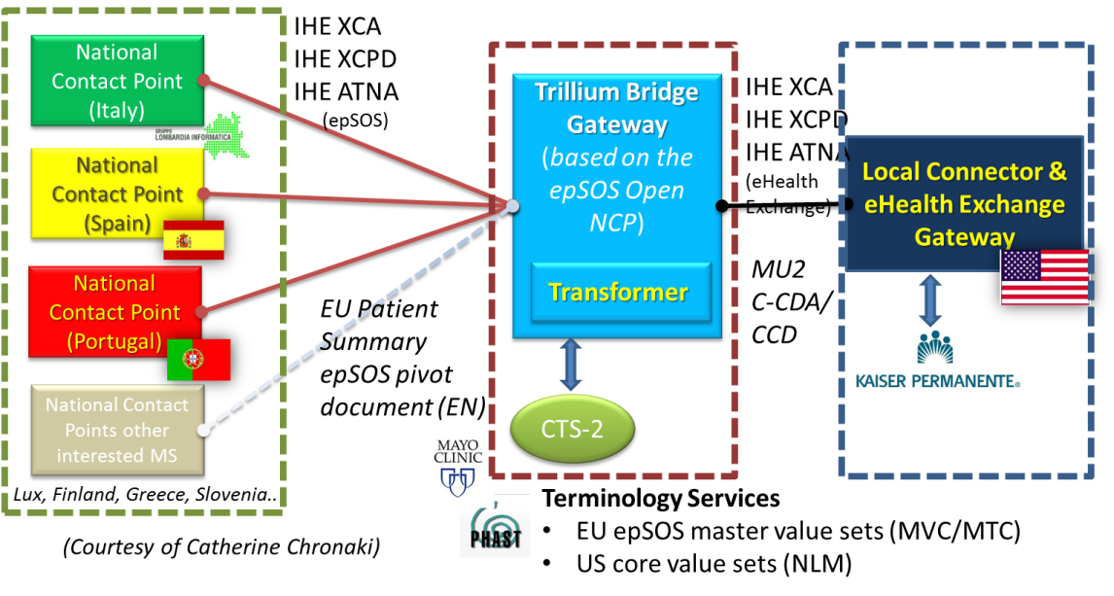
Technology Evolution – Roadmap (Trillium Bridge)
Trillium: Build the Bridge between EU / US, in line with MoU
Adopt epSOS NCP infrastructure to include EU/US Transformer
Extend epSOS Patient Access for the new paradigm of Patient Mediated
Analyse gaps (IHE profiles, HL7 CDA, Terminologies) to enhance harmonization and
interoperability

Slide 15
Technology Evolution – Roadmap (e-SENS)
e-SENS: Define infrastructure based on Building Blocks from LSP
eHealth Domain: Improve existing epSOS Infrastructure integrating
e-SENS Building Blocks to solve issues

Slide 16
Technology Evolution – Roadmap (e-SENS)
e-SENS – EXPAND – OpenNCP: Joint implementation
Find solution to cross-charge

Slide 17
Technology Evolution - Resources
Timeframe
1 Orchestrator
Technical
Continuous Integration
IHE Testing Tools
2 Architects
4 Developers (equivalent /distributed)
Knowledge and Dev. Management
Until Connected European Facility (CEF) handover (10 to 12 months)
Human

Slide 18
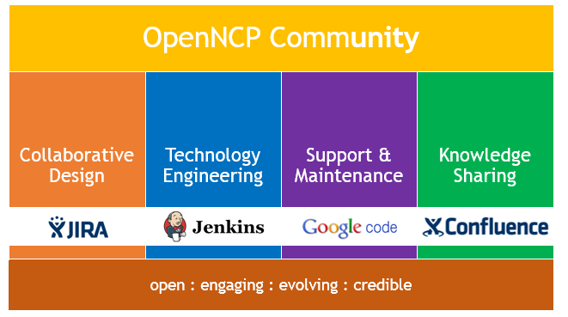
Building it together
pilots
Malta

Slide 19
Community – Way Forward
Do EXPAND believe that the following assets are relevant?
OpenNCP (community: knowledge + organizational environment)
OpenNCP (technology)
OpenNCP (development process)

Slide 20
Community – Way Forward
HOW CAN EXPAND WP5 contribute to:
Create conditions to assure effective operation/collaboration between:
Member States
Projects
Industry
European Commission DGs
Healthcare providers IT departments

Slide 21
Community – Way Forward
Working together with DG’s towards CEF (eHealth DSI)
Roles of EC DG-SANCO / EC DG-DIGIT
Core component
Generic component
DG-SANCO Installed and studied openNCP
Willing to contribute to openNCP Community e.g.:
Security Testing
Stress test
Possibility of taking over assets, according to EC DGs roles

Slide 22
Notes (from EXPAND WP5 – F2F Brussels)

