Slide 1
CEF Building Blocks
Joao RODRIGUES FRADE
CEF Project and Architecture Office (DIGIT.B4)

Slide 2
Take home messages
What CEF is
CEF reuse logic
CEF building blocks

Slide 3
Connecting Europe Facility
Financing instrument of trans-European networks from 2014 to 2020 - procurement, grants and innovative financial instruments
Regulation no 1316/2013
Transport
Energy
Telecom
€26.25 billion
€5.85 billion
€1.14 billion
Regulation no 283/2014
Informatics
Notes:
Infrastructure package of the Union: old TEN-T
Telecom first time there

Slide 4
CEF Telecom | DG CNECT
€1.14 billion
Regulation no 283/2014
Work Programmes
€170 million
€970 million
Broadband
DSIs
Building block
Sector-specific
Legend:
Core Service Platforms
Generic Services
Core Service Platforms
Generic Services
DIGIT focus
Informatics
Notes:
Follow-up to the Large Scale Pilots and rooted in the Digital Agenda for Europe

Slide 5
How to become a DSI?
Criteria
Policy Projects
Sufficient maturity
Sustainable
Support EU policies
Compliance with standards/ open specifications and orientations for interoperability
Reuse of building blocks
Building block DSIs
LSPs
DSIs that can be re-used in
sector-specific DSIs
ISA
H2020
Sector-specific DSIs
DSIs attached to a specific policy domain or sector
EVERY YEAR
Technology
Dev. & Piloting
CEF
2014 to 2020
Time

Slide 6
Objective of CEF Telecom
Support the completion of the Digital Single Market
deployment of Digital Service Infrastructures

Slide 7
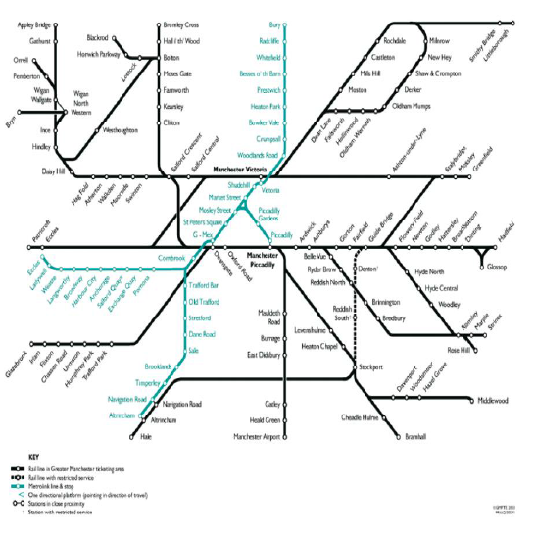
Another way of looking at it (MOVE)
From patchwork
To network

Slide 8
Applied to CEF Telecom
From patchwork
To Digital ecosystem
DSIs
Administrations
Citizens
Businesses
Policy Domains

Slide 9
A fully functioning Digital Single Market could contribute as much as 4 % of EU GDP growth over the next ten years
Source: Enabling the full potential of the digital single market - stocktaking paper (22.04.2014)

Slide 10
The building blocks logic
Architecture
What purpose?
What function?
What elements of form?
Making trade-offs
Build vs. Buy vs. Reuse
Cost to build vs. 5 year TCO
Coordination Costs vs. Isolation Costs

Slide 11
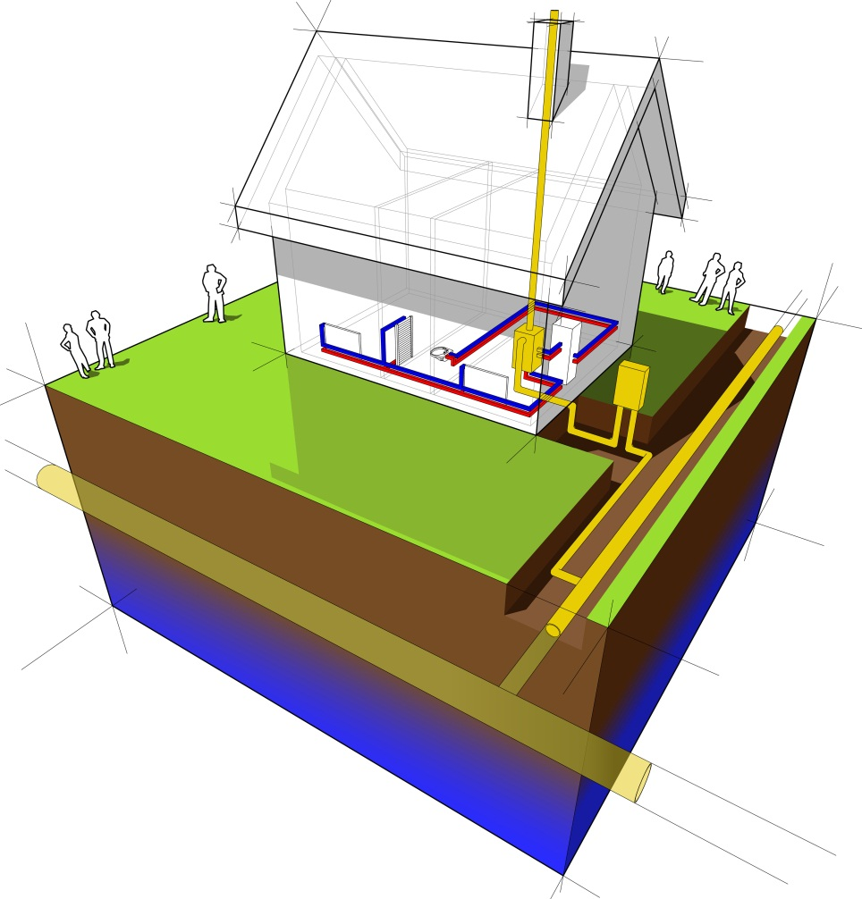
What are the 'CEF building blocks'?
CEF build·ing block
noun
basic infrastructural capability
ready to be (re)used
Automated
Translation
as Software
as a Central Service
Specifications
e-ID
e-Signature
e-Delivery
e-Invoicing

Slide 12
The CEF reuse logic
Building block (DSIs)
Take-up channels:
Reuse by CEF's sector-specific DSIs
Reuse outside CEF
Traction created through Generic Services
Adoption by the private sector
Users
Take-up
B
A
Sector-specific (DSIs)
CEF
Take-up channels:
Legislation (top-down)
Traction created through Generic Services
Maturity
2014
2020
Sustainability
Time

Slide 13
Why reuse matters?
Typical
CEF thinking
Creation costs
15% - 30%
Distribution of costs over a broad base of projects
60% - 80%
Maintenance costs
25% - 50%
Operation Costs

Slide 14
Why reuse matters?
Increase
Interoperability
Reduce
Technical Risks

Slide 15
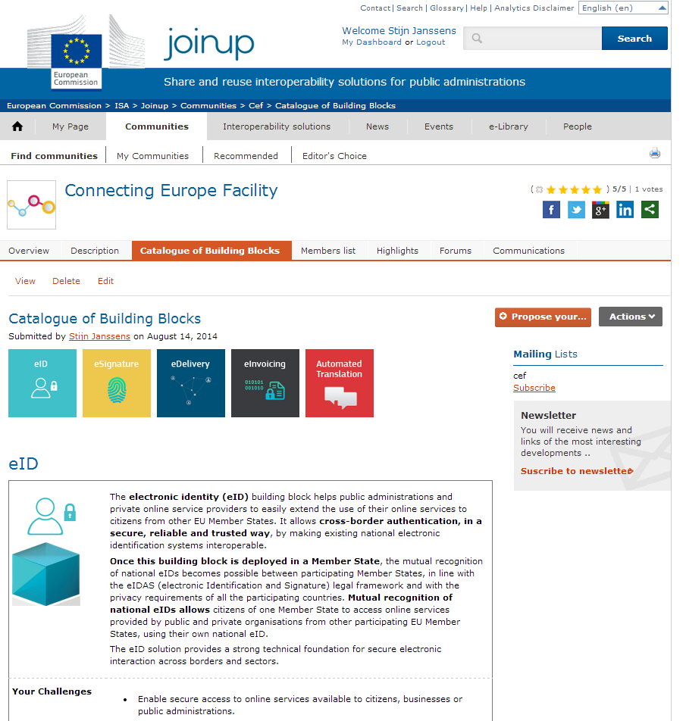
Catalogue of
CEF building blocks
Information at your fingertips
Learn more >
https://joinup.ec.europa.eu/community/cef/home

Slide 16
Supplementary services
Training
Support
Maintenance
eID
e-Invoicing
Automated Translation
eSig
e-Delivery
Project and Architecture Office
Stakeholder Management Office

Slide 17
CEF building blocks
e-Delivery
e-ID
e-Signature
e-Invoicing
Automated
Translation
What is it about?
Examples of use?
What can be reused?

Slide 18
e-Delivery
e-ID
e-Signature
e-Invoicing
Automated
Translation
What is it about?
Transport layer for delivering electronic documents (and data in general)
Examples of use?
PEPPOL (11 Countries), e-Codex (16 Countries)
What can be reused?
Access Points, Discovery Service, Specifications (e.g. ebMS 3.0)

Slide 19
e-Delivery
e-ID
e-Signature
e-Invoicing
Automated
Translation
What is it about?
Mutual recognition of electronic identification (eIDAS)
Examples of use?
STORK 1.0 (14 Countries)
What can be reused?
Pan European Proxy System (PEPS), EU PEPS (ECAS-STORK)

Slide 20
e-Delivery
e-ID
e-Signature
e-Invoicing
Automated
Translation
What is it about?
Creation and validation of e-signatures (eIDAS)
Examples of use?
Implementation of the Services Directive (DG MARKT)
What can be reused?
Trust List Manager, Digital Signature Services (DSS)

Slide 21
e-Delivery
e-ID
e-Signature
e-Invoicing
Automated
Translation
What is it about?
Electronic transfer of Invoices
Examples of use?
PEPPOL (11 Countries), e-PRIOR (55 EU Bodies)
What can be reused?
Reusable tools (test, validate, transfer e-Invoices)

Slide 22
e-Delivery
e-ID
e-Signature
e-Invoicing
Automated
Translation
What is it about?
Automated translation of content into any relevant EU language
Examples of use?
Commission Machine Translation service (MT@EC)
What can be reused?
MT@EC system

Slide 23
Contact us: DIGIT-CEF@ec.europa.eu
Joao Rodrigues Frade
CEF Project & Architecture Office
European Commission Directorate-General for Informatics (DIGIT) Information Systems for policy support and activity management (DIGIT.B.4.002)
Rue Belliard 28, 1040 Brussels/Belgium
B-28 04/159 | +32-2-295.02.40
joao.rodrigues-frade@ec.europa.eu

