Slide 1
OpenNPC
@ EXPAND WP5 Kickoff
2014-07-10

Slide 2
OpenNCP - Solution Usage
pilots
Malta

Slide 3
OpenNCP - Solution Usage
Patient Summary
PN | PS A | PS B
Austria | FET (OpenNCP) | FET (OpenNCP)
Estonia | OpenNCP | OpenNCP
France | FET | FET
Hungary | N/A | OpenNCP
Italy | OpenNCP | OpenNCP
Luxembourg | N/A | OpenNCP
Malta | OpenNCP | OpenNCP
Portugal | OpenNCP | OpenNCP
Slovenia | OpenNCP | OpenNCP
Spain | OpenNCP | OpenNCP
Switzerlan | OpenNCP | OpenNCP
ePrescription
PN | eP A | eP B
Croatia | OpenNCP | OpenNCP
Denmark | FET (OpenNCP) | FET (OpenNCP)
Finland | OpenNCP | OpenNCP
Greece | N/A | FET (OpenNCP)
Hungary | FET (OpenNCP) | FET (OpenNCP)
Italy | OpenNCP | OpenNCP
Spain | OpenNCP | OpenNCP
Sweden | OpenNCP | OpenNCP
(OpenNCP) Require confirmation on
migration progress status

Slide 4
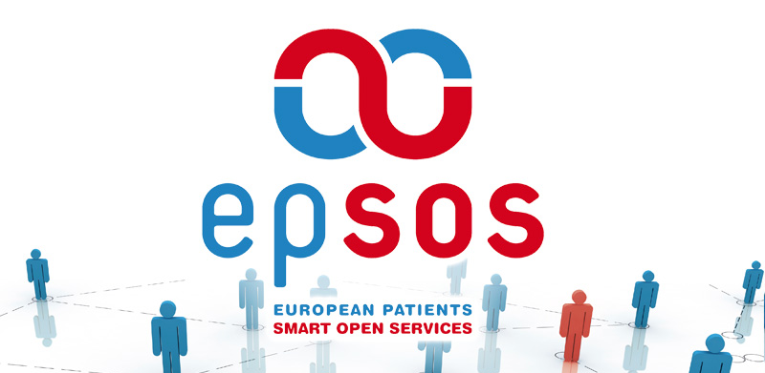
OpenNCP Community
Beyond epSOS…
New vision
New governance
New goals
but ALWAYS
Acknowledging the remarkable epSOS Team

Slide 5
Community – raison d’être
along epSOS
Open group of people orchestrated by an agile software development methodology conducting effort on designing, coding, testing and delivering OpenNCP software
beyond epSOS
Open group of people orchestrated by common principles, conducting effort on designing, coding, testing and delivering eHealth Interoperability technology

Slide 6
Community
people
values
skills
tools
joint by a
common
vision

Slide 7
Community – vision
along epSOS
Design and develop a set of Open Source Components (OpenNCP) that can be adopted by Participating Nation, to build their local implementation of the epSOS NCP.
beyond epSOS
Design, develop and sustain a set of open source components (OpenNCP) that can be adopted by anyone, to build an eHealth Information Exchange Point.

Slide 8
Community Governance Model

Slide 9
Community
Challenges ahead!
Using
Contributing
Interested
Pushing
Malta

Slide 10
Technology Evolution – Why?
Using
Contributing
Interested
Pushing
13 countries already use the technology
4 new countries are looking for the opportunity to start using
4 EC projects are relying on this Technology and Community to achieve their goals

Slide 11
Technology Evolution - Drivers
Evolve
Reduce dependency from Central Services;
Fix and Extend Master Value Catalogue;
Sustain
Components Fix and Improve
Disseminate and educate usage
Incorporate non-sectorial building blocks from e-SENS, while keeping eHealth specificities
Extend Patient Summary to support Chronic Diseases, Rare Diseases (SHnet);
Morph OpenNCP to be used at national level;
Support PATIENT REGISTRIES interoperability;
Consolidate knowledge repositories
Consolidate Patient Access related services;
Support new adopters

Slide 12
Technology Evolution - Resources
Timeframe
1 Orchestrator
Technical
Continuous Integration
IHE Testing Tools
3 Architects
4 Developers (equivalent /distributed)
Knowledge and Dev. Management
Until Connected European Facility (CEF) handover
Human

Slide 13
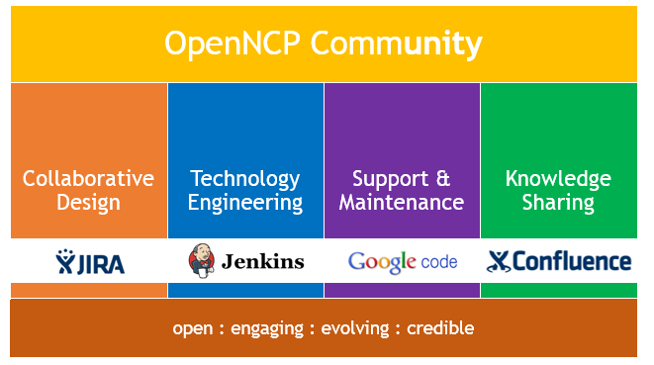
Building it together
pilots
Malta

Slide 14
Technology Evolution - Resources
Person
0.5 person/month
Financial
90k€ (for 18 months)
Time
18 months (July 2014, Dec. 2015)
Countries
10 countries or more
or
Does not include IHE Connecthaton participation fees. Usually 2.4K€ per System

