Slide 1
epSOS OpenNCP WorkShop 14 May 2014, Athens
| OpenNCP Community
outlook into the future
OpenNCP

Slide 2
epSOS OpenNCP WorkShop 14 May 2014, Athens
| OpenNCP Community
The future of the OpenNCP
depends on the community sustainability
Testing, Validation and Adoption
lead to technology maturity assurance
PNs MUST acknowledge
Willingness and Commitment to participate and autonomy to maintain local services
We envision our work as FOUNDATIONAL
and may empower future eHealth initiatives
Lessons Learnt

Slide 3
epSOS OpenNCP WorkShop 14 May 2014, Athens
| OpenNCP Community
Road Map – More is coming
The driving motivation
Current USING Countries
eHealth projects around the world
Community desire to improve
Notes:
Those are the main.
- Projects:
-- Trillium Bridge
-- e-SENS
-- EXPAND
-- OpenHIE initiative (Indianapolis)
-- eGovLab
Others like: willing to USE countries

Slide 4
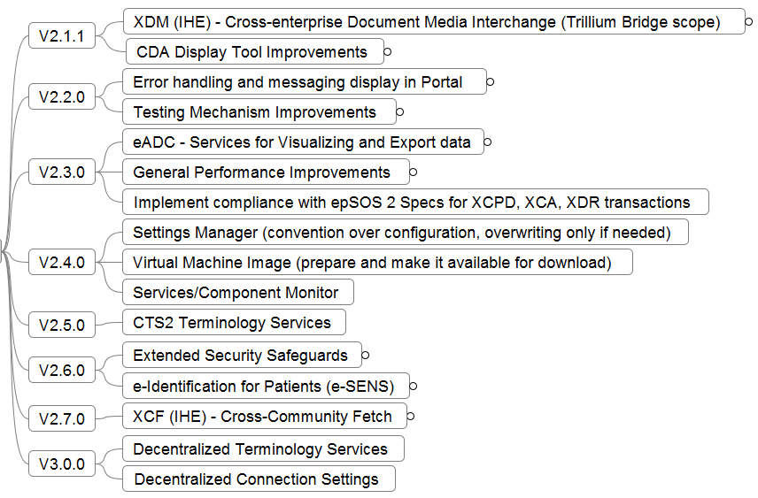
epSOS OpenNCP WorkShop 14 May 2014, Athens
| OpenNCP Community
Road Map – More is coming

Slide 5
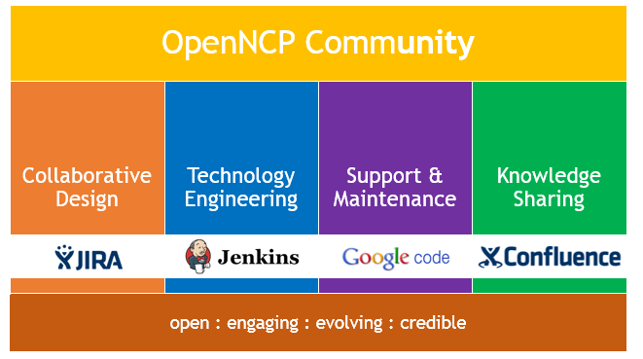
epSOS OpenNCP WorkShop 14 May 2014, Athens
| OpenNCP Community
Challenge
Malta

Slide 6
epSOS OpenNCP WorkShop 14 May 2014, Athens
| OpenNCP Community
OpenNCP
Thank you for your attention!
info@epsos.eu

