Slide 1
epSOS Industry Team and OpenNCP Community Workshop
OpenNCP Development Tools, Integration and Testing Arrangements
Marcelo Fonseca
Software Developer
marcelo.fonseca@iuz.pt
www.iuz.pt

Slide 2
epSOS Industry Team and OpenNCP Community Workshop
Development Tools

Slide 3
Team Organization
Others
INDUSTRY
TEAM
TCONFS
AWESOME TECHNICAL DEBATES
Epic
DEVELOPMENT ITERATIONS
STRONG SENSE OF COOPERATION
Ultra-fast
SUPPORT
This is how we able to work as Community!
PN RESOURCES
Others

Slide 4
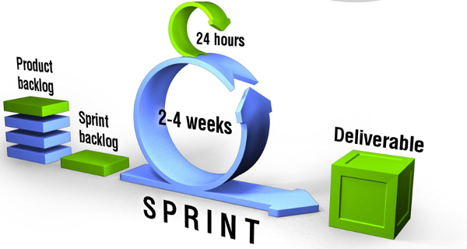
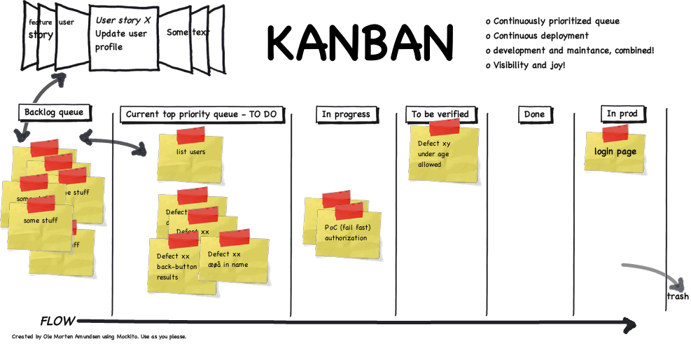
Methodologies
DEVELOPMENT
SCRUM BASED
We are Agile!
Development iterations organized in SPRINTS
Required features represented in BACKLOG items
WORK-ITEMS produced after each iteration
TODO, IN PROGRESS, QUALITY CONTROL and DONE are the tasks / issue available statuses
SUPPORT
KANBAN
BASED
Representation of pending issues in a easy-to-check board perspective;
Each issue has a card assigned;
Each card navigates across multiple swimlanes, representing the current status;
Each card also contain information about how long they are present in the board;
Multiple levels of priority are available for each issue;
Issue solving is not confined to sprint duration (vs SCRUM);
Set in place since the very beginning of OpenNCP!

Slide 5
Used Tools
Development and Support Management
Knowledge Sharing
Code Management
Continuous Integration
Atlassian supports actively OPEN-SOURCE initiatives by providing free-of-charge tools at on-demand platform;
All the stored information is OPEN for everyone to access;
We are now migrating code repositories from Google Code to Bitbucket;
OpenNCP also uses Jenkins for Continuous Integration and delivery;

Slide 6
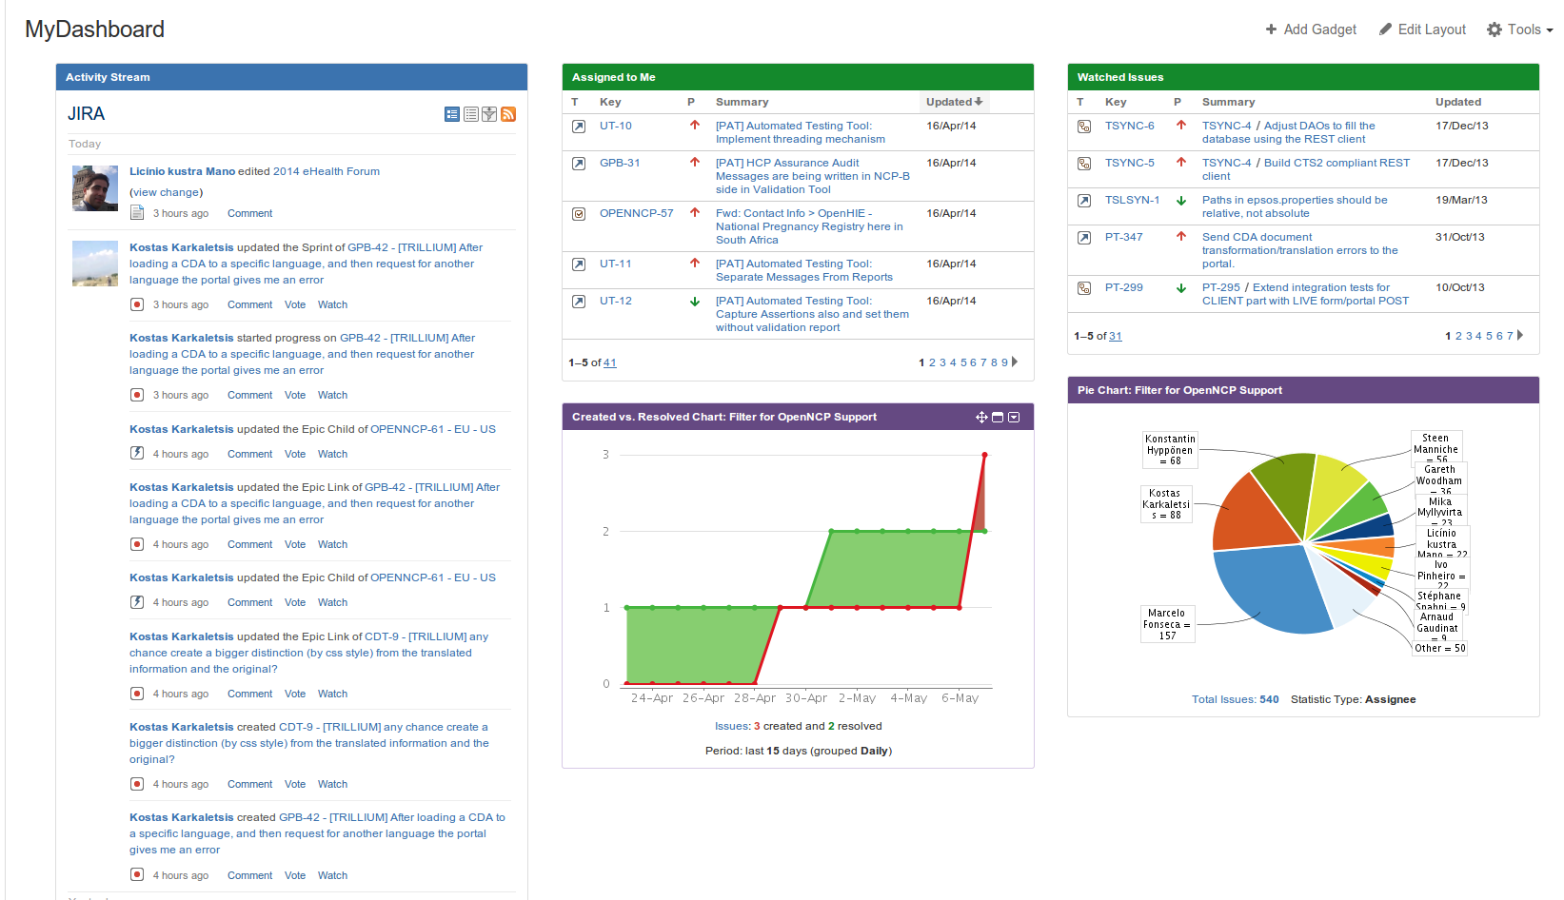
Development Management
Landing Page
Assigned issues
Graphical statistics
Updates stream
JIRA customized landing page with useful information about projects and development progress;
The OpenNCP contributor can easily check the assigned issues and the latest updates;

Slide 7
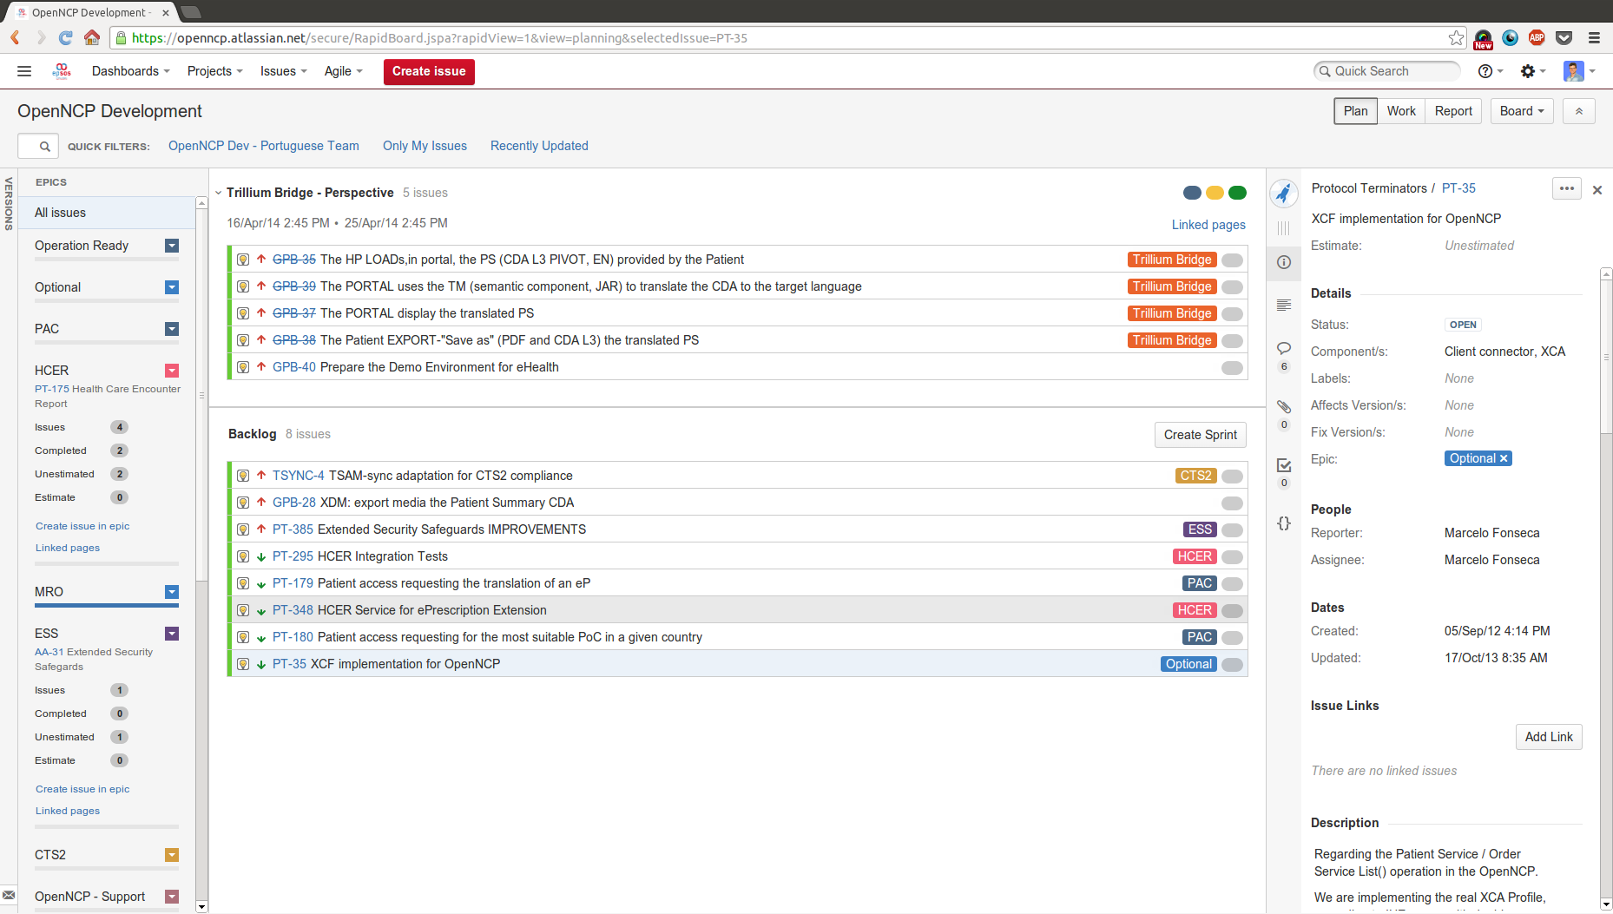
Planning Development
Development Board I
Sprints planning
Grouping by epics
Labeling makes easy to understand
This is how we plan the development work
Product owners, scrum masters and developers plan the development sprints, including ahead ones;
Grouping by epics makes it easier to focus on goals;

Slide 8
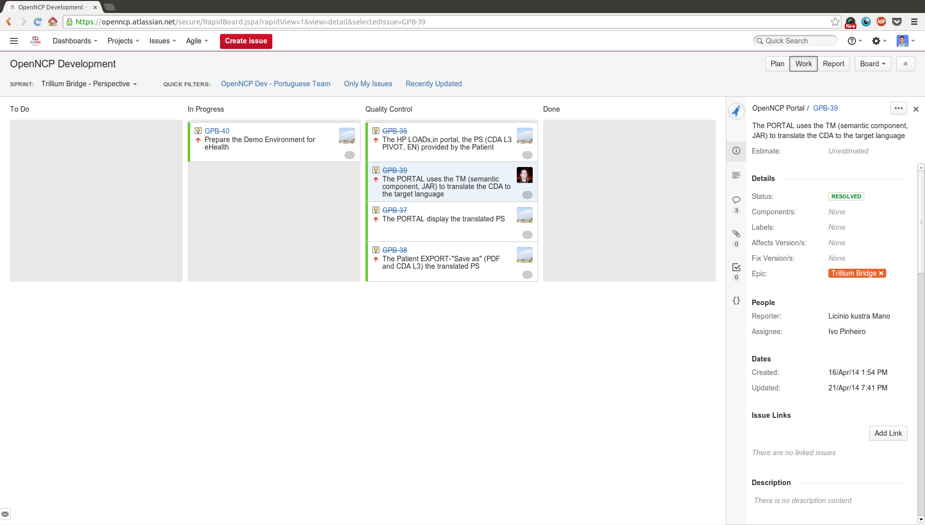
Tracking Development
Development Board II
Status swimlanes
Quick filters
...and how we track the performed work
Resumed task information
Scrum board, where developers can check their assigned tasks;
Configured Quick filters makes it easier to focus on targets;
This board handles only one sprint at the time;

Slide 9
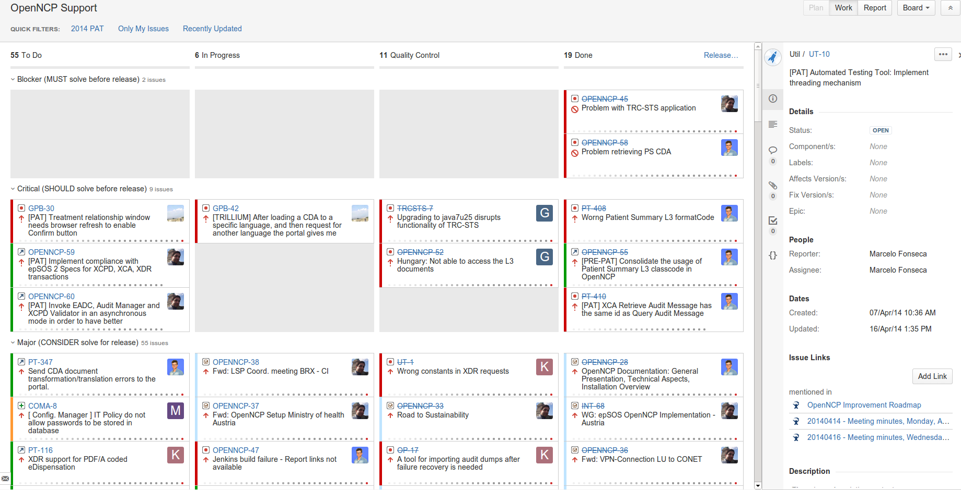
Tracking Support
Support Board
Status swimlanes
Indication about issue time
Priority grouping
JIRA Kanban view of support incidences;
The developers and reporters are able to track the progress of the issues;
The issues stay on the board until they are solved;

Slide 10
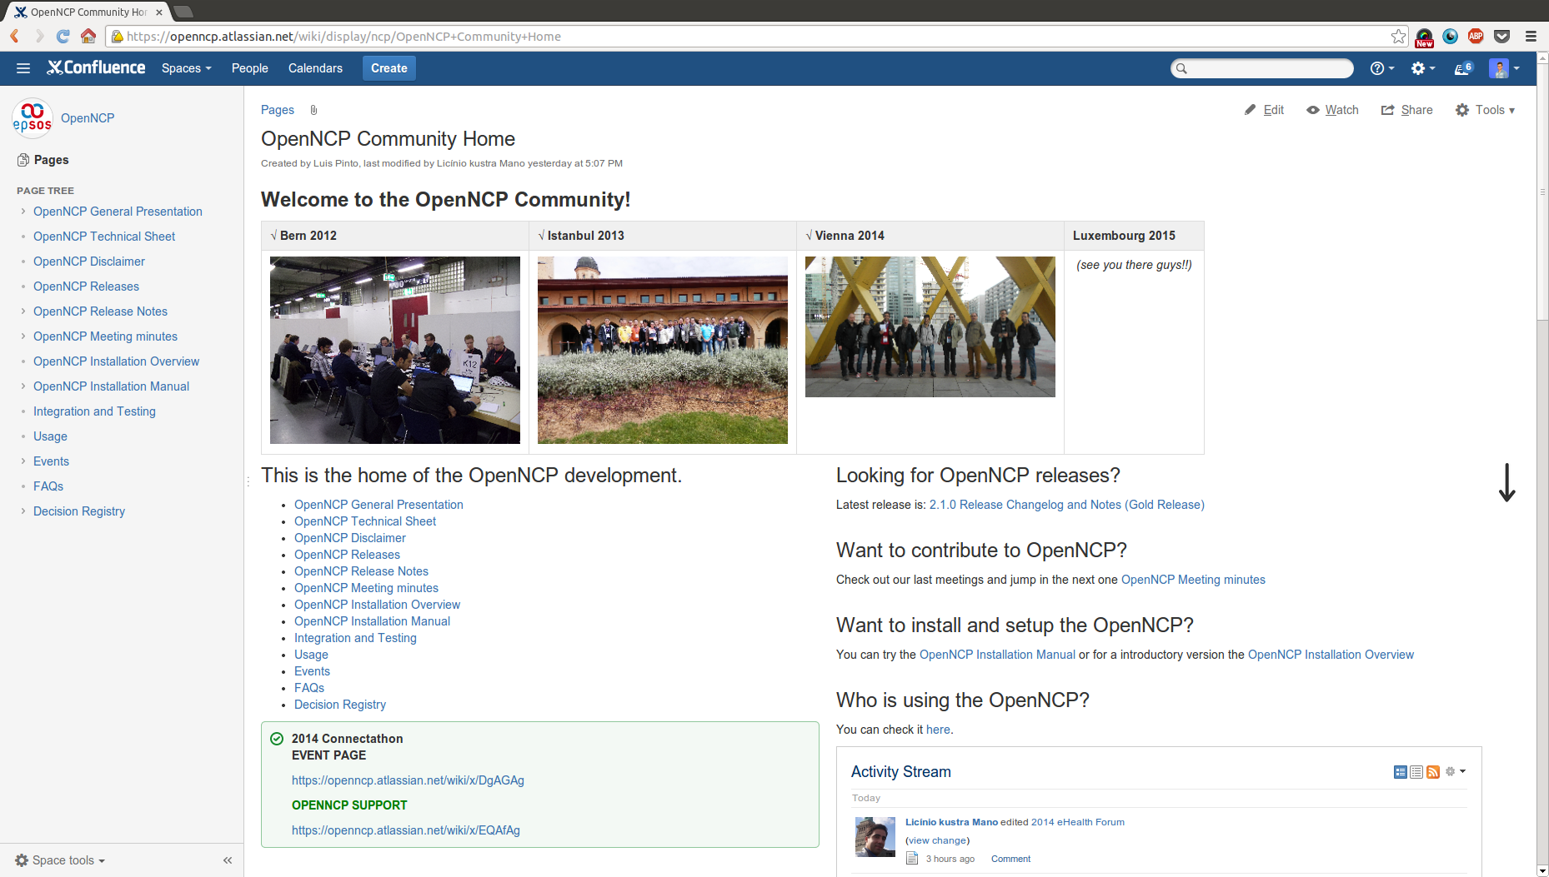
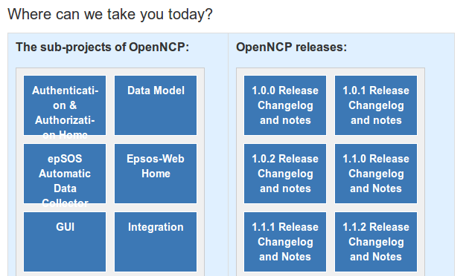
Knowledge Sharing
Landing Page
Past events
Quick access to relevant topics
Activity Stream
Quick access to releases and component specifications
Landing page of Knowledge Sharing platform;
Tries to concentrate different kinds of pointers to information stored on sub-pages;
Entry point for OpenNCP Documentation;

Slide 11
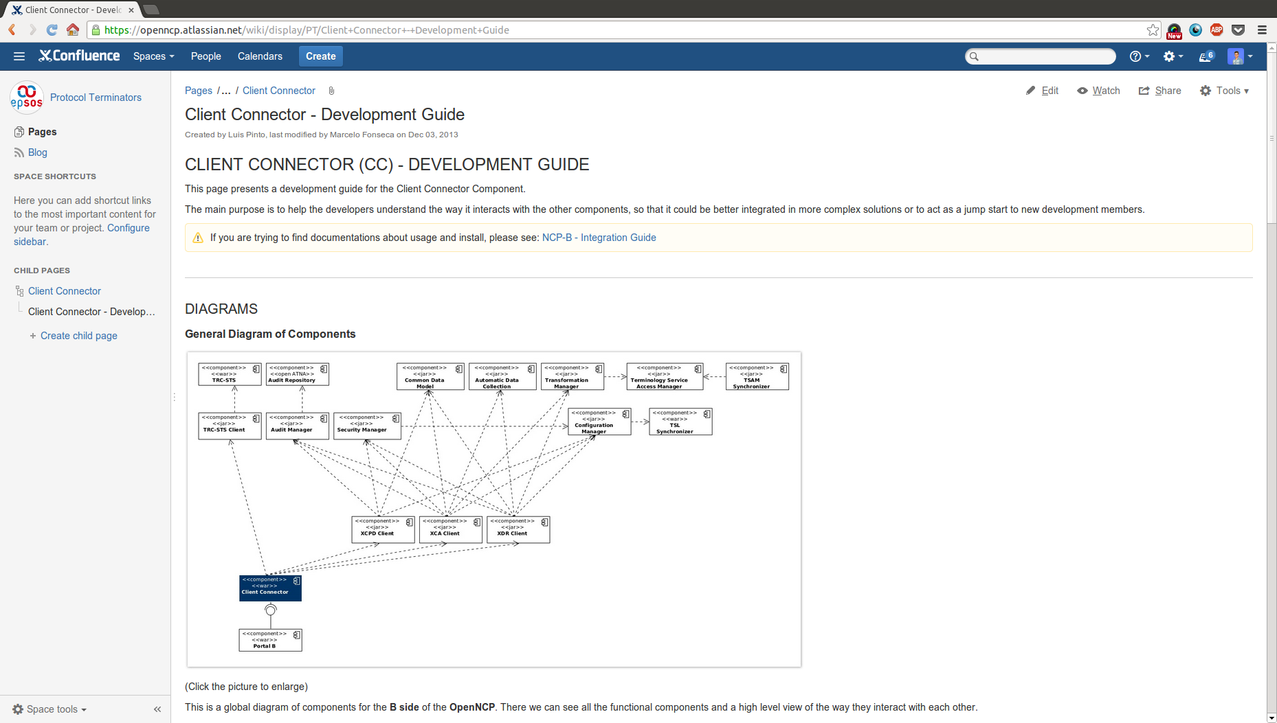
Knowledge Sharing
Specification Page
Diagrams
Code Snippets
Usage information
Specification pages contain details about the implementation of the components;
Provide information on how to integrate and use the components;
Keep track of the component versions;

Slide 12
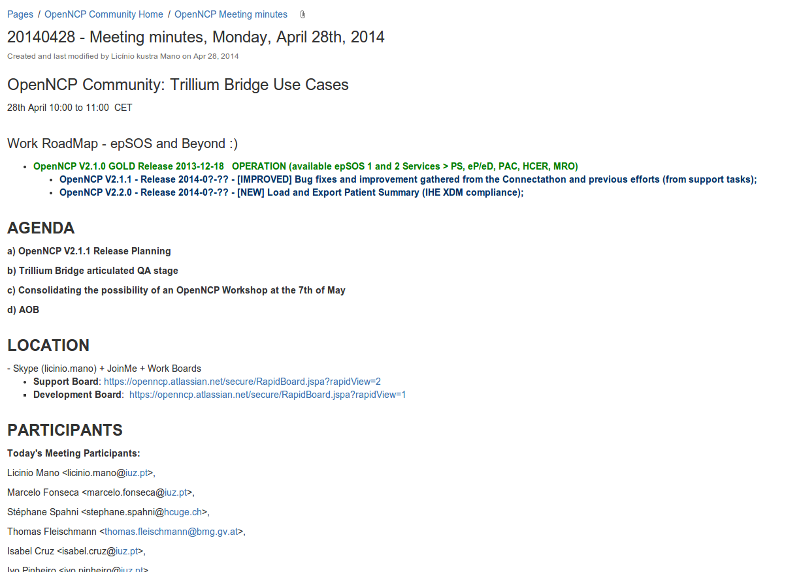
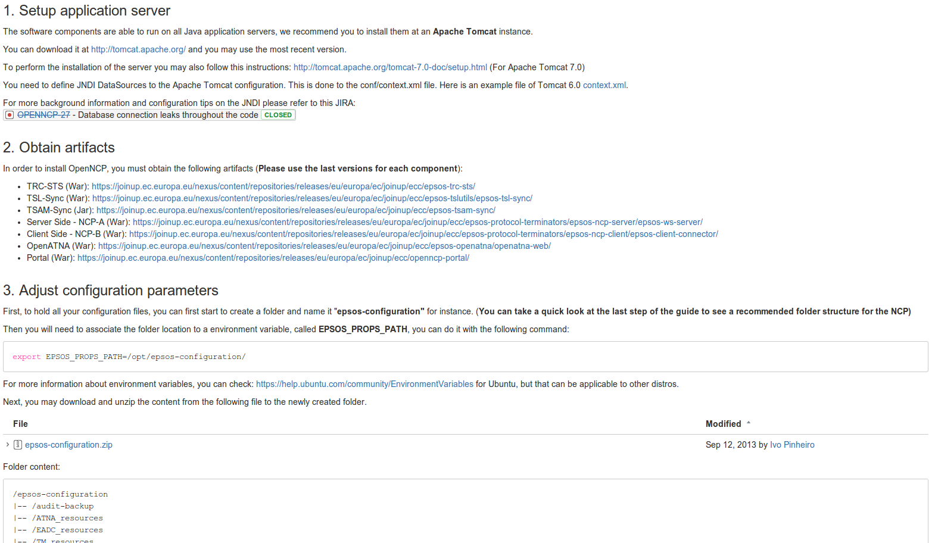
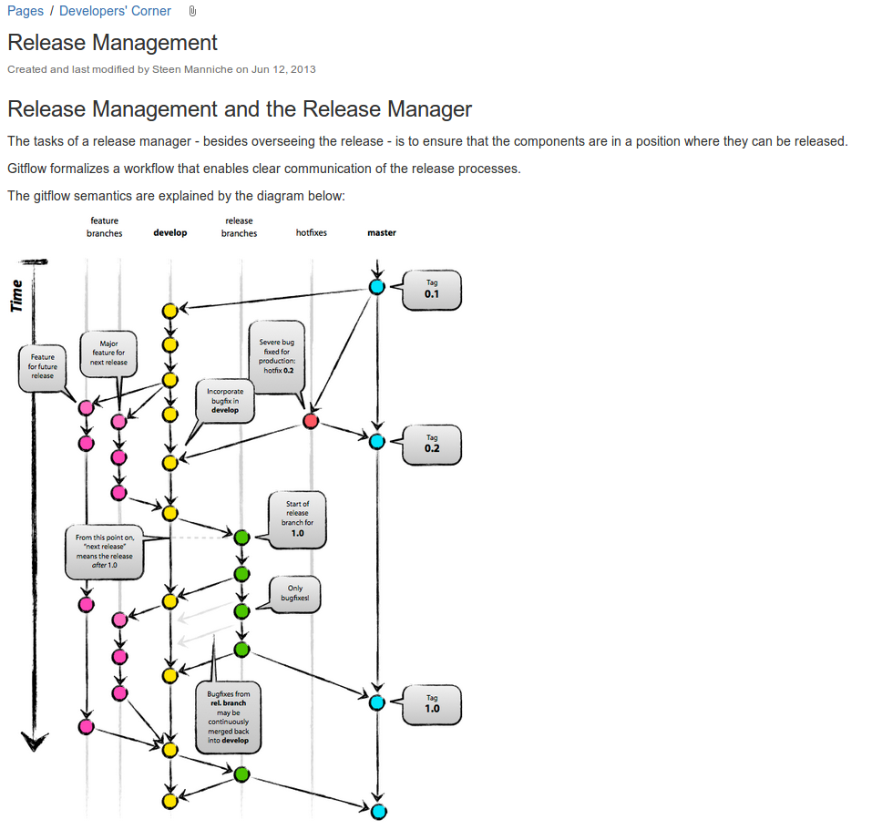
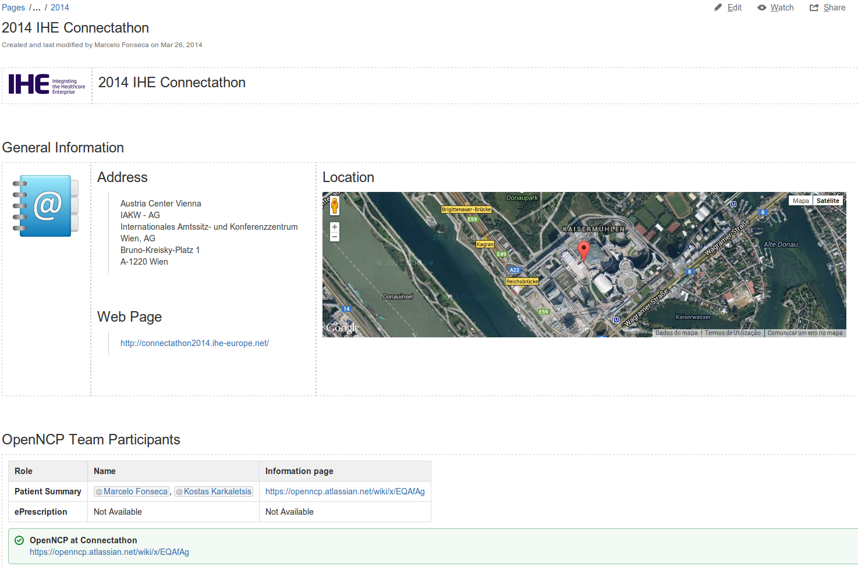
Knowledge Sharing
Meeting Minutes
Installation Manuals
Development Topics
Event Pages
Please jump in and explore it!

Slide 13
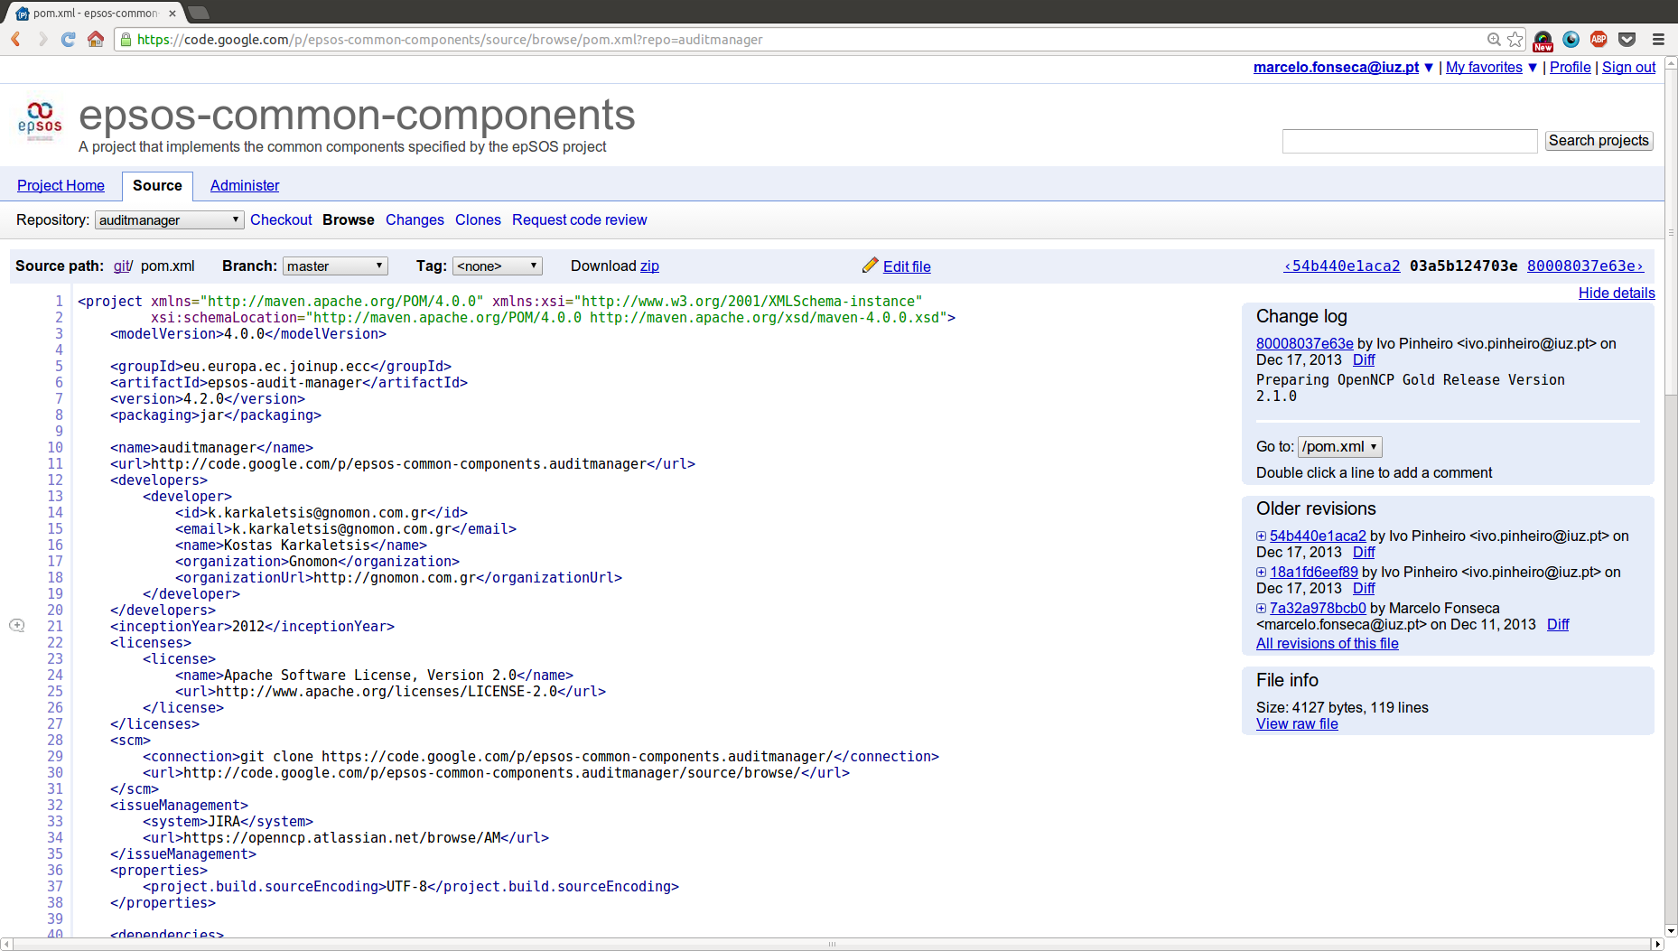
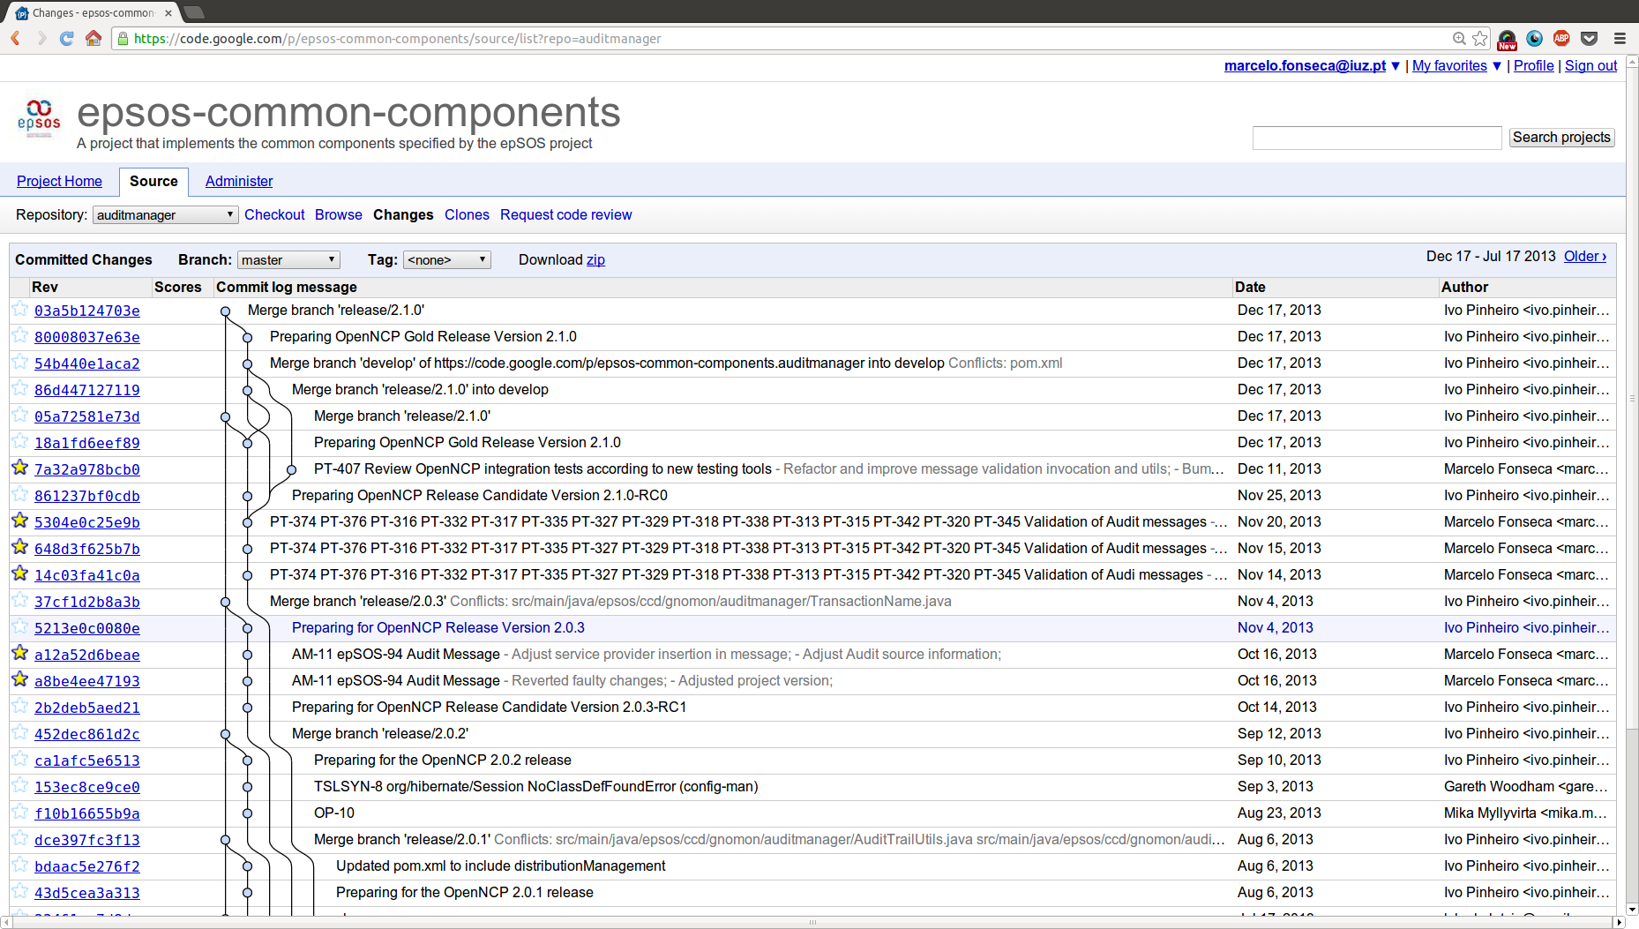
Code Management
Git repositories
Commit history
First selected code hosting solution was Google Code, as it was free and open;
It fulfills all the requirements needed until this moment;
Additional requirements in the present pushed the migration to a more capable platform;

Slide 14
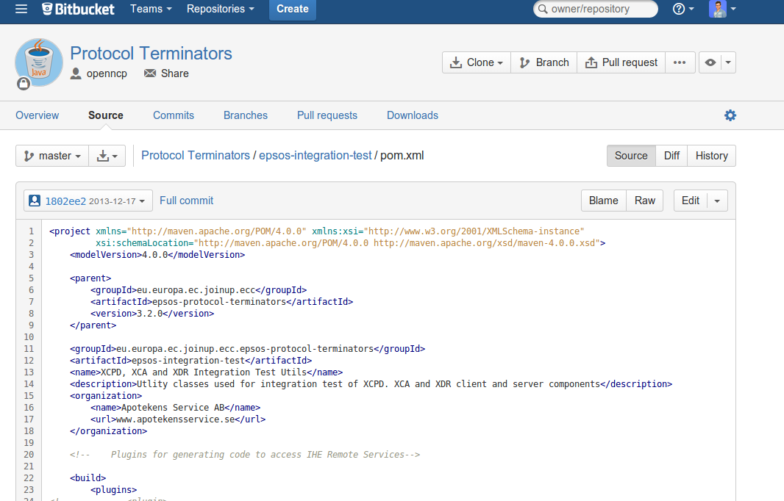
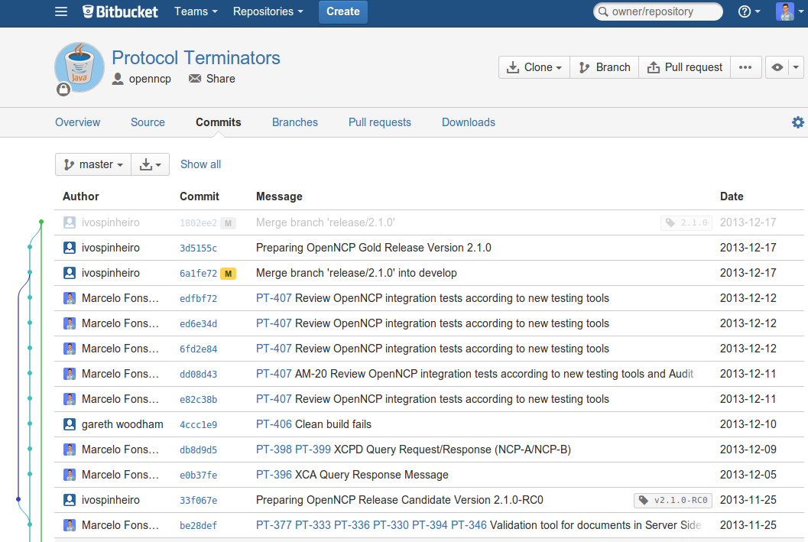
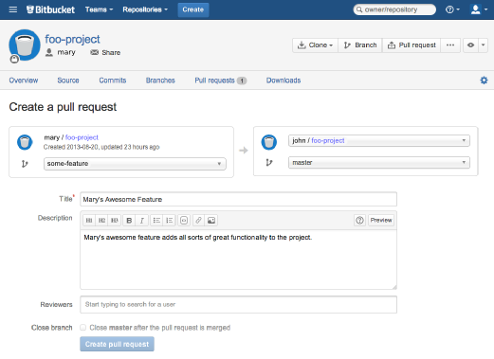
Code Management
Git repositories
Commit history
Code Reviewing
The Bitbucket solution provides all the previous functionality;
It also allows code reviewing mechanisms, with pull requests;
All the JIRA and Confluence users are also integrated, and other information as well;

Slide 15
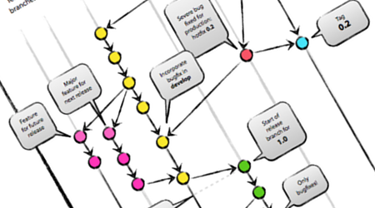
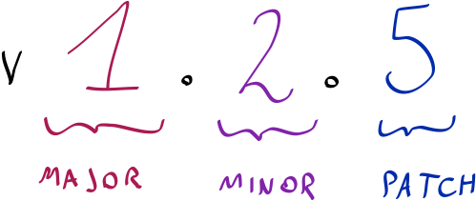
Coding Culture
GIT FLOW Model is used for branching, versioning and development management
Semantic Versioning is used as version scheme
We always try to document our work, by relating the tasks with the performed work. And that includes additional explanations, if necessary.
Notes:
Maven – main reasons: ease of code distribution, ease of inter-component version management and ease of build, test and release/publication processes.
Git - facilitate the distributed and non-sequential nature of development, ensure that all contributions would have equal footing in the repository, the de-centralized and distributed version control system git
Semantic Versioning has a well-defined set of rules describing which types of code changes warrants which types of version number changes.
Cont. Int server furthermore ensure the publication of development snapshots, such that new developers are always able to work on the newest versions of the code.

Slide 16
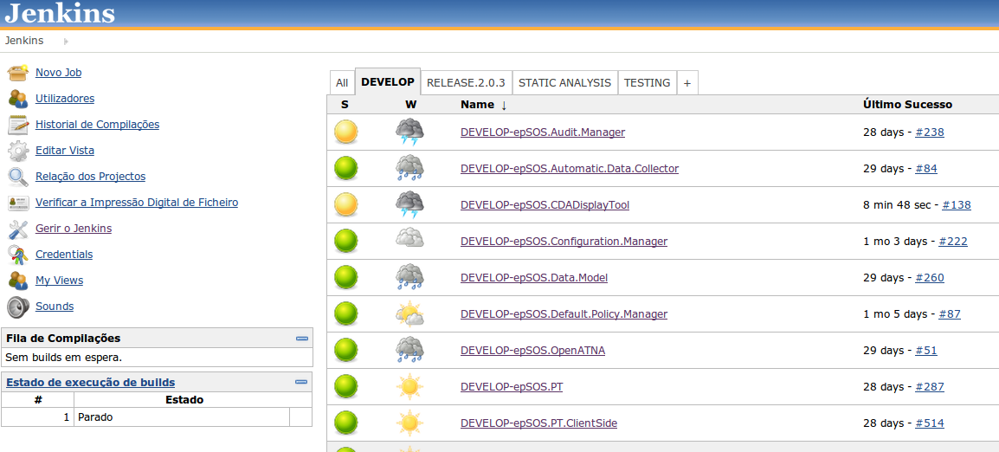
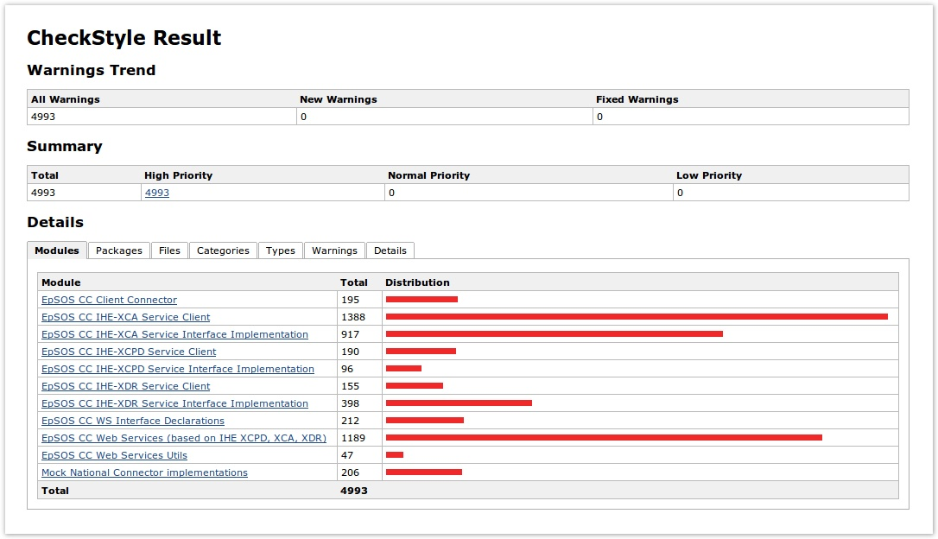
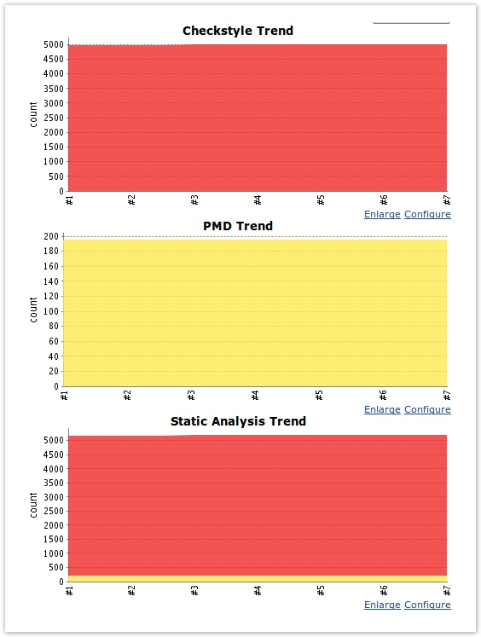
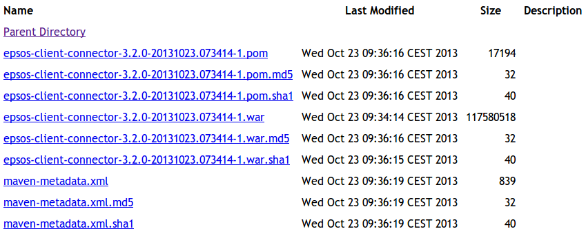
Quality Assurance
Continuous Integration
Continuous Delivery
List of Jobs
w/ execution information
Code Quality
Integration Testing
Continuous Delivery

Slide 17
Tools
Publishing Framework
Collaborative platform created by the European Commission
Support open source development work done by government agencies in Europe
Tool | JoinUp
Location | https://joinup.ec.europa.eu/software/ecc/home

Slide 18
Other Used Technologies
Programming Language
Web-Service Framework
Build Framework
Versioning Scheme
Licensing Scheme
Notes:
Maven – main reasons: ease of code distribution, ease of inter-component version management and ease of build, test and release/publication processes.
Git - facilitate the distributed and non-sequential nature of development, ensure that all contributions would have equal footing in the repository, the de-centralized and distributed version control system git
Semantic Versioning has a well-defined set of rules describing which types of code changes warrants which types of version number changes.
Cont. Int server furthermore ensure the publication of development snapshots, such that new developers are always able to work on the newest versions of the code.

Slide 19
epSOS Industry Team and OpenNCP Community Workshop
Integration and Testing Arrangements

Slide 20
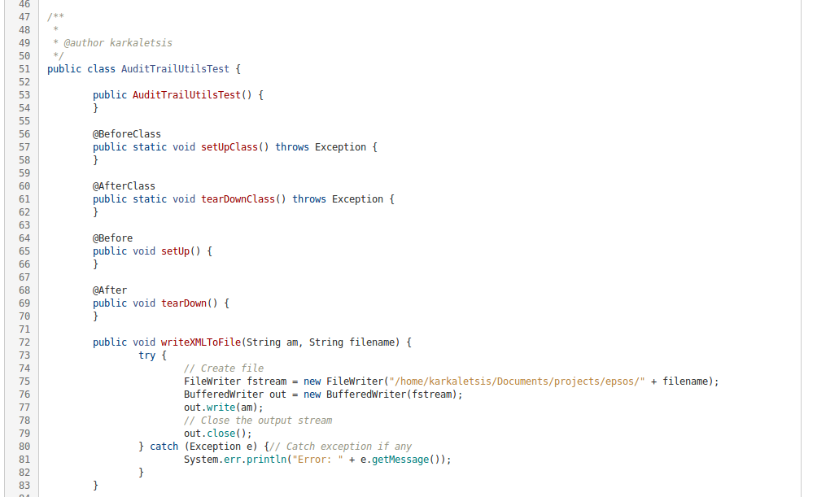
Integration and Testing
Quality Assurance: Unit Tests
Unit Testing is also used in several components in the OpenNCP (e.g. Audit Manager, Transformation Manager);
The unit tests coverage is expected to increase, as new developments are performed and the usage of OpenNCP components is more widespread;
Test Definitionat Knowledge Base

Slide 21
Integration and Testing
Code Repository
Pull/Push Source-code
Pull
Source-code
Contribution
Local development Environment
Continuous Integration Environment
Integration Testing
Environment
Pull dependency binaries
Pull dependency binaries
Adoption
Artifacts
Repository
Push dependency binaries
Continuous Integration Actors and Relations

Slide 22
Integration and Testing
Test Classes
Artifact To Test
Mocked Information
NCP-A
Test Client
(Simulates NCP-B)
NCP-A
Mocked National Connector
Clients simulate both Portal and NCP-A, with hard-coded messages, according to each test.
Mocked information is used to perform the tests.
NCP-B
Test Client
(Simulates Portal)
NCP-B
All this orchestration is made possible with:
NCP-B Artifact is tested using the previously produced NCP-A Artifact.
Integration Testing Scheme

Slide 23
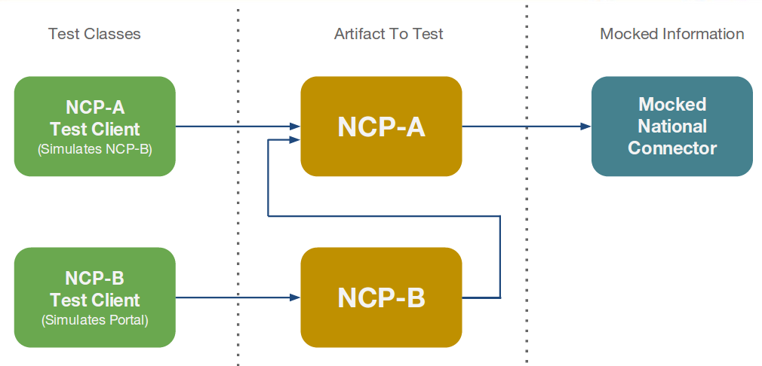
Integration and Testing
Assertions
HL7v3
IHE Remote Validation Services are used during integration testing, within Jenkins pipelines.
Audit Messages
XD*
Assertions
Assertions
OpenNCP Integration Testing
CDA
PDF
Remote Validation Service Invocation
IHE Validation Services
This is the output we see on our CI environment
This features can also be used by PNs, on their national environments.
Integration Testing: IHE Remote Validation Services

Slide 24
epSOS Industry Team and OpenNCP Community Workshop
Thank you for your attention!
marcelo.fonseca@iuz.pt

