Slide 2
epSOS reference terminology
Athens 14th of May

Slide 3
epSOS Semantic Interoperability paradigm –
Jacob Boye Hansen
The epSOS large scale pilot has yielded a viable infrastructure on both organizational, legal, technical as well as the semantic level. The latter aspect proves to be one of the most challenging in this project - how to enable health professionals to provide care to foreign patients by overcoming the language barrier? To make sure each nation participating in this project can take ownership of the translation and transcoding of medical coding systems, epSOS has provided an ingenious and creative solution. In his presentation, Jacob Boye Hansen will bring you up to speed with just how epSOS created an intermediate 'language', how to do translation and transcoding and how to keep the ever evolving coding systems in sync. After this session you will have a good understanding of how epSOS has facilitated true semantic interoperability between all European member states.

Slide 4
Semantic Transformation: Syntax

Slide 5
Semantic Transformation: Terminology

Slide 6
Translation / Transcoding

Slide 7
Master ValueSet Catalogue –
Master Translation/Transcoding Catalogue
MVC
MTC - Translation
Display-EN
Code
Display-FR
Display-AT
Display-IT
Display-FR-Code
Display-FR-Code
Display-FR-Code
Code-FR
Code-FR
Code-FR
Display-AT-Code
Code-AT
MTC –
Transcoding
MAIN-Code
MTC –
Transcoding
MTC –
Transcoding
MAIN-Code
MAIN-Code
MAIN-Code

Slide 8
Redundant Coded Data Elements for Safety
Country A
document
Pivot Document
In Country A
Pivot Document
In Country B
Country B
Document
C-A Code
C-A Code
C-A Code
?
?
?
?
?
C-A Display name
C-A Display name
C-A Display name
@
epSOS Code
epSOS Code
epSOS English
Display name
epSOS English
Display name
C-B Code
@
epSOS C-B lang.
Display name
C-B Display name
MVC+
MTC-
Transc.
MTC-
Translat.
MTC-
Transc.

Slide 10
epSOS MVC: 8873 codes
Medical Devices Implants: Snomec CT (223 codes)
Nullflavor: HL7 (12 codes)
Package: EDQM (75 codes)
ParticipationTypePatientContact: HL7 (3 codes)
PersonalRelationshipRoleType: HL7 (34 codes)
PregnancyInformation: LOINC (3 codes)
Procedures: Snomed CT (62 codes)
ReactionAllergy : Snomed CT (8 codes)
RoutesofAdministration: EDQM (69 codes)
Sections. LOINC – IHE template (17)
Severity: Snomed CT (from 3 to 8 codes)
StatusCode: Snomed CT (4 codes)
TelecommunicationAddressUse: HL7 (8 codes)
Units: UCUM (27 codes)
unknownInformation: Snomed CT (7 codes)
URL: HL7 (10 codes)
Vaccination: Snomed CT (16 codes)

Slide 11
Specification of epSOS Central Reference Terminology Server
Specs provided by WG Semantic to formalise requirements on eCRTS
1 Introduction
2 Requirements
    2.1 Creation of the national translations / transcodings
    2.2 Creation of the epSOS MTC
    2.3 Creation of the epSOS Ontology
    2.4 Maintenance of the MVC
    2.5 Maintenance of the MTC
    2.6 Maintenance of the epSOS Ontology
    2.7 Synchronization using Terminology Service Access Manager
3 General description of the actors/roles using the epSOS Central Reference Terminology Server
    3.1 The epSOS Central Reference Terminology Server Actors & Roles
    3.2 epSOS Terminology Value Set Developer
    3.3 epSOS Terminology Mapper
    3.4 epSOS Terminology Translator
4 epSOS Central Reference Terminology Server
    4.1 User administration
    4.2 Browsing
    4.3 Value set creation and maintenance
    4.4 Translation
    4.5 Transcoding /mapping
    4.6 Request handling
    4.7 Export/distribution
    4.8 Structure and security requirements of Central Services

Slide 12
epSOS reference terminology repository
Need to include the following processes:
  Create MVC (value sets)
    With version control
    With user rights control
  MS translation to local language
  MS transcoding/mapping from local classifications to epSOS value sets (MTC)
  Compile MTC for distribution to all MS
  Create epSOS ontology

Slide 13
Maintenance of epSOS reference terminology
  Maintenance of MVC
    Need for updates of value sets when codes are missing or classifications are updated
  Maintenance of MTC
    Need for updates when the MVC changes, and to re-translate incorrect translations
  Maintanance of mappings/transcodings
    When MVC changes or local classification changes, or when incorrect mappings needs correction.
  epSOS Ontology
    When MVC changes or classifications change

Slide 14
Why is ECRTS needed?
Quality, Quality and Quality
If the translations and transcodings are not done right, potential safety risks are introduced
The quality can only be upheld if you have the right resources and the right tools to establish an overview (e.g.)
  Common view on classifications/terminologies (browser)
  See all similar translations during the process of translation
  Full history of translation/transcoding incl. communication
The cost of NOT having control on versions and process can be very high
  Want to follow international terminology standards translation/transcoding, to ensure the best possible translation/transcoding

Slide 15
Why a central solution
To have a common view on the MVC and the classifications
To have an easy synchronization of MVC and MTC
To have all participants at the same level
To have a common standard that applies to all
To share translations when languages are closely related
  E.g. Denmark and Sweden are sharing their SNOMED CT® translations
To share transcoding projects
  If two or more MSs need to make the same local transcoding, they can split the task between them
To have a common reference on all versions of all components

Slide 16
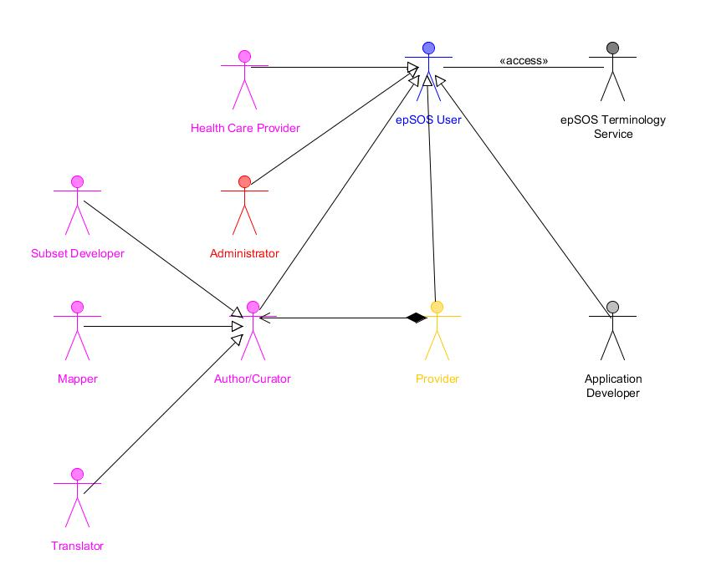
The epSOS terminology actors
All actors need to work together:
- To be up-to-date with the most recent version of the value sets for integration into local systems
To have translated latest versions of the value sets
To have mapped the latest versions of the value sets to local code system
To have a commen view of the epSOS classifications
To have a commen view of the epSOS value sets

Slide 17
The epSOS Central Reference Terminology Server (ECRTS)
Central Group:
Security setup
Creation and maintenance of value sets
Maintenance of classifications
Education and guidance of best practice in translation and transcoding/mapping
Administration of requests for changes to the MTC
Creation and maintenance of the ontology
Central web-based tool
MS:
Browser of all code systems
Translation of value sets to national language
Transcoding from national coding system to epSOS value sets
MS:
Distribution of MTC to national NCP´s
Web-services or FTP site for download of newest version of MVC, MTC, browse classifications

Slide 18
The MS tasks
To translate MVC into local language and transcode from local classifications
Total number of concepts (MVC) to translate is 8873
An average MS has already translated approx. 82%
  As the MS is using the same classification as epSOS have chosen
  Therefore they can choose to import only for quality review
The transcoding task can be difficult and will need resources with knowledge on both source and target classification
  Therefore the central semantic group needs to support the MS
Depending on the MS local classifications - some transcodings can be done automatically and imported for quality review
HealthTerm is in line with epSOS Terminology Service requirements

Slide 19
What is HealthTerm about?
HealthTerm terminology & classification server
Request & Editing
Subset
Translation
Qualification
Concept Browser
Mapping
Distribution
One repository for all terminologies and classifications. A one-stop online web based service
100% Web application with:
  Concept Browser
  Request & Editing module
  Mapping module
  Subset module
  Qualification module
  Translation module
  Distribution module
  Workflow mechanism
  History mechanism
100% multilingual:
  Currently in Danish, Swedish, English, French

Slide 20
What does HealthTerm cover?
One application to handle all aspects of classifications and terminologies
  Browse and search all kinds of classifications/terminologies in the same environment
  Subset module to build and maintain value sets
  Translation module to translate from original language to local language
  Mapping module to map between classifications/terminologies
  Web-services to access the terminologies/classifications/maps/translations etc.
  Maintain existing and creating new concepts (in extensions of classifications/terminologies)
100 % multilingual application
  Currently in Danish, Swedish, English, French
100 % web application
Notes:
14/05/14
20

Slide 21
Where can HealthTerm help?
On the creation and maintenance of:
  Value Sets
  Translations
  Mappings/Transcodings
  Concepts
As an online terminology service (web-services)
  Lookup for a mapping
  Lookup for a translation
  Check value sets for specific members
  Search classifications/terminologies
Create and maintain a high quality of the results of translations/transcodings through a strict workflow based control of each individual step in the processes

Slide 22
Close the gaps between your
business and semantics!

