Slide 2
epSOS: Smart Open Services for European Patients
epSOS overview, architecture and organization
Miroslav Koncar – Oracle

Slide 3
Miroslav Koncar – Oracle
Introduction
Business Development Director,
Healthcare and Education, Oracle
HL7 Croatia Chair
Honorary Assistant Professor, Medical Informatics
Involved in epSOS as the member of industry team, representing Oracle

Slide 4
epSOS The European eHealth Project
OVERVIEW

Slide 5
The epSOS overarching goal
epSOS aims to design, build and evaluate
a service infrastructure that demonstrates
cross-border interoperability
between electronic health record systems in Europe
Notes:
The epSOS overarching goal is to develop a practical eHealth framework and an Information and Communication Technology (ICT) environment as a service infrastructure that will demonstrate the ability to securely access patient health information on different European healthcare systems. The two main use cases are the basic patient summary and the ePrescription.

Slide 6
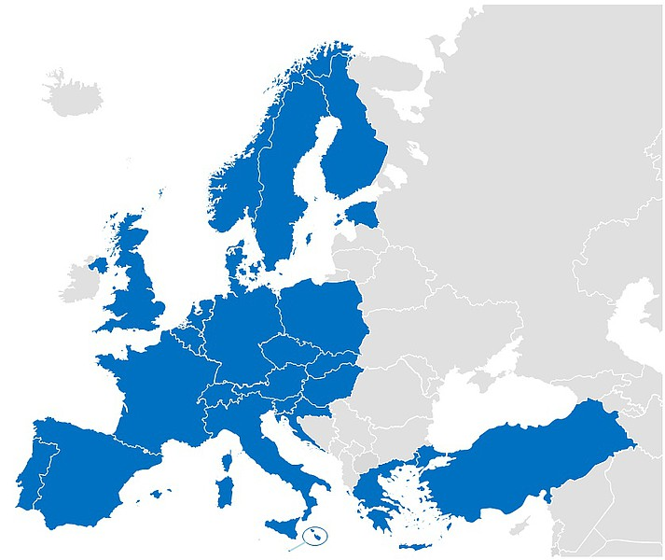
epSOS in one slide
Abbreviation: Smart Open Services for European Patients
Goal: supporting patient mobility in the EU, using IT solutions
Means: implementing cross-border interoperability
Involved: 21 of the 27 member states, plus 3
Austria, Croatia, Czech Republic, Denmark, Estonia, Finland, France, Germany, Greece, Hungary, Italy, Luxembourg, Malta, the Netherlands, Poland, Portugal, Slovenia, Slovakia, Spain, Sweden, United Kingdom
Norway, Switzerland and Turkey
Methods: develop, build and test an infrastructure
Exchange: (1) patient summary (2) prescription data
Prerequisites:
epSOS doesn’t change national regulations or eHealth infra
epSOS will not require a centrally managed infrastructure
Running from July 2008 up until June 2014
Notes:
The abbreviation stands for Smart Open Services for European Patients
Goal of the project is to support patient mobility across the EU using IT solutions, in accordance with Directive 2011/24/EU of the European Parliament and of the Council dated 9 March 2011 regarding the application of patients’ rights in cross-border healthcare
The means to achieve this goal is by implementing cross-border interoperability
Involved in this project are 21 of the 27 EU member states, plus three nations that formally are not member of the EU

Slide 7
Why epSOS?
eHealth as an enabler for cross-border health care
answering to Directive 2011/24/EU of the European Parliament and of the Council dated 9 March 2011 regarding the application of patients’ rights in cross-border healthcare
Improve the quality and safety of healthcare for citizens
reduce the frequency of medical errors in cross-border health care
provide quick access to patient medical record from another country
provide access to prescriptions from home when abroad
Develop a practical eHealth framework and ICT infrastructure
enabling secure access to patient health information
make different European healthcare systems interoperable
cross the language barrier
Notes:
So what purpose does epSOS server?

Slide 8
epSOS The European eHealth Project
ARCHITECTURE

Slide 9
The epSOS overarching goal
epSOS aims to design, build and evaluate
a service infrastructure that demonstrates
cross-border interoperability
between electronic health record systems in Europe

Slide 10
epSOS Design Prerequisites
epSOS shall not
require participating nations to …
… change their eHealth laws and legislation
… change their technical national eHealth set-up
require a central infrastructure needing maintenance
a big server in Brussels
a large central data repository
Notes:
The two main design prerequisites are

Slide 11
epSOS Building Prerequisite
epSOS shall
design centrally
implement locally

Slide 12
epSOS Evaluation Set-Up
epSOS will
Do a baseline evaluation of current processes
Do continuous evaluation to monitor progress
Do an end evaluation to prove effectiveness

Slide 13
epSOS envisioned end results
Citizens and patients
Receive health care abroad (almost) seamlessly
Receive medication in a foreign country on existing prescription
Health care providers
Get quick and easy access to key patient data
Improve health care cooperation across borders
Health care quality
Reduce medication errors by exchanging data
Facilitate the occasional care of foreign patients

Slide 14
The epSOS overarching goal
epSOS aims to design, build and evaluate
a service infrastructure that demonstrates
cross-border interoperability
between electronic health record systems in Europe

Slide 15
Cross-Border eHealth Service Infrastructure ...
Picking the low-hanging fruit: two initial use cases
Patient summary
Demographic data
Brief medical history, current conditions, allergies
Medication history
ePrescription
Electronic prescribing of medication
Prescription filling

Slide 16
... between (existing) EU eHealth systems
A European Circle of Trust with National Contact Points
Centrally designed service infrastructure for exchange
Technical circle of trust
Legal circle of trust
National contact points (NCP)
Adapt national (technical) infrastructure
Enforce security, privacy
Legal entity as ‘end point’ or ‘entry point’ for epSOS

Slide 17
epSOS Circle of Trust
Legal as well as technical
Network of interconnected NCP’s
(national contact points)
NCP’s with trusted relationships
Technical
which systems can connect
security policies, logging
Legal
what data to exchange
who exchanges using what
legal framework agreement
Notes:
Note: security is mentioned in the extra slides.

Slide 18
Oh, yeah, right. Languages!
There are 23 official languages in the EU (and counting)

Slide 19
epSOS and semantic transcoding
Country A
coding format
epSOS
pivot format
Country B
coding format
Jacob Hansen will cover this in more detail
Notes:
Concept of the pivot language, serving the liability of the translation. Each nation is responsible for the correct translation and transcoding to and from the intermediate code set.

Slide 20
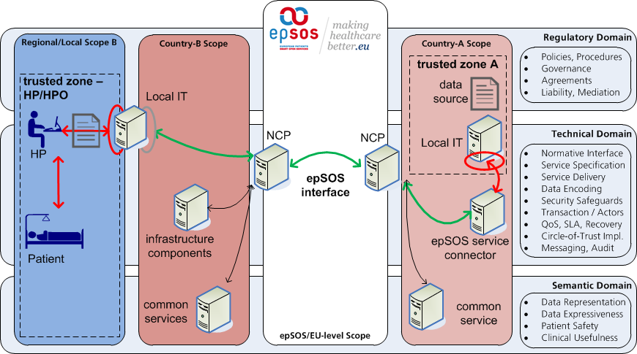
The resulting architecture of epSOS
Licinio, Konstantin and Marcelo cover this

Slide 21
epSOS The European eHealth Project
ORGANISATION

Slide 22
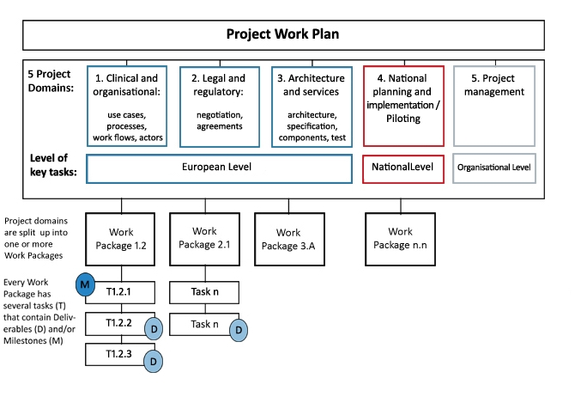
Project Structure
Notes:
The project is been divided in 5 project domains, each with a number of work packages.
WP1 was concerned with drawing use cases, workflows etc. and determining eHealth status In each of the member states
WP2 was concerned with the legal and regulatory aspects of cross-border communication of patient information
WP3 was the architectural design and specification, a very technical work package
WP4 was the piloting of this design spec in the member states
WP5 generic project overhead (coordination, technical and administrative project management)

Slide 23
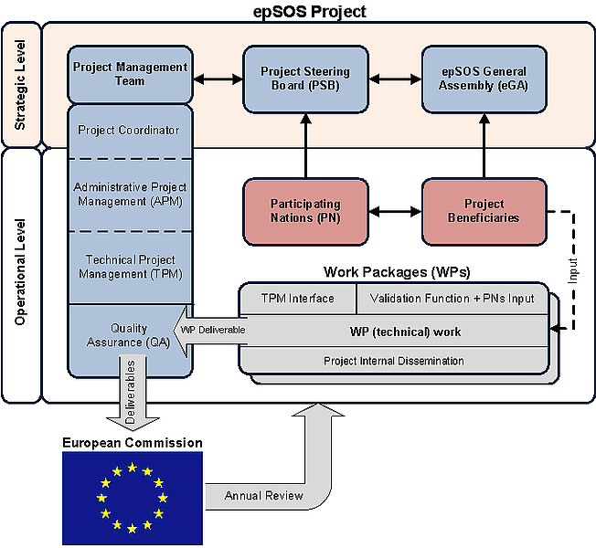
Project Organisation
Notes:
Participating nations were represented in the Project Steering Board (PSB)
Each country has several eHealth competence centers as beneficiaries to the project, who were represented at the General Assembly

Slide 24
Project Organisation
epSOS
Industry Team

Slide 25
Industry Team cooperation in epSOS (1/2)
The epSOS Industry Team (coordinated by IHE Europe)
Approx. 30 companies, organized in a consortium
Both SME’s as well as multinationals
Elected Steering Group of 7 representatives
Most active industry team members
Companies provide pro bono effort in work packages
ROI: knowledge, network, business opportunities
Industry Team influences at the steering level
Help drive European eHealth in the ‘right’ direction

Slide 26
Industry Team cooperation in epSOS (2/2)
Reasons for having an industry team on board
Provide market view (design and specification phase)
Re-use best practises, existing standards, profiles
Access to off-the-shelf solutions (implementation phase)
Short time-to-market, connect to existing architectures
Support and maintenance (operational phase)
Latch on to already established services
Have experienced consultancy on OSS

Slide 27
(Some of) The Lessons Learned
Points of Discussion
Industry was far more involved in early stages of the project...?
Sustainability model – from project into market category?
How sizable is the epSOS market, and should it be regulated more then open market competition
Open source ≠ open standards ≠ free of charge
80% of the work estimated to be done on national level – how realistic is it to expect that you don’t change the national infrastructure?
Central governance body after the project will end

Slide 28
Thanks for your attention!
Questions?

Slide 29
epSOS The European eHealth Project
SPARE SLIDES

Slide 30
IHE and epSOS
mutual beneficial influencing

Slide 31
Goals of IHE involvement in epSOS
Involvement of IHE at European eHealth developments
Having IHE methodology adopted
both Industry and European eHealth organisations
Organize involvement/influence of industry in epSOS
Coordination of the Industry Team
Adoption of specific IHE profiles European eHealth
Having epSOS work incorporated in IHE-profiles

Slide 32
Influence of IHE in epSOS (1)
IHE and industry: influence epSOS technical design
“Both feet on the ground”: practical solutions
Many products and projects are IHE based
Report real-life implementations with IHE
IHE profiles have been chosen in favor of OMG standards
IHE XCA instead of OMG RLUS
IHE XCPD instead of OMG EIS
Incorporate epSOS work in IHE and HL7
IHE: extensions on e.g. PCC and XCA profiles

Slide 33
Influence of IHE in epSOS (2)
IHE Europe builds the test tools for epSOS
Eric Poiseau, Karima Bourquard + team
IHE Connectathon tools, adapted to epSOS where necessary
IHE Europe helps organizing the Projectathon
Projectathon = Project Connectathon
Bratislava (Slovakia), November 23-28, 2010
Pisa (Italy), April 11-15, 2011 alongside Connectathon
Bern (Switzerland), May 21-25, 2012 alongside Connectathon
Istanbul (Turkey), April 15-19, 2013 alongside Connectathon
Pre-pilot testing slots
On-line Projectathons, to speed up embarking process

Slide 34
epSOS profiles versus IHE profiles (1)
Definition | epSOS | IHE | Adapt
Establish mutual trust | Circle of Trust | ITI-19 | 1
Get Resource URL | Circle of Trust |  | 2
Maintain Time | Consistent Time | CT | 1
Get Resource URL | Loc/Retrv Shared Object |  | 2
Format Audit Trail | Audit Trail | ATNA | 2
Provide Identity Assertion | HCP Identity Assertion | XUA | 1
Query Medical Data | Medical Data Access | XCA | 1
Retrieve Medical Data | Medical Data Access | XCA | 1
Notify Medical Data Processing | Medical Data Access | XDR | 1
Attest Authenticity | Attest Authenticity | DSIG | 1

Slide 35
epSOS profiles versus IHE profiles (2)
Definition | epSOS | IHE | Adapt
Patient ID discovery | ID and Location Handshake | XCPD | 2
Patient Data Location Query | ID and Location Handshake | XCPD | 2
Provide Authorization Assertion | Authorization Assertion | BPPC + | 3
Request Authorization Assertion | Authorization Handshake | BPPC + | 3
CRL Retrieval | PKI Operational Protocols
Certificate Status Verification | PKI Operational Protocols
CDA Prescription Document | - | PCC | 2
CDA Dispensation Document | - | PCC | 2
CDA Patient Summary | - | PCC | 2
Terminology Access Service | -
PDF Original Documents | - | SD | ?

Slide 36
The epSOS overarching goal
epSOS aims to design, build and evaluate
a service infrastructure that demonstrates
secure cross-border interoperability
between electronic health record systems in Europe

Slide 37
epSOS security and privacy
Different security levels: no obstacle for EU data exchange
Art.1 §2 Data Protection Directive
To pursue: realistic acceptable security level
to be gradually enhanced
epSOS security policy, part of the Framework Agreement
allows for basic cross-border services
Mutually accepted appropriate security and privacy policies
protection of personal data
integrity and authorship of documents
access control and role mandate management
patient consent mechanism
Notes:
Different levels of security in national legislations must not impose an obstacle to EU exchange of data (Art.1 §2 Data Protection Directive)

Slide 38
Current status of epSOS
The good,…
Two reference implementations of NCP
NCP-in-a-Box: collection of software components
OpenNCP: open source NCP implementation
Currently piloting
Patient Summary: Austria, Estonia, France, Hungary, Italy, Luxembourg, Malta, Portugal, Slovenia, Spain, Switzerland
ePrescription: Croatia, Denmark, Hungary, Finland, Greece, Italy, Spain, Sweden

Slide 39
Current status of epSOS
…the bad and the ugly.
Use cases from epSOS phase 2 not implemented
Healthcare encounter report, medication related overview, patient access use case, emergency access
Very low number of actual encounters
Mitigation: virtual encounters

Slide 40
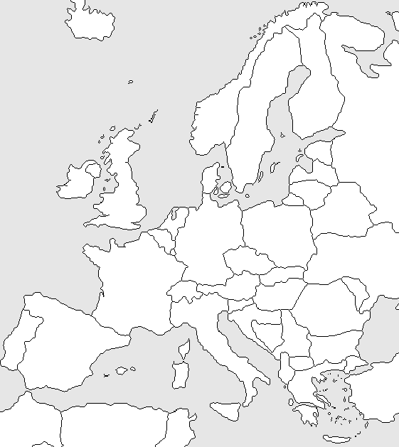
In Operation
PS-A + PS-B
PS-A
PS-B
(AT, ES, FR, IT)
(ES)
Starting in Q2 2013
(MT)
PS-A + PS-B
PS-A
(CH)
Starting in Q3 2013
PS-A + PS-B
PS-B
(EE, PT, SI)
(HU)

Slide 41
In Operation
eP-A
eP-B
(IT)
(GR)
Starting in Q2 2013
eP-A + eP-B
(DK)
Starting in Q3 2013
eP-A + eP-B
eP-B
(FI, SE)
(ES, HR, HU)

