Slide 1
OpenNCP General Presentation
123456

Slide 2
OpenNCP General Presentation
123456
“epSOS in short”
www.epsos.eu

Slide 3
Content I
123456
Page 3
Introduction to epSOS
  Intro to the project
  What is an NCP
History
  The development of the original common components
  NCP-in-the-box
  SRDC NCP and interoperability with NCP-in-the-box
  OpenNCP
  epSOS 2.0 Services
Organization
  Who
  For Whom
  How

Slide 4
Content II
123456
Page 4
Architecture and technologies
  IHE, HL7, other standardization bodies
  Architecture overview
  What is fully implemented, what is partly implemented, what is outside the scope
Tools
  Code repositories and CI
  Java, Maven, Gitflow
Experiences and an outlook to the future

Slide 5
OpenNCP General Presentation
123456
Introduction to epSOS

Slide 6
Intro to the project
123456
Page 6
epSOS Mantra
From strategies to services
eHealth as the enabler for cross-border healthcare

Slide 7
Intro to the project
123456
Page 7
Oh so you are also implementing eHealth?
Cooperation is the key
base from Mikael Erlandsson
Notes:
Common constraint on eHealth Interoperability
Cooperation from as early as possible is essential, now is a good time

Slide 8
Policy Context for EU eHealth Interoperability
Intro to the project
123456
Page 8
Recommendation on cross-border interoperability of electronic health record systems
Communication on interoperability for European public services
Article 29 Working Party
eHealth Action Plan (eHAP) 2012-2020
Communication on Quality Criteria for Health related Websites
Council Conclusions on Safe and efficient healthcare through eHealth
Directive on the application of patients’ rights in cross-border healthcare
2002 2004 2008 2009 2010 2011 2012
Communication on a Digital Agenda for Europe
Communication on telemedicine for the benefit of patients, healthcare systems and society
Communication on European Innovation Partnership on Active and Healthy Ageing
Communication on e-Health - making healthcare better for European citizens: An action plan for a European e-Health Area
eHealth Standardisation Mandate 403
Communication on a strategic vision for European standards

Slide 9
Intro to the project
123456
Page 9
epSOS Time Frames
epSOS I
epSOS II
2008
2009
2010
2011
2012
2013

Slide 10
Intro to the project
123456
Page 10
The Goal
Smart Open Services for European Patients
..to develop a practical eHealth framework and ICT infrastructure [based on existing national infrastructures] that will enable secure access to patient health information, particularly with respect to a basic Patient Summary and ePrescription, between European healthcare systems.
Notes:
Challenges to get there (based on the EIF (European Interoperability Framework)):
Legal Interoperability
Organisational Interoperability
Semantic Interoperability
Technical Interoperability

Slide 11

Intro to the project
123456
Page 11
epSOS Vision
International base standards and profile development
eHealth European Interoperability Framework: EU Recognised profiles
<To be determined>
Business Use Case “ePrescription / eDispensaton”
Profile 2
LOINC
SNOMED/CT
HL7 v2
Business Use Case
“Patient Summary”
<To be determined>
IHE-BPPC
Profile 2
HL7v3
IHE-XCPD
CDA L1 L3
IHE-XCA
Pdf/A
IHE-CT
epSOS EU Cross-Border eHealth Interoperability Project
HTPP1.1
Identification Service
epSOS Business Service
UTF8
IHE-XDR
OASIS ebRIM 3.0
IHE-ATNA
Extensions
Extensions
IHE-XCPD
IHE- (XUA)/XSPA
IHE-XCA
IHE-XCF
OASIS ebRS 3.0
IHE-XSPA
Profile 1
Profile 1
Profile 2
Profile 2
W3C MTOM
IHE-XUA
HL7 V3 PA DSTU
W3C XOP
IHE-XCF
OASIS ebRIM 3.0
OASIS ebRIM 3.0
W3C SOAP 1.2
HL7 V3 Datatypes
OASIS ebRS 3.0
OASIS ebRS 3.0
WSI BP 1.1
...
WSI SBP 1.1
Dispensation Service
Consent Service
Security and Infrastructure services
RFC1305 (NTP)
TSP
IHE-ATNA
IHE-CT
IHE-XDR
IHE-BPPC
Profile 4
Profile 4
ETSI TS 102 231
CEN activities
Profile 4
Profile 4
SAML
IEEE 11073
TLS 1.2
NTP V3
…
OASIS ebMS 3.0
HL7 CDA R2
Syslog
SNTP V4
X509
OASIS ebRS 3.0
RFC 3881
RFC 3881
OASIS ebRIM 3.0
WSI SBP 1.1
XACLM
IHE- (XUA)/XSPA
SAML (v2)
Profile 1
TSL/NSL
XACML (v2)

Slide 12
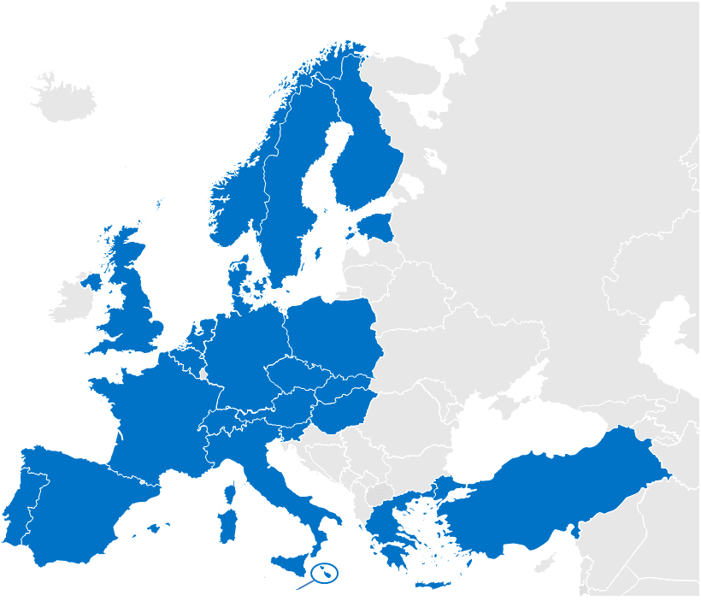
Intro to the project
123456
Page 12
26 Participating Nations
Notes:
Consisting of: National ministries of health, National/regional competence centers, Industry consortium and Project Management Team

Slide 13
Intro to the project
123456
Page 13
Industry Team
as per 15.05.2013
3M | Agfa HealthCare | Alert Life Sciences Computing | Apollo Information Technologies
Boston Life Labs | CareCom | Cisco | Conet AG
dbMotion | Dedalus Healthcare Systems Group | Engineering S.p.A | GE Healthcare
Gnomon Informatics | IBM | IHE Europe* | Indra
Insiel S.p.A. | Intel Corporation | Mawell | MediCognos
Microsoft | Netsmart | Oracle | Posam
RISE | Steria | Tiani-Spirit | TrebleM
T-Systems | UBM Medica | X-tention
Industry Team Steering Group members are underlined
*Industry Team Coordinator, no member of Industry Team
Notes:
Led by an IHE Representative minimum contribution of 2 man months per company. Participating in all Work Packages

Slide 14
Intro to the project
123456
Page 14
Provide concrete cross border Health services
Patient Summary for EU Citizens
  Occasional and Regular Visit
ePrescribing for EU Citizens
  Medication ePrescription and eDispensation
epSOS I
Notes:
Excluding reimbursement, minimal invasiveness in the MS
Provide concrete cross border services that ensure safe, secure and efficient medical treatment for citizens when travelling across Europe
Focus on services close to the patient:
Build on existing National eHealth Projects and use experiences and knowledge from all Member States

Slide 15
Intro to the project
123456
Page 15
Patient Access
  Give the patients access to their information in multi-language
Health-Care Encounter Report
  Report information about an encounter
Medication Related Overview
  Provide relevant information for medication dispensation
epSOS II

Slide 16
What is an NCP
123456
Page 16
National Contact Point
Legal
Controls the flow of information to and from the PN
Technical
Acts as an entry/exit point for a national eHealth infrastructure
Handles semantinc and technical adaptations of eHealth applications
Gathers all the legal supporting NCP structure
Is built using the delivered components

Slide 17
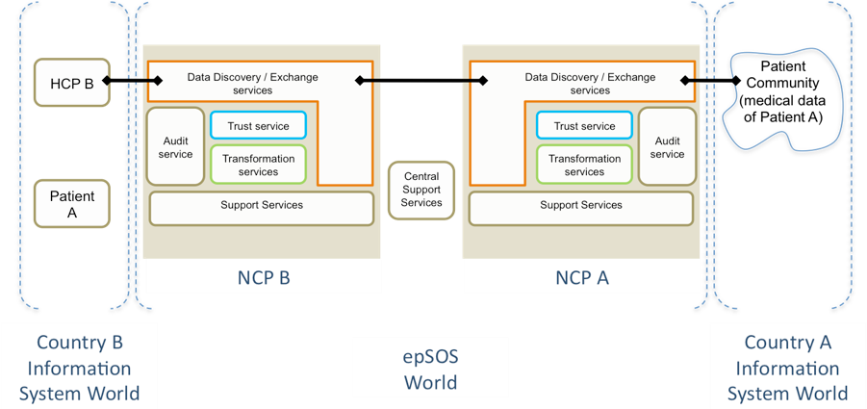
What is an NCP
123456
Page 17
NCP Concept

Slide 18
OpenNCP General Presentation
123456
History

Slide 19
The development of the original components
123456
Page 19
Motivations
Interoperability to connect services and architectures, potentially different in every Participating Nation (PN)
The National Contact Point (NCP) is the fulcrum of cross border interoperability, exploiting the role of connecting the PN to the European Level environment.

Slide 20
The development of the original components
123456
Page 20
Original Idea
Limit central project results to specifications
Leave implementation to PNs
Recognized outcome
Feasibility of achieving interoperability between NIs was very low
PNs commitement with specs was low
Actions taken
It was decided in 2010 to engage a consortium to develop a reference implementation

Slide 21



The development of the original components
123456
Page 21
FraunhoferElgaTiani Solution
Developed by the consortium of beneficiaries and industry team
Mainly constituted by Fraunhofer, Elga and Tiani
The resulting components were in part proprietary software

Slide 22
The development of the original components
123456
Page 22
Common Components Development (CCD) Composition
IHE Gazelle Testing Tools
Country-A Infrastructure
HCP
Country-A National Connector
Country-B National Connector
Country-B Infrastructure
eCRTS
yellow
Vendor ready-to-deploy and IHE connect-a-thon tested products
→ no JARF sponsoring, royalty-free licence for epSOS pilot projects
cooperative, common development by Industry Team / Beneficiaries
→ JARF sponsored Open Source Software, linked to vendor products
red
Notes:
eCRTS = epSOS Central Reference Terminology Server

Slide 23
SRDC NCP
123456
Page 23
Second NCP implementation developed by SRDC (Software Research, Development and Consultancy Ltd., Turkey)
Provided free of charge to several countries for their own NCP, under GPL license
Makes use of open epSOS common components
Has compliant interoperability with FET solution and OpenNCP

Slide 24
OpenNCP
123456
Page 24
Concrete plans for forming an open source project (OpenNCP)
Delivering the software components necessary to run a NCP
Manifest it in the formation of an international task-force team
Summer of 2012

Slide 25
OpenNCP General Presentation
123456
Organization
OpenNCP

Slide 26
Who
123456
Page 26
OpenNCP Community
  Open group of people orchestrated by an agile software development methodology conducting effort on designing, coding, testing and delivering OpenNCP software

Slide 27
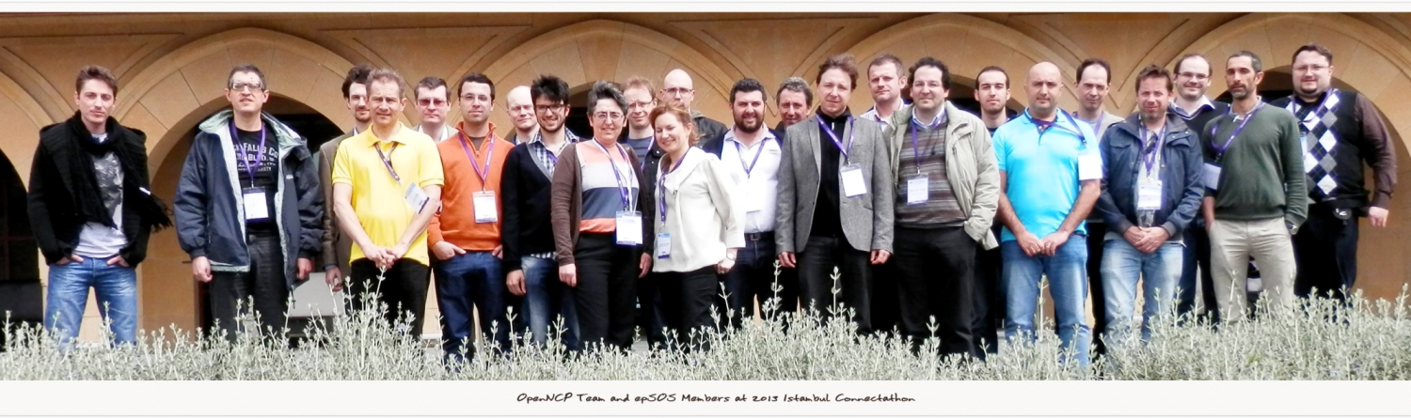
Who
123456
Page 27
Willing People == Community

Slide 28
For Whom
123456
Page 28
OpenNCP Adoption
Patient Summary
PN | PS A | PS B
Austria | FET | FET
Estonia | OpenNCP | OpenNCP
France | FET | FET
Hungary | N/A | OpenNCP
Italy | FET (OpenNCP) | FET (OpenNCP)
Luxembourg | N/A | OpenNCP
Malta | OpenNCP | OpenNCP
Portugal | OpenNCP | OpenNCP
Slovenia | OpenNCP | OpenNCP
Spain | FET (OpenNCP) | FET (OpenNCP)
Switzerlan | OpenNCP | OpenNCP
ePrescription
PN | eP A | eP B
Croatia | OpenNCP | OpenNCP
Denmark | FET | FET
Finland | OpenNCP | OpenNCP
Greece | N/A | FET (OpenNCP)
Hungary | FET (OpenNCP) | FET (OpenNCP)
Italy | FET (OpenNCP) | N/A
Spain | OpenNCP | FET (OpenNCP)
Sweden | OpenNCP | OpenNCP
Last Update: 10/12/2013

Slide 29
How
123456
Page 29
Since then (2012-06)
100
+ meetings
21
Software components
4
Used over 1 PAT and 4 PPTs
epSOS I/II
epSOS I and II services available
          Adopted by MOST of epSOS PN (10+)

Slide 30
How
123456
Page 30
OpenNCP Vision
...design and develop a set of Open Source Components (OpenNCP) that can be adopted by Participating Nation, to build their local implementation of the NCP (National Contact Point).

Slide 31
How
123456
Page 31
OpenNCP Definition
“epSOS NCP software publicly available under Open Source licensing”

Slide 32
How
123456
Page 32
Key Ingredients
Common needs
Motivation and Culture
Willing People
Skills and Expertise

Slide 33
How
123456
Page 33
Distributed Development
10
Countries
27
Contributors (not all coding)
3
Spanned timezones
24
Source repositories
development and contributions to the project should be easily obtainable and understandable

Slide 34
How
123456
Page 34
Method
Software components released MUST
Be readily deployable;
Have qualitative demands on the build tools (Continuous Integration);
Have discipline of the developers when committing code;

Slide 35
How
123456
Page 35
OpenNCP Community
Collaborative Design
Technology Engineering
Support & Maintenance
Knowledge Sharing

Slide 36
OpenNCP General Presentation
123456
Architecture and Technologies

Slide 37

IHE
123456
Page 37
IHE Definition
Aims to speedup the adoption of EHRs and optimize the clinical information exchange between systems.
By improving the quality, eficiency e safety of healthcare procedures due to improved information availability.

Slide 38
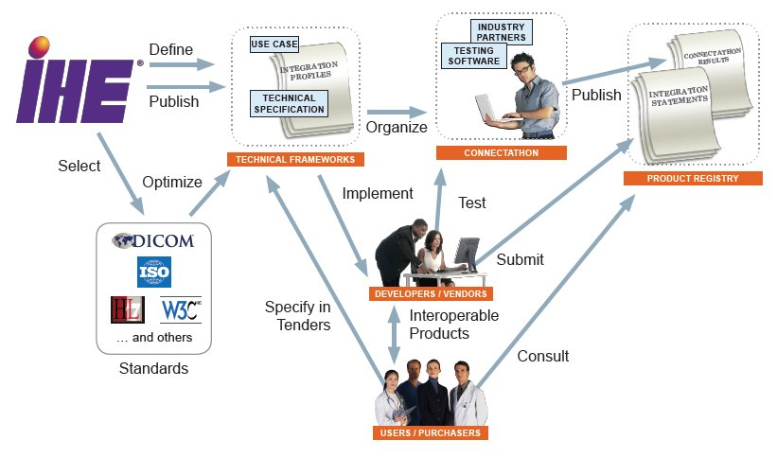
IHE
123456
Page 38

Slide 39

HL7
123456
Page 39
HL7 Definition
Vision
Create the best and most widely used standards in healthcare
Mission
Provide standards that improve care delivery, optimize workflow, reduce ambiguity and enhance knowledge transfer. All based on maximum scientific rigor.
Meaning
Level Seven refers to the seventh level of the OSI model, the application level.

Slide 40
Architecture
123456
Page 40
NCP Common Component Architecture

Slide 41
Architecture
123456
Page 41
NCP Logical Component Model

Slide 42
Architecture
123456
Page 42
NCP-A
Components
Architecture

Slide 43
Architecture
123456
Page 43
NCP-B
Components
Architecture

Slide 44
Implementation Status
123456
Page 44
OpenNCP Services Implementation Status
epSOS I
Patient Service
Order Service
Consent Service
epSOS II
Healthcare Encounter Report
Medication Related Overview
Patient Access
112 Emergency
Automated Validation
Implemented
Partially Implemented
Outside Scope

Slide 45
OpenNCP General Presentation
123456
Tools

Slide 46
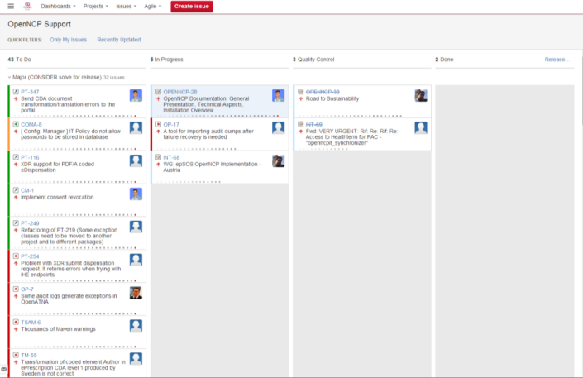
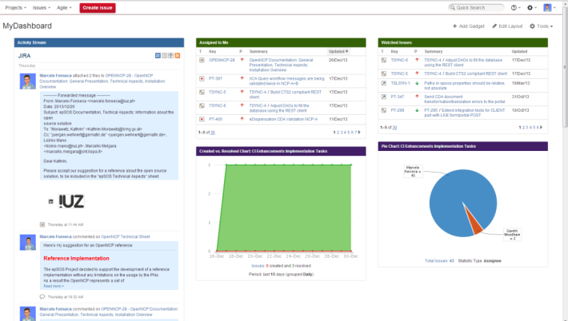
Tools
123456
Page 46
Development Management
Tool | Atlassian Jira + GreenHopper
Location | https://openncp.atlassian.net

Slide 47
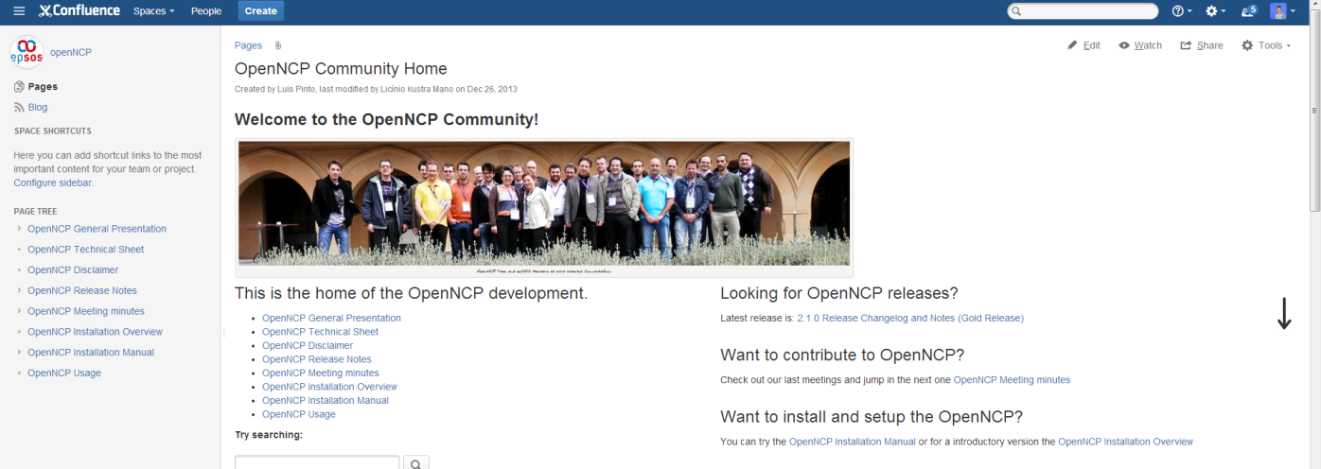
Tools
123456
Page 47
Knowledge Sharing
Tool | Atlassian Confluence
Location | https://openncp.atlassian.net/wiki

Slide 48
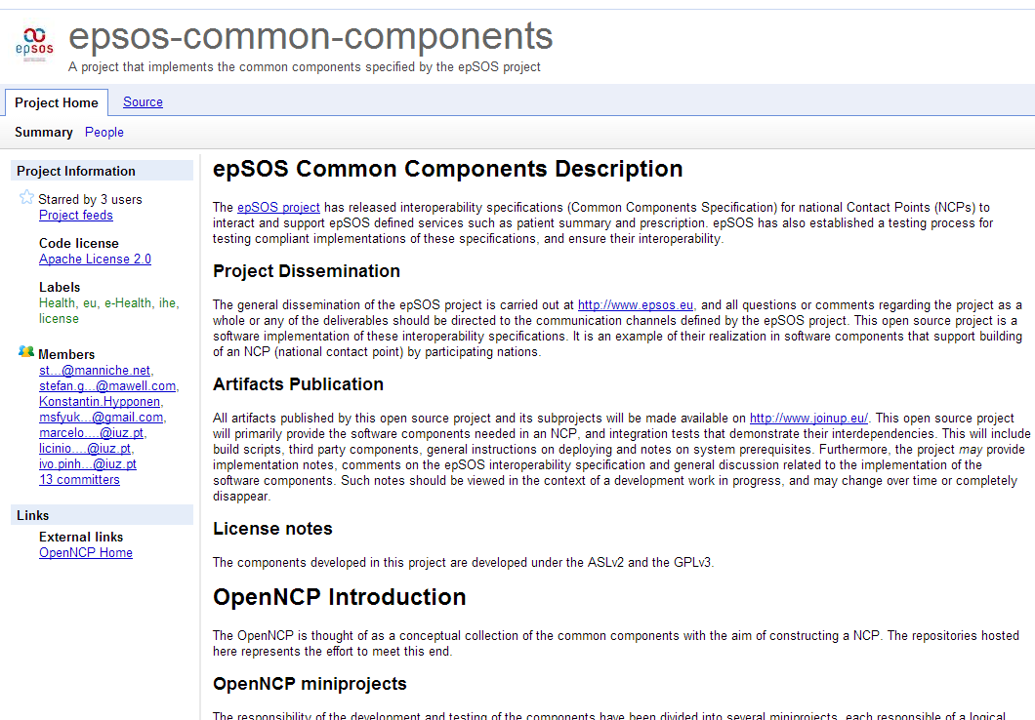
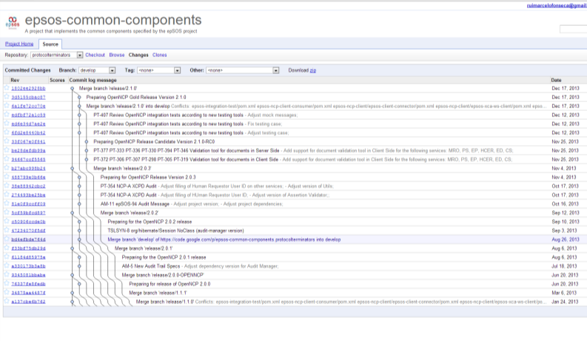
Tools
123456
Page 48
Code Sharing
Tool | Google Code + Git SCM
Location | https://code.google.com/p/epsos-common-components/

Slide 49
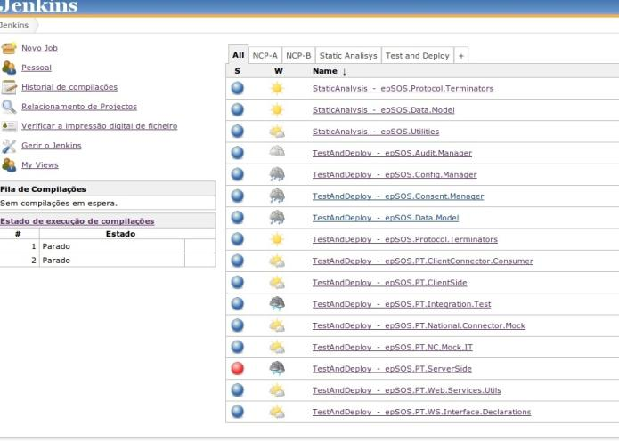
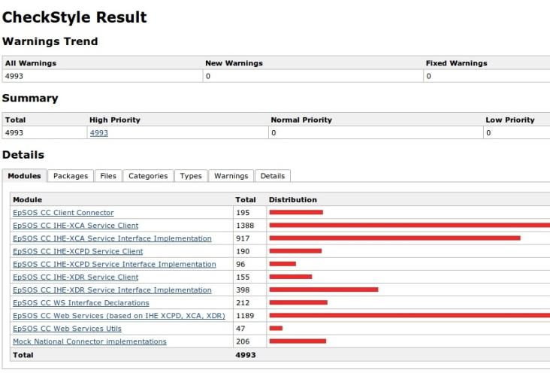
Tools
123456
Page 49
Quality Assurance
Tool | Jenkins
Location | http://dev.iuz.pt/openncp-jenkins/

Slide 50
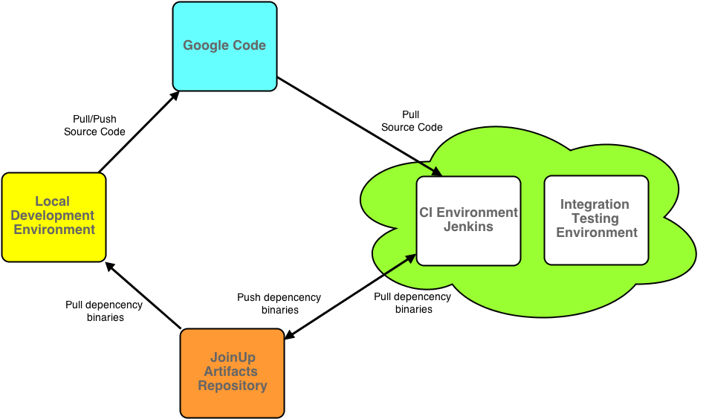
Tools
123456
Page 50
Quality Assurance: CI Actors and Relations

Slide 51
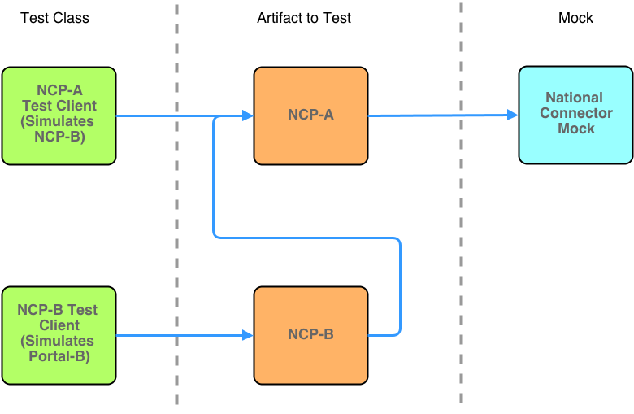
Tools
123456
Page 51
Quality Assurance: Continuous Integration Scheme

Slide 52
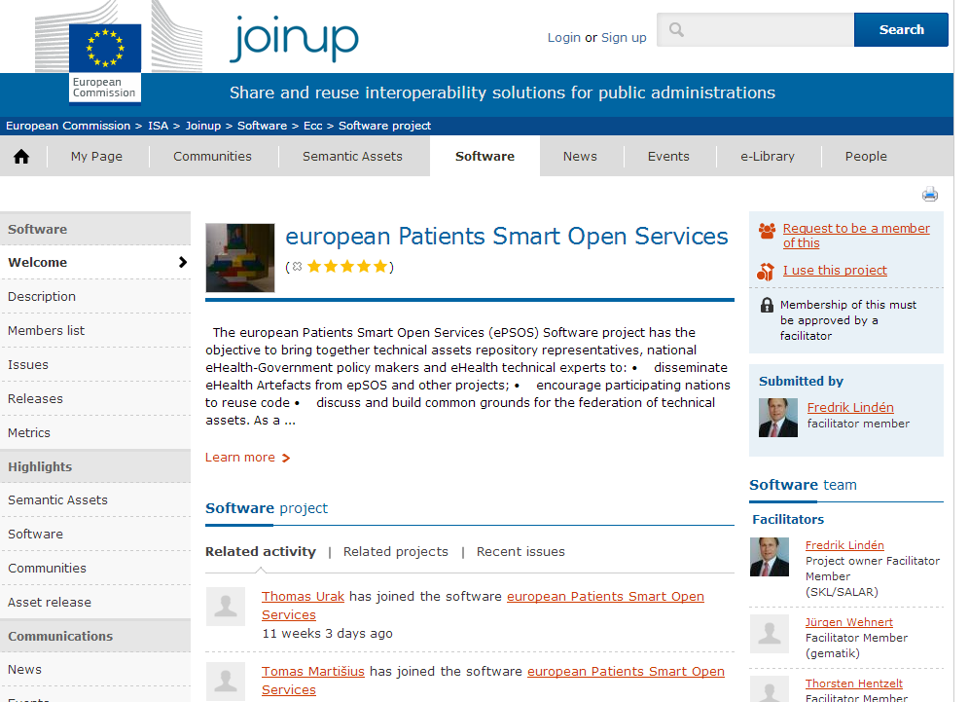
Tools
123456
Page 52
Publishing Framework
Collaborative platform created by the European Commission
Support open source development work done by government agencies in Europe
Tool | JoinUP
Location | https://joinup.ec.europa.eu/software/ecc/home

Slide 53
Tools
123456
Page 53
Other tools and technologies used in OpenNCP
Programming Language | Java
Webservice framework | Axis 2
Build framework | Maven
Versioning Scheme | Semantic Versioning
Licensing | GPLv3 and ASLv2
Notes:
Maven – main reasons: ease of code distribution, ease of inter-component version management and ease of build, test and release/publication processes.
Git - facilitate the distributed and non-sequential nature of development, ensure that all contributions would have equal footing in the repository, the de-centralized and distributed version control system git
Semantic Versioning has a well-defined set of rules describing which types of code changes warrants which types of version number changes.
Cont. Int server furthermore ensure the publication of development snapshots, such that new developers are always able to work on the newest versions of the code.

Slide 54
OpenNCP General Presentation
123456
Experiences and outlook to the future

Slide 55
Experiences
123456
Page 55
The past year and a half has been quite challenging to all of the OpenNCP members;
We have managed to produce and maintain a set of important SW artifacts, with contributions from different PNs, with many constraints;
Each PN earned a lot of knowledge and experience highly based on the sense of community and the information exchange;

Slide 56
Outlook to the future
123456
Page 56
The future of the OpenNCP will highly depend on the community good health;
The increase of testing load under OpenNCP will lead to the assurance of the solution maturity;
Each PN will gain more responsibility and independence in the testing activities;
We hope to see the work performed in the OpenNCP used across multiple future projects;

Slide 57
OpenNCP General Presentation
123456
Thank you for your attention!
info@epsos.eu

