Slide 2
epSOS – OpenNCP Initiative
epSOS in short
www.epsos.eu

Slide 3
epSOS - mantra
Page 3
From strategies to services
eHealth as the enabler for cross-border healthcare
Notes:
Practical implementation is the Goal

Slide 4
Cooperation is Key
Page 4
Oh so you are also implementing eHealth?
base from Mikael Erlandsson
Notes:
Common constraint on eHealth Interoperability
Cooperation from as early as possible is essential, now is a good time

Slide 5
Policy Context for EU eHealth Interoperability
Recommendation on cross-border interoperability of electronic health record systems
Communication on interoperability for European public services
Article 29 Working Party
eHealth Action Plan (eHAP) 2012-2020
Communication on Quality Criteria for Health related Websites
Council Conclusions on Safe and efficient healthcare through eHealth
Directive on the application of patients’ rights in cross-border healthcare
2002 2004 2008 2009 2010 2011 2012
Communication on a Digital Agenda for Europe
Communication on telemedicine for the benefit of patients, healthcare systems and society
Communication on European Innovation Partnership on Active and Healthy Ageing
Communication on e-Health - making healthcare better for European citizens: An action plan for a European e-Health Area
eHealth Standardisation Mandate 403
Communication on a strategic vision for European standards

Slide 6
epSOS 1 & epSOS 2
epSOS Time Frames
epSOS 1
  2008 to 2011
epSOS 2
  2012 to 2013

Slide 7
epSOS - Goal
Page 7
Smart Open Services for European Patients
“to develop a practical eHealth framework and ICT infrastructure [based on existing national infrastructures] that will enable secure access to patient health information, particularly with respect to a basic Patient Summary and ePrescription, between European healthcare systems.”
Notes:
Challenges to get there (based on the EIF (European Interoperability Framework)):
Legal Interoperability
Organisational Interoperability
Semantic Interoperability
Technical Interoperability

Slide 8

epSOS - Vision
International base standards and profile development
eHealth European Interoperability Framework: EU Recognised profiles
<To be determined>
Business Use Case “ePrescription / eDispensaton”
Profile 2
LOINC
SNOMED/CT
HL7 v2
Business Use Case
“Patient Summary”
<To be determined>
IHE-BPPC
Profile 2
HL7v3
IHE-XCPD
CDA L1 L3
IHE-XCA
Pdf/A
IHE-CT
epSOS EU Cross-Border eHealth Interoperability Project
HTPP1.1
Identification Service
epSOS Business Service
UTF8
IHE-XDR
OASIS ebRIM 3.0
IHE-ATNA
Extensions
Extensions
IHE-XCPD
IHE- (XUA)/XSPA
IHE-XCA
IHE-XCF
OASIS ebRS 3.0
IHE-XSPA
Profile 1
Profile 1
Profile 2
Profile 2
W3C MTOM
IHE-XUA
HL7 V3 PA DSTU
W3C XOP
IHE-XCF
OASIS ebRIM 3.0
OASIS ebRIM 3.0
W3C SOAP 1.2
HL7 V3 Datatypes
OASIS ebRS 3.0
OASIS ebRS 3.0
WSI BP 1.1
...
WSI SBP 1.1
Dispensation Service
Consent Service
Security and Infrastructure services
RFC1305 (NTP)
TSP
IHE-ATNA
IHE-CT
IHE-XDR
IHE-BPPC
Profile 4
Profile 4
ETSI TS 102 231
CEN activities
Profile 4
Profile 4
SAML
IEEE 11073
TLS 1.2
NTP V3
…
OASIS ebMS 3.0
HL7 CDA R2
Syslog
SNTP V4
X509
OASIS ebRS 3.0
RFC 3881
RFC 3881
OASIS ebRIM 3.0
WSI SBP 1.1
XACLM
IHE- (XUA)/XSPA
SAML (v2)
Profile 1
TSL/NSL
XACML (v2)

Slide 9
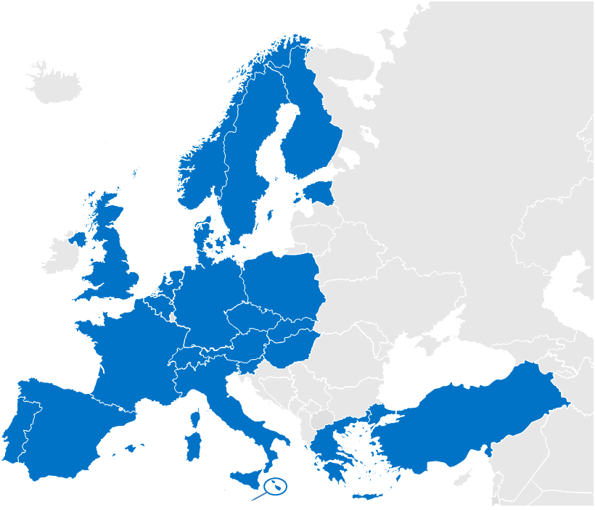
epSOS - participating nations
26 Participating Nations
Notes:
Consisting of: National ministries of health, National/regional competence centers, Industry consortium and Project Management Team

Slide 10
epSOS - Industry Team
as per 15.05.2013
3M | Agfa HealthCare | Alert Life Sciences Computing | Apollo Information Technologies
Boston Life Labs | CareCom | Cisco | Conet AG
dbMotion | Dedalus Healthcare Systems Group | Engineering S.p.A | GE Healthcare
Gnomon Informatics | IBM | IHE Europe* | Indra
Insiel S.p.A. | Intel Corporation | Mawell | MediCognos
Microsoft | Netsmart | Oracle | Posam
RISE | Steria | Tiani-Spirit | TrebleM
T-Systems | UBM Medica | X-tention
Industry Team Steering Group members are underlined
*Industry Team Coordinator, no member of Industry Team
Notes:
Led by an IHE Representative minimum contribution of 2 man months per company. Participating in all Work Packages

Slide 11
epSOS – main Services
Provide concrete cross border Health services
Patient Summary for EU Citizens
  Occasional and Regular Visit
ePrescribing for EU Citizens
  Medication ePrescription and eDispensation
Other Services (epSOS 2):
  PAC, HCER, etc.
Notes:
Excluding reimbursement, minimal invasiveness in the MS
Provide concrete cross border services that ensure safe, secure and efficient medical treatment for citizens when travelling across Europe
Focus on services close to the patient:
Build on existing National eHealth Projects and use experiences and knowledge from all Member States

Slide 12
epSOS – OpenNCP Initiative
epSOS 1
Common Components Development

Slide 13
Implementation Strategy
Page 13
Baselines
Interoperability to connect services and architectures, potentially different in every Participating Nation (PN)
The National Contact Point (NCP) is the fulcrum of cross border interoperability, exploiting the role of connecting the PN to the European Level environment.
…
Notes:
Challenges to get there (based on the EIF (European Interoperability Framework)):
Legal Interoperability
Organisational Interoperability
Semantic Interoperability
Technical Interoperability

Slide 14
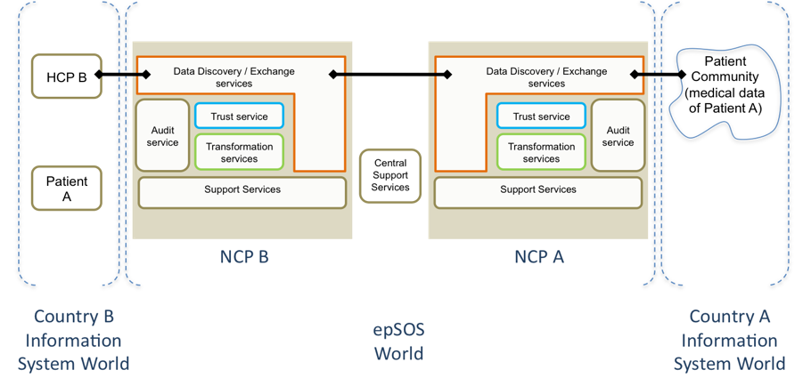
epSOS NCPs

Slide 15
Common Components Development (CCD) Composition
IHE Gazelle / Testing Tools
Country-A Infrastructure
HCP
Country-A National Connector
Country-B National Connector
Country-B Infrastructure
eCRTS
yellow
Vendor ready-to-deploy and IHE connect-a-thon tested products
→ no JARF sponsoring, royalty-free licence for epSOS pilot projects
cooperative, common development by Industry Team / Beneficiaries
→ JARF sponsored Open Source Software, linked to vendor products
red
Notes:
eCRTS = epSOS Central Reference Terminology Server

Slide 16
epSOS – OpenNCP Initiative
epSOS 2
Open Source Initiative

Slide 17
Open Source Initiative
Page 17
In the summer of 2012
  Concrete plans for forming an open source project (OpenNCP)
  Delivering the software components necessary to run a NCP
  Manifested in an international implementation team forming
Notes:
Challenges to get there (based on the EIF (European Interoperability Framework)):
Legal Interoperability
Organisational Interoperability
Semantic Interoperability
Technical Interoperability

Slide 18
Open Source Initiative
Page 18
Since than (2012-06)
  More 100 meetings
  21 SW Components
  10 public available releases
  Used under 1 PAT and 4 PPT
  epSOS 1 & 2 services available
Adopted by MOST of epSOS PN (10+)

Slide 19
Open Source Initiative
Page 19
OpenNCP / vision
“design and develop a set of Open Source Components (OpenNCP) that can be adopted by Participating Nation, to build their local implementation of the NCP (National Contact Point)”
Notes:
Practical implementation is the Goal

Slide 20
Open Source Initiative
Page 20
OpenNCP / definition
“epSOS NCP software publicly available under Open Source licensing”
Notes:
Practical implementation is the Goal

Slide 21
Open Source Initiative
Page 21
Key Ingredients
Motivation and Culture
Skills and Expertise
Willing Person

Slide 22

Open Source Initiative
Page 22
Willing Person

Slide 23
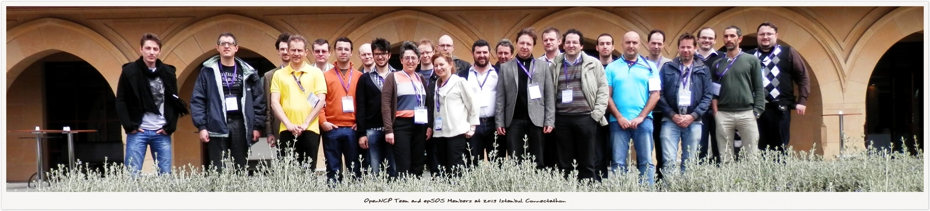
Open Source Initiative
Page 23
Willing Faces <> Community

Slide 24
Open Source Initiative
Page 24
OpenNCP Community
  Open group of people orchestrated by an agile software development methodology conducting effort on designing, coding, testing and delivering OpenNCP software;

Slide 25
Open Source Initiative
Page 25
Principles
distributed development
10 countries
27 contributors (not all coding)
spanning 3 time zones
24 source repositories
develop and contribute to the project should be easily obtainable and understandable

Slide 26
Open Source Initiative
Page 26
contributions licensed over
  GPLv3
  ASLv2
Notes:
Challenges to get there (based on the EIF (European Interoperability Framework)):
Legal Interoperability
Organisational Interoperability
Semantic Interoperability
Technical Interoperability

Slide 27
Open Source Initiative
Page 27
Method
software components released MUST
Readily deployable
Qualitative demands on the build tools (Continuous Integration Env.)
Discipline of the developers when committing code

Slide 28
Open Source Initiative
Page 28
Tools
Programming Language (Java)
Knowledge Sharing (Atlassian Confluence)
Code Sharing (Google Code + GIT)
Development Mng. (Atlassian Jira & GreenHopper)
Build (Maven + Semantic Versioning)
Quality Assurance (Jenkins - Continuous Integration)
Notes:
Maven – main reasons: ease of code distribution, ease of inter-component version management and ease of build, test and release/publication processes.
Git - facilitate the distributed and non-sequential nature of development, ensure that all contributions would have equal footing in the repository, the de-centralized and distributed version control system git
Semantic Versioning has a well-defined set of rules describing which types of code changes warrants which types of version number changes.
Cont. Int server furthermore ensure the publication of development snapshots, such that new developers are always able to work on the newest versions of the code.

Slide 29
Open Source Initiative
Page 29
  epSOS Open Source Community at JoinUP
  Collaborative platform created by the European Commission
    Support open source development work done by government agencies in Europe
  The arena where we are building the epSOS Open Source Community
    work, improvement, extension, maintenance and release

Slide 30
Open Source Initiative
Page 30
OpenNCP Community
Collaborative Design
Technology Engineering
Support & Maintenance
Knowledge Sharing

Slide 31
Open Source Initiative
Page 31
epSOS OpenNCP
  Please, jump in!!!
  openncp.atlassian.net/wiki

Slide 32
Thank you for your attention!
info@epsos.eu

